Slide 1
New York State 2013 Grades 3-8 Common Core ELA Rubric and Scoring Turnkey Training
Notes:
Introduce the presenters.
Ensure each participant has a copy of the following materials:
PowerPoint presentation
Grade 4 Short-response (2-Point) Sample Question Guide Set packet
Grade 3 Extended-response (4-Point) Sample Question Guide Set packet
Grade 4 Extended-response (4-Point) Sample Question Guide Set packet
Grade 8 Extended-response (4-Point) Sample Question Guide Set packet
Review the general purpose of the Turnkey Training sessions:
The purpose of this training is to give you a thorough understanding of the new NY test constructed-response rubrics, how to apply them, and to give you the ability to perform this training in your districts.
Time estimate:
2 minutes

Slide 2
Housekeeping and Logistics
9:00-3:00
Morning and afternoon break
Lunch
Restrooms
Emergency exit locations
“Parking Lot” and Resources
Notes:
Take a minute to review the housekeeping and logistics for today’s training:
Today’s session will be from 9:00 until 3:00.
We will have a fifteen minute break in the morning and a fifteen minute break in the afternoon.
We will have one hour for lunch. Share suggested locations.
Review nearest restroom locations.
Review the emergency exit locations.
Review the nearest vending machines/snack bar locations.
Explain the use of the parking lot and resources you will be providing:
As we go through the training, questions will arise that we can’t answer today.
Make note of those questions and add them to our Parking Lot (point to this location).
At the end of the training, we will gather these questions and post a list of Frequently Asked Questions and their answers along with the training materials on our site.
In addition, at the end of this training, there is a slide that provides a list of resources where you can access additional information.

Slide 3
Getting Started
3
Notes:
Welcome! Today we will get an up close look at the new NYS 2-point and 4-point ELA rubrics and have an opportunity to apply them to sets of student responses to sample test questions measuring the NYS Common Core ELA Standards.
Before we begin, it is worth taking a moment to frame our minds around the reason why we are making these changes – to truly prepare our students for college and careers – and how we are going to do this – through a new set of standards – the Common Core – and the instructional shifts. We have all grown considerably with our familiarity with these shifts, so instead of doing a training on them we are going to quickly review how these shifts will be evident in tests so that we are in a Common Core frame of mind when applying these rubrics for the first time.
Time estimate:
3 minutes

Slide 4
Instructional Shifts
Shift 1
Balancing Informational & Literary Text
Notes:
So to ensure we are all on the same page but to do so very briefly, if Shift 1 calls for Balancing Informational & Literary Text, students read a true balance of informational and literary texts. In terms of test, passages will be authentic, and will be balanced between informational and literary texts.

Slide 5
Instructional Shifts
Shift 1
Balancing Informational & Literary Text
Shift 2
Knowledge in the Disciplines
Notes:
If Shift 2 calls for Knowledge in the Disciplines students build knowledge about the world (domains/ content areas) through TEXT rather than the teacher or activities. In terms of assessment, tests will contain knowledge-based questions about the informational text; students will not need outside knowledge to respond.

Slide 6
Instructional Shifts
Shift 1
Balancing Informational & Literary Text
Shift 2
Knowledge in the Disciplines
Shift 3
Staircase of Complexity
Notes:
With Shift 3 being Staircase of Complexity, students are being asked to read the central, grade appropriate text around which instruction is centered. Teachers are patient, create more time and space and support in the curriculum for close reading. Test implications involve passage selection to be based on text complexity that is appropriate to grade level per Common Core.

Slide 7
Instructional Shifts
Shift 1
Balancing Informational & Literary Text
Shift 2
Knowledge in the Disciplines
Shift 3
Staircase of Complexity
Shift 4 & 5
Text-based Answers and Writing from Sources
Notes:
With Shifts 4 and 5, Text-based Answers and Writing from Sources, students engage in rich and rigorous evidence based conversations about text, and writing emphasizes use of evidence from sources to inform or make an argument. Test questions will require students to marshal evidence from the text, including from paired passages.

Slide 8
Instructional Shifts
Shift 1
Balancing Informational & Literary Text
Shift 2
Knowledge in the Disciplines
Shift 3
Staircase of Complexity
Shift 4 & 5
Text-based Answers and Writing from Sources
Shift 6
Academic Vocabulary
Notes:
And finally, with Shift 6, Academic Vocabulary, students constantly build the transferable vocabulary they need to access grade level complex texts, which can be done effectively by spiraling like content in increasingly complex texts. On assessments, students will be tested directly on the meaning of pivotal, common terms, the definition of which can be discerned from the text. Academic vocabulary will also be tested indirectly through general comprehension of the text.

Slide 9
In the past…
In the past students were asked to do things like:
Characterize the text.
Exhibit a cursory understanding of the lead character.
Comprehend one sentence from the entire text.
Understand basic, non-consequential vocabulary.
Answer without a deep analysis of text.
Look beyond text for stimuli.
Answer by recalling text details.
Answer without complete sentences required.
Notes:
So when it comes to the actual reflection of the shifts in items themselves, in the past, students were asked to do things like:
Characterize the text.
Exhibit a cursory understanding of the lead character.
Comprehend one sentence from the entire text.
Understand basic, non-consequential vocabulary.
Answer without a deep analysis of text.
Look beyond text for stimuli.
Answer by recalling text details.
Answer without complete sentences required.

Slide 10
Now
Now, students are going to be asked to:
Comprehend complex, grade-level texts. (What should be noted is comprehension of text is assumed, it is not the focus of measurement.)
Identify central themes and key text elements.
Consider entire text.
Place aspects of the text in context of the entire text.
Move beyond basic recall of details within text in ways such as making an inference as to how specific portions of text relate to the structure of the whole text or wrestle with meaningful, real-world questions.
In terms of analysis, make and support text-based analyses, to support their text-based analyses with key details, and carry an analysis beyond one text, relating details to overarching messages of both entire texts.
Notes:
Now, students are going to be asked to:
Comprehend complex, grade-level texts. (What should be noted is comprehension of text is assumed, it is not the focus of measurement)
Identify central themes and key text elements.
Requires students to consider entire text.
Place aspects of the text in context of the entire text.
Move beyond basic recall of details within text in ways such as making an inference as to how specific portions of text relate to the structure of the whole text or wrestle with meaningful, real-world questions.
In terms of analysis, students will be asked to make and support text-based analyses, to support their text-based analyses with key details, and carry an analysis beyond one text, relating details to overarching messages of both entire texts.
These are the types of things we will be seeing today, and the rubrics will scored accordingly. So now let’s get to the reason why we are here – the rubrics and their application.

Slide 11
The New ELA 2- and 4-point Rubrics
11
Notes:
This training session will focus on the new English Language Arts (ELA) constructed-response rubrics and questions.

Slide 12
Our Goals
Define holistic scoring and how it differs from typical grading.
Review each ELA rubric in detail:
Short-response (2-point) Rubric/Constructed-response
Extended-response (4-point) Rubric/Constructed-response
Practice scoring some student examples.
Notes:
Review the goals for the ELA training session with the participants:
Define holistic scoring and how scoring differs from grading.
Review the new ELA constructed-response rubrics (2-point for all grades, 4-point rubrics for grade 3, grades 4-5, grades 6-8).
Review guide responses that correspond to each rubric.
Practice scoring both 2-point and 4-point student responses.

Slide 13
Holistic Scoring
13
Notes:
This section of the training discusses holistic scoring vs. grading student responses.
Time estimate:
5 minutes

Slide 14
Holistic Scoring
When scoring holistically:
Read thoroughly, yet quickly, to gain an impression of the entire response.
Read the entire response before determining a score, and then promptly assign a score.
Read supportively, looking for and rewarding those things done well in a response.
Keep in mind that each response represents a first draft, written under timed conditions.
Notes:
It is important to understand holistic scoring and how it applies to the new ELA rubrics and questions (prompts).
Explain: To score holistically, you must look at the writing as a total piece of work, greater than the sum of its parts. A response may have some characteristics of adjacent score points, but you must assign the score that best describes the response as a whole – the “best fit” score. When scoring holistically:
Read thoroughly, yet quickly, to gain an impression of the entire response – Scoring too slowly can cause a reader to become analytical (focusing on specific traits, good or bad, of a response) instead of seeing the response as a whole. Likewise, scoring too quickly can cause a reader to miss key aspects of a response.
Read the entire response before determining a score, and then promptly assign a score – Students can often write themselves into or out of a score point, so it is important to read the whole response before assigning a score. Do not read and re-read a student response – by the third or fourth time reviewing a student response, it is no longer the same paper as when a reader reads it for the first time.
Read supportively, looking for and rewarding those things done well in a response – When scoring holistically, you must weigh and balance what is done well in a response with areas that need improvement to find the best-fit score.
Keep in mind that each response represents a first draft, written under timed conditions – These responses are not edited, polished pieces of student work. Even responses at the top score points will have errors.

Slide 15
Scoring versus Grading
Scoring a state test is quite different from grading classroom papers.
There is no single “correct” answer to the test questions.
Students come to the test without knowledge of the passages or prompts.
On-demand writing does not provide time to plan, edit, and revise work as does writing compositions for a class.
Notes:
Scoring a state test is quite different from grading classroom papers – When grading one purpose is to provide feedback on areas that need improvement so a student can work on those areas. The purpose of scoring is to assess a student’s work at a specific point in time. This is why it is important to weigh and balance what a student does well with areas for improvement to find the best-fit score for a response.
There is no single correct answer to the test questions – The new test questions ask students to make inferences/claims (draw conclusions) based on reading passages and to support their inferences/claims with details from the text. There are multiple ways to respond to these questions that are valid, text-based inferences (e.g., passages may have more than one theme or main idea).
Students come to the test without knowledge of the passages or prompts – This is on-demand writing, which is quite different from writing compositions for a class, where students may have time to plan, edit, and revise their work.

Slide 16
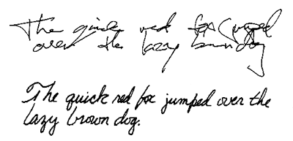
Guard Against Scoring Biases
Appearance of response
The quality of the handwriting, the use of cursive or printing, margins, editing marks, cross-outs, and overall neatness are not part of the scoring criteria.
Offensive or Disturbing Content
If a student uses inappropriate language, adopts an offensive point of view, or perhaps takes a naïve or narrow approach to a topic, readers should not let the student’s point of view affect the score. Likewise, readers should not let a student’s lifestyle or maturity level influence them either positively or negatively regarding their writing.
Notes:
Reader Bias - Reader Bias refers to personal factors that may affect a reader’s perception of a student response, but have no basis in the rubric. The next few slides cover some factors that affect some readers but must not be allowed to have an impact on scoring.
Review each scoring bias.

Slide 17
Guard Against Scoring Biases (Continued)
Reactions to Style
A reader’s own grammatical biases should not play a part in assigning a score if the student has not violated standard writing conventions. In other words, beginning a sentence with “and,” the absence of a formal thesis sentence, the use of first or second person, or an informal tone are not necessarily wrong in this type of assessment.
Writer Personality
Writers may come across as brash, sassy, cute, self-aware, shy, surly, flat, honest, or naïve. Readers are scoring the written passage, not the writer’s personality.
Notes:
Continue to review each scoring bias.

Slide 18
Guard Against Scoring Biases (Continued)
Reactions to Performance Assessments
Some readers may approach writing assessments with their own biases in favor of one type of assessment over another. Or, they may believe it is impossible to fairly score writing. Or, they may feel as though the standards used in an assessment violate their own sense of what constitutes good writing. It is important for each reader to set aside his/her own biases in order to keep the scoring as standardized and as fair to each student as possible.
Notes:
Continue to review each scoring bias.

Slide 19
Keep in Mind…
Remember: You are scoring, not grading.
Set aside your own grading practices while scoring.
Determine scores based only on the work in the student booklet, using state standards—not classroom standards—to score responses accurately, fairly, and consistently.
Notes:
Remember: You are scoring, not grading, student responses – For this test, you do not have the opportunity to watch writers improve over time, you do not have knowledge of their past work, and you do not look at final drafts. Although you may be experienced in reviewing student writing, you need to set aside your own grading practices while scoring. Determine scores based only on the work in the student booklet, using state standards – not classroom standards – to score student responses accurately, fairly, and consistently.

Slide 20
Q&A
Notes:
Ask scorers if they have any questions about holistic scoring and guarding against biases.

Slide 21
Grade 4 ELA Short-response (2-point) Rubric/Constructed-response
Notes:
This section of the training is focused on the new 2-point constructed-response questions.
Instruct the participants to find their 2-point materials, including the rubric, passage, guide, and practice papers.
While participants find their materials, explain the rational behind the 2-point questions – While all ELA constructed-response questions are “writing” questions, the 2-point questions are more focused on reading comprehension. Each question is aligned with a specific Common Core Standard. The 2-point questions ask students to synthesize information in the text (or texts), make a claim/inference (draw a conclusion – answer the question), and support their claim with evidence from the text(s). The questions are designed so that an inference is required, simple recall from the text is not enough to earn full credit. There are multiple ways to respond to each question – and no one “right” answer. The inference a student provides must be valid, and supported by details from the text(s).
Remind the participants to take notes on their rubric and the training responses for use when delivering the training in their districts.
Time estimate:
15 minutes

Slide 22
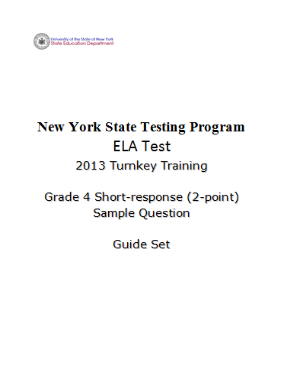
Notes:
Refer participants to the rubric in the Grade 4 Short-response (2-Point) Sample Question Guide Set packet.

Slide 23
2-point Rubric: Short-response
Score | Response Features
2 Point | The features of a 2-point response are Valid inferences and/or claims from the text where required by the prompt Evidence of analysis of the text where required by the prompt Relevant facts, definitions, concrete details, and/or other information from the text to develop response according to the requirements of the prompt Sufficient number of facts, definitions, concrete details, and/or other information from the text as required by the prompt Complete sentences where errors do not impact readability
1 Point | The features of a 1-point response are A mostly literal recounting of events or details from the text as required by the prompt Some relevant facts, definitions, concrete details, and/or other information from the text to develop response according to the requirements of the prompt Incomplete sentences or bullets
0 Point | The features of a 0-point response are A response that does not address any of the requirements of the prompt or is totally inaccurate No response (blank answer) A response that is not written in English A response that is unintelligible or indecipherable
If the prompt requires two texts and the student only references one text, the response can be scored no higher than a 1.
Notes:
Explain that you will review each score point in detail.

Slide 24
2-point Rubric: Short-response
Score | Response Features
2 Point | The features of a 2-point response are Valid inferences and/or claims from the text where required by the prompt Evidence of analysis of the text where required by the prompt Relevant facts, definitions, concrete details, and/or other information from the text to develop response according to the requirements of the prompt Sufficient number of facts, definitions, concrete details, and/or other information from the text as required by the prompt Complete sentences where errors do not impact readability
If the prompt requires two texts and the student only references one text, the response can be scored no higher than a 1.
Notes:
Review the response features of score point 2.

Slide 25
2-point Rubric: Short-response
Score | Response Features
1 Point | The features of a 1-point response are A mostly literal recounting of events or details from the text as required by the prompt Some relevant facts, definitions, concrete details, and/or other information from the text to develop response according to the requirements of the prompt Incomplete sentences or bullets
If the prompt requires two texts and the student only references one text, the response can be scored no higher than a 1.
Notes:
Review the response features of score point 1.

Slide 26
2-point Rubric: Short-response
Score | Response Features
0 Point | The features of a 0-point response are A response that does not address any of the requirements of the prompt or is totally inaccurate No response (blank answer) A response that is not written in English A response that is unintelligible or indecipherable
If the prompt requires two texts and the student only references one text, the response can be scored no higher than a 1.
Notes:
Review the response features of score point 0.

Slide 27
Q&A
Notes:
Ask scorers if they have any questions about the 2-point ELA rubric.
Ask if the distinctions between the score points make sense. Review what responses at each score point may look like:
Score 2 – will have an inference and required supporting details.
Score 1 – there are multiple ways to achieve a 1. A response could be a mostly literal recounting of events or details, or contain a valid inference and insufficient details, or just contain a valid inference.
Score 0 – will not address any requirements of the prompt or may be totally inaccurate.
Remind participants that the rubric tells us what a response at each score point looks like, but the guide papers show us what the responses look like at each score point. Scorers need to reference their guide papers while scoring.
Encourage participants to remove the rubric from the packet in order to be able to refer to it while reviewing the 2-point student responses.

Slide 28
Grade 4 Short-response (2-point)
Sample Guide Set
Notes:
Refer participants to the Grade 4 Short-response (2-point) Sample Guide Set in their packet.
Time estimate:
15 minutes

Slide 29
Grade 4 Short-response Passage
Paired Passages: Myth and fact about why evergreen trees do not lose their leaves
Passage 1: Myth
Why the Evergreen Trees Never Lose Their Leaves
by Florence Holbrook
Winter was coming, and the birds had flown far to the south, where the air was warm and they could find berries to eat. One little bird had broken its wing and could not fly with the others. It was alone in the cold world of frost and snow. The forest looked warm, and it made its way to the trees as well as it could, to ask for help.
First it came to a birch-tree. “Beautiful birch-tree,” it said, “my wing is broken, and my friends have flown away. May I live among your branches till they come back to me?”
“No, indeed,” answered the birch-tree, drawing her fair green leaves away. “We of the great forest have our own birds to help. I can do nothing for you.”
“The birch is not very strong,” said the little bird to itself, “and it might be that she could not hold me easily. I will ask the oak.” So the bird said, “Great oak-tree, you are so strong, will you not let me live on your boughs till my friends come back in the springtime?”
1
2
3
4
Notes:
Refer participants to the passage in their Grade 4 Short-response (2-point) Sample Guide Set.
Instruct participants to take 5 minutes to read the passage to themselves.

Slide 30
Grade 4 Short-response Passage
Continued from previous page…
“In the springtime!” cried the oak. “That is a long way off. How do I know what you might do in all that time? Birds are always looking for something to eat, and you might even eat up some of my acorns.”
“It may be that the willow will be kind to me,” thought the bird, and it said, “Gentle willow, my wing is broken, and I could not fly to the south with the other birds. May I live on your branches till the springtime?”
The willow did not look gentle then, for she drew herself up proudly and said, “Indeed, I do not know you, and we willows never talk to people whom we do not know. Very likely there are trees somewhere that will take in strange birds. Leave me at once.”
The poor little bird did not know what to do. Its wing was not yet strong, but it began to fly away as well as it could. Before it had gone far, a voice was heard. “Little bird,” it said, “where are you going?”
“Indeed, I do not know,” answered the bird sadly. “I am very cold.”
“Come right here, then,” said the friendly spruce-tree, for it was her voice that had called. “You shall live on my warmest branch all winter if you choose.”
5
6
7
8
9
10

Slide 31
Grade 4 Short-response Passage
Continued from previous page…
“Will you really let me?” asked the little bird eagerly.
“Indeed, I will,” answered the kind-hearted spruce-tree. “If your friends have flown away, it is time for the trees to help you. Here is the branch where my leaves are thickest and softest.”
“My branches are not very thick,” said the friendly pine-tree, “but I am big and strong, and I can keep the north wind from you and the spruce.”
“I can help too,” said a little juniper-tree. “I can give you berries all winter long, and every bird knows that juniper berries are good.”
So the spruce gave the lonely little bird a home, the pine kept the cold north wind away from it, and the juniper gave it berries to eat.
The other trees looked on and talked together scornfully.
“I would not have strange birds on my boughs,” said the birch.
“I shall not give my acorns away for any one,” said the oak.
11
12
13
14
15
16
17
18

Slide 32
Grade 4 Short-response Passage
Continued from previous page…
“I never have anything to do with strangers,” said the willow, and the three trees drew their leaves closely about them.
In the morning all those shining green leaves lay on the ground, for the cold north wind had come in the night, and every leaf that it touched fell from the tree.
“May I touch every leaf in the forest?” asked the wind in its frolic.
“No,” said the forest king. “The trees that have been kind to the little bird with the broken wing may keep their leaves.”
This is why the leaves of the spruce, the pine, and the juniper are always green.
www.gutenberg.org
19
20
21
22
23

Slide 33
Grade 4 Short-response Question
1
What is a theme of the myth “Why the Evergreen Trees Never Lose Their Leaves,”? Use two details from the myth to support your answer.
Write your answer in complete sentences.
Notes:
Refer participants to the question in the Grade 4 Short-response (2-point) Sample Guide Set.
Introduce the question to the participants by stating the grade level and reading the question out loud to the group.
Give the participants a few minutes (2-3 minutes) to write some notes about how a 4th grade student would/might respond to the question.
Have participants share their answers with their neighbors.
Ask one or two participants to share how they would answer the question.
Ask if any participants have any other answers – share several if participants have other answers.

Slide 34
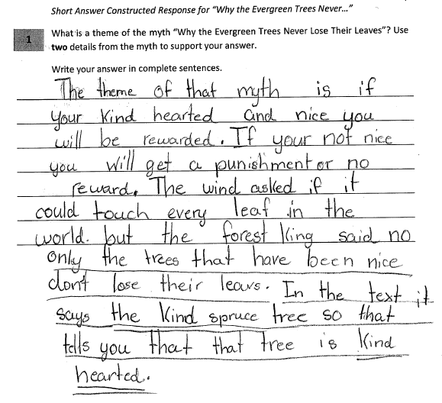
Grade 4 Short-response Guide Paper 1
Notes:
Refer participants to the Guide Paper 1 in their Grade 4 Short-response (2-point) Sample Guide Set packet.
Read the entire response out loud to the participants.

Slide 35
Grade 4 Short-response Guide Paper 1 Annotation
Score Point 2
This response makes a valid inference from the text to identify the theme of the myth (The theme of that myth is if your kind hearted and nice you will be rewarded. If your not nice you will get a punishment or not reward). The response provides a sufficient number of concrete details from the text for support as required by the prompt (The wind asked if it could touch every leaf in the world and In the text it says the kind spruce tree so that tells you that the tree is kind hearted). This response includes complete sentences where errors do not impact readability.
Notes:
Using the bulleted annotations marks that follow, review the score for the guide response and explain why the guide paper is the approved score, covering the information given in the annotation. Refer to the passage location while reviewing the annotation. The locations are noted below.
Be sure to use rubric language when explaining the score.
The score point for this response is 2.
This response makes a valid inference from the text to identify the theme of the myth (The theme of that myth is if your kind hearted and nice you will be rewarded. If your not nice you will get a punishment or not reward).
The response provides a sufficient number of concrete details from the text for support as required by the prompt (The wind asked if it could touch every leaf in the world and In the text it says the kind spruce tree so that tells you that the tree is kind hearted).
This response includes complete sentences where errors do not impact readability.
Note: Annotations describe why a response received the approved score using rubric language.

Slide 36
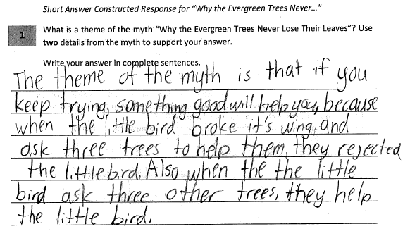
Grade 4 Short-response Guide Paper 2
Notes:
Refer participants to the Guide Paper 2 in their Grade 4 Short-response (2-point) Sample Guide Set packet.
Read the entire response to the participants.

Slide 37
Grade 4 Short-response Guide Paper 2 Annotation
Score Point 2
This response makes a valid inference from the text to identify the theme of the myth (The theme of the myth is that if you keep trying, something good will help you). The response provides a sufficient number of concrete details from the text for support as required by the prompt (when the little bird broke it’s wing and ask three trees to help them, they rejected the little bird. Also when the little bird ask three other trees, they help the little bird). This response includes complete sentences where errors do not impact readability.
Notes:
Using the bulleted annotations marks that follow, review the score for the guide response and explain why the guide paper is the approved score, covering the information given in the annotation. Refer to the passage location while reviewing the annotation. The locations are noted below.
Be sure to use rubric language when explaining the score.
The score point for this response is 2.
This response makes a valid inference from the text to identify the theme of the myth (The theme of the myth is that if you keep trying, something good will help you).
The response provides a sufficient number of concrete details from the text for support as required by the prompt (when the little bird broke it’s wing and ask three trees to help them, they rejected the little bird. Also when the little bird ask three other trees, they help the little bird).
This response includes complete sentences where errors do not impact readability.

Slide 38
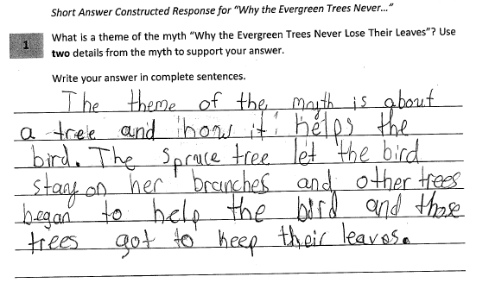
Grade 4 Short-response Guide Paper 3
Notes:
Refer participants to the Guide Paper 3 in their Grade 4 Short-response (2-point) Sample Guide Set packet.
Read the entire response out loud to the participants.

Slide 39
Grade 4 Short-response Guide Paper 3 Annotation
Score Point 1
This response is a mostly literal recounting of events from the text (The theme of the myth is about a tree and how it helps the bird). While the response provides two details from the text (The spruce tree let the bird stay on her branches and other trees began to help the bird and those trees got to keep their leaves), no valid inference and/or claim is present. This response includes complete sentences where errors do not impact readability. Holistically, this response achieves a score point one by giving only some relevant information and no valid claim according to the requirements of the prompt.
Notes:
Using the bulleted annotations marks that follow, review the score for the guide response and explain why the guide paper is the approved score, covering the information given in the annotation. Refer to the passage location while reviewing the annotation. The locations are noted below.
Be sure to use rubric language when explaining the score.
The score point for this response is 1.
This response is a mostly literal recounting of events from the text (The theme of the myth is about a tree and how it helps the bird).
While the response provides two details from the text (The spruce tree let the bird stay on her branches and other trees began to help the bird and those trees got to keep their leaves), no valid inference and/or claim is present.
This response includes complete sentences where errors do not impact readability.
Holistically, this response achieves a score point one by giving only some relevant information and no valid claim according to the requirements of the prompt.
Note the differences between this score point 1 response and the score point 2 responses in the guide set. Ask the participants if the difference is clear to them.

Slide 40
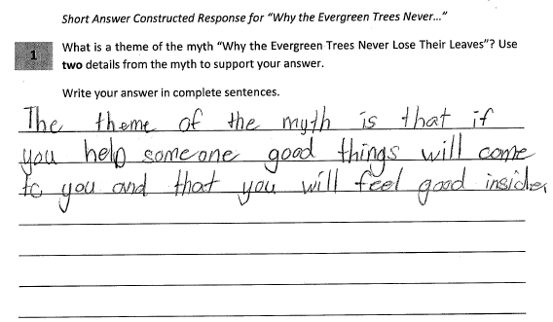
Grade 4 Short-response Guide Paper 4
Notes:
Refer participants to the Guide Paper 4 in their Grade 4 Short-response (2-point) Sample Guide Set packet.
Read the entire response out loud to the participants.

Slide 41
Grade 4 Short-response Guide Paper 4 Annotation
Score Point 1
This response makes a valid inference from the text to identify the theme of the myth (The theme of the myth is that if you help someone good things will come to you and that you will feel good inside); however, the response does not provide two details from the text for support as required by the prompt.
Notes:
Using the bulleted annotations marks that follow, review the score for the guide response and explain why the guide paper is the approved score, covering the information given in the annotation. Refer to the passage location while reviewing the annotation. The locations are noted below.
Be sure to use rubric language when explaining the score.
The score point for this response 1.
This response makes a valid inference from the text to identify the theme of the myth (The theme of the myth is that if you help someone good things will come to you and that you will feel good inside).
However, the response does not provide two details from the text for support as required by the prompt.

Slide 42
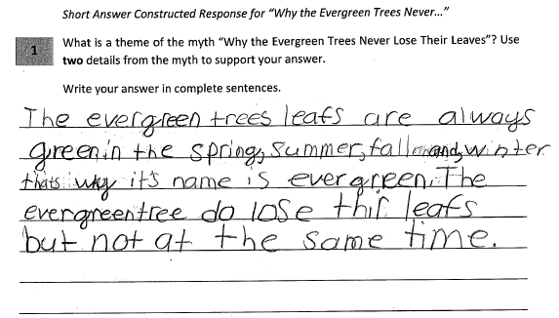
Grade 4 Short-response Guide Paper 5
Notes:
Refer participants to the Guide Paper 5 in their Grade 4 Short-response (2-point) Sample Guide Set packet.
Read the entire response out loud to the participants.

Slide 43
Grade 4 Short-response Guide Paper 5 Annotation
Score Point 0
This response does not address any of the requirements of the prompt (The evergreen trees leafs are always green in the spring, summer, fall and, winter thats why it’s name is evergreen).
Notes:
Using the bulleted annotations marks that follow, review the score for the guide response and explain why the guide paper is the approved score, covering the information given in the annotation. Refer to the passage location while reviewing the annotation. The locations are noted below.
Be sure to use rubric language when explaining the score.
The score point for this response is 0.
This response does not address any of the requirements of the prompt (The evergreen trees leafs are always green in the spring, summer, fall and, winter thats why it’s name is evergreen).
Note the differences between this score point 0 response and the score point 1 responses in the guide set. Ask the participants if the difference is clear to them.

Slide 44
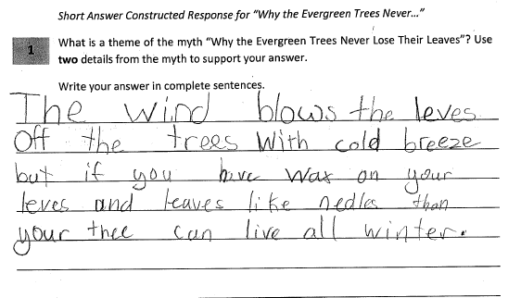
Grade 4 Short-response Guide Paper 6
Notes:
Refer participants to the Guide Paper 6 in their Grade 4 Short-response (2-point) Sample Guide Set packet.
Read the entire response out loud to the participants.

Slide 45
Grade 4 Short-response Guide Paper 6 Annotation
Score Point 0
This response does not address any of the requirements of the prompt.
Notes:
Using the bulleted annotations marks that follow, review the score for the guide response and explain why the guide paper is the approved score, covering the information given in the annotation. Refer to the passage location while reviewing the annotation. The locations are noted below.
Be sure to use rubric language when explaining the score.
The score point for this response is 0.
This response does not address any of the requirements of the prompt.

Slide 46
Q&A
Notes:
Ask the participants if they have any questions about the guide set.
Ask the participants if the distinctions between the score points is clearly illustrated in the guide set.

Slide 47
Grade 4 Short-response (2-point) Practice Set
Notes:
In this section of the training the participants will have an opportunity to practice scoring some 2-point responses.
Time estimate:
25 minutes

Slide 48
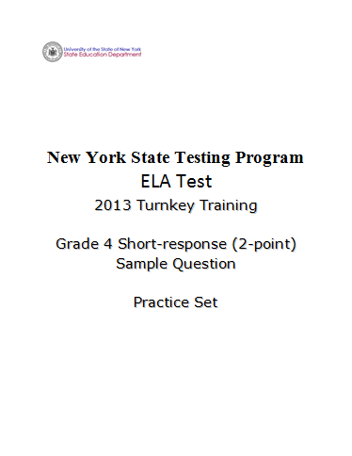
Notes:
Refer participants to the Grade 4 Short-response (2-Point) Sample Question Practice Set packet.
Direct participants to read and score each of the five practice responses.
Explain that they will have 10-15 minutes for the activity.
Remind participants to work independently and reference their rubric and guide papers while they score.
Move forward when the 15 minutes is up or all participants have completed the scoring activity.

Slide 49
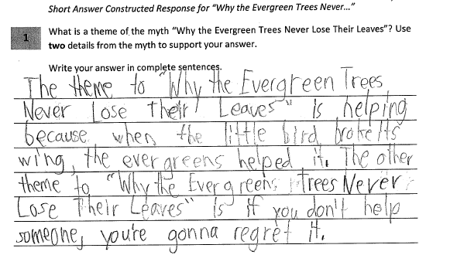
Grade 4 Short-response Practice Paper 1
Notes:
Refer participants to the Practice Paper 1 in their Grade 4 Short-response (2-point) Sample Guide Set packet.
Read the entire response to the participants.

Slide 50
Grade 4 Short-response Practice Paper 1 Annotation
Score Point 1
This response makes valid inferences from the text to identify themes in the myth (The theme to...is helping and The other theme...is if you don’t help someone, you’re gonna regret it); however, the response provides only one concrete detail from the text for support (when the little bird broke its wing, the evergreens helped it). This response includes complete sentences where errors do not impact readability.
Notes:
Using the bulleted annotations marks that follow, review the score for the practice response and explain why the guide paper is the approved score, covering the information given in the annotation. Refer to the passage location while reviewing the annotation. The locations are noted below.
Use rubric language when explaining the score.
The score point for this response is 1.
This response makes valid inferences from the text to identify themes in the myth (The theme to...is helping and The other theme...is if you don’t help someone, you’re gonna regret it); however, the response provides only one concrete detail from the text for support (when the little bird broke its wing, the evergreens helped it).
This response includes complete sentences where errors do not impact readability.
Point out:
This response makes two valid inferences, but does not provide the required text-based support for the inferences.
While this response does not look exactly like any of the score point 1 responses in the guide set, the response shares the aspects of a type of score point 1 response – valid inference with insufficient details from the text as support.

Slide 51
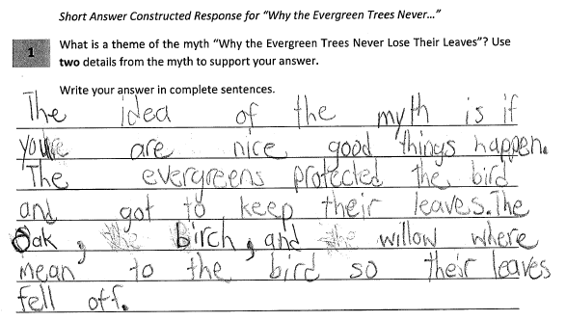
Grade 4 Short-response Practice Paper 2
Notes:
Refer participants to the Practice Paper 2 in their Grade 4 Short-response (2-point) Sample Guide Set packet.
Read the entire response to the participants.

Slide 52
Grade 4 Short-response Practice Paper 2 Annotation
Score Point 2
This response makes a valid inference from the text to identify the theme of the myth (The idea of the myth is if you are nice good things happen). The response provides a sufficient number of concrete details from the text for support as required by the prompt (The evergreens protected the bird and got to keep their leaves. The oak, birch, and willow where mean to the bird so their leaves fell off). This response includes complete sentences where errors do not impact readability.
Notes:
Using the bulleted annotations marks that follow, review the score for the practice response and explain why the guide paper is the approved score, covering the information given in the annotation. Refer to the passage location while reviewing the annotation. The locations are noted below.
Use rubric language when explaining the score.
The score point for this response is 2.
This response makes a valid inference from the text to identify the theme of the myth (The idea of the myth is if you are nice good things happen).
The response provides a sufficient number of concrete details from the text for support as required by the prompt (The evergreens protected the bird and got to keep their leaves. The oak, birch, and willow where mean to the bird so their leaves fell off).
This response includes complete sentences where errors do not impact readability.

Slide 53
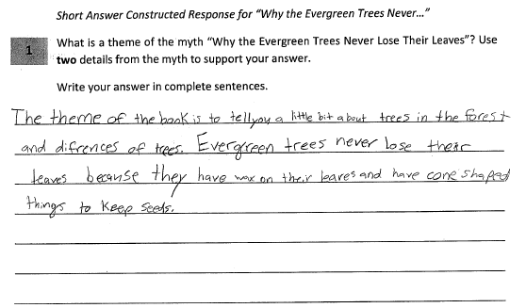
Grade 4 Short-response Practice Paper 3
Notes:
Refer participants to the Practice Paper 3 in their Grade 4 Short-response (2-point) Sample Guide Set packet.
Read the entire response to the participants.

Slide 54
Grade 4 Short-response Practice Paper 3 Annotation
Score Point 0
This response does not address any of the requirements of the prompt (The theme of the book is to tell you a little bit about trees in the forest and difrences of trees).
Notes:
Using the bulleted annotations marks that follow, review the score for the practice response and explain why the guide paper is the approved score, covering the information given in the annotation. Refer to the passage location while reviewing the annotation. The locations are noted below.
Use rubric language when explaining the score.
The score point for this response is 0.
This response does not address any of the requirements of the prompt (The theme of the book is to tell you a little bit about trees in the forest and difrences of trees).

Slide 55
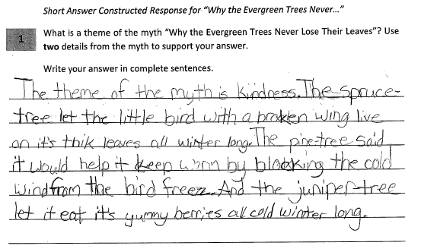
Grade 4 Short-response Practice Paper 4
Notes:
Refer participants to the Practice Paper 4 in their Grade 4 Short-response (2-point) Sample Guide Set packet.
Read the entire response to the participants.

Slide 56
Grade 4 Short-response Practice Paper 4 Annotation
Score Point 2
This response makes a valid inference from the text to identify the theme of the myth (The theme of the myth is kindness). The response provides a sufficient number of concrete details from the text for support as required by the prompt (The spruce-tree let the little bird with a broken wing live on it’s thik leaves all winter long. The pine-tree said it would help it keep warm by blocking the cold wind from the bird freez). This response includes complete sentences where errors do not impact readability.
Notes:
Using the bulleted annotations marks that follow, review the score for the practice response and explain why the guide paper is the approved score, covering the information given in the annotation. Refer to the passage location while reviewing the annotation. The locations are noted below.
Use rubric language to review the score point explanation.
The score point for this response is 2.
This response makes a valid inference from the text to identify the theme of the myth (The theme of the myth is kindness).
The response provides a sufficient number of concrete details from the text for support as required by the prompt (The spruce-tree let the little bird with a broken wing live on it’s thik leaves all winter long. The pine-tree said it would help it keep warm by blocking the cold wind from the bird freez).
This response includes complete sentences where errors do not impact readability.

Slide 57
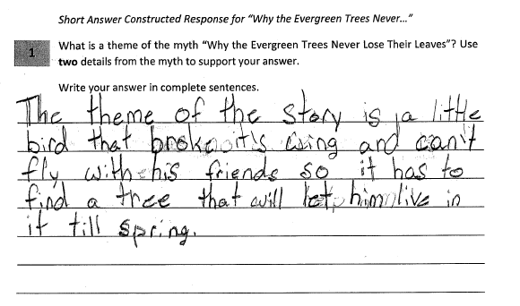
Grade 4 Short-response Practice Paper 5
Notes:
Refer participants to the Practice Paper 5 in their Grade 4 Short-response (2-point) Sample Guide Set packet.
Read the entire response to the participants.

Slide 58
Grade 4 Short-response Practice Paper 5 Annotation
Score Point 1
This response is a mostly literal recounting of details from the text (The theme of the story is a little bird that broke it’s wing and can’t fly with his friends so it has to find a tree that will let him live in it till spring). This response includes complete sentences where errors do not impact readability.
Notes:
Instruct participants to perform a Talk and Turn:
Turn to a fellow participant and discuss the score point you have given the response using the rubric as a guide.
Note evidence for your score point.
You will have 2 minutes to discuss this response.
Activate the timer.
After the allotted 2 minutes, ask a participant to share their score point and related evidence for the response.
Using the bulleted annotations marks that follow, review the score for the practice response and explain why the guide paper is the approved score, covering the information given in the annotation. Refer to the passage location while reviewing the annotation. The locations are noted below.
Use rubric language to review the score point explanation.
The score point for this response is a 1.
This response is a mostly literal recounting of details from the text (The theme of the story is a little bird that broke it’s wing and can’t fly with his friends so it has to find a tree that will let him live in it till spring).
This response includes complete sentences where errors do not impact readability.

Slide 59
Q&A
Notes:
Ask the participants if they have any questions about the practice responses and the scores they received.
Ask if the participants see how the practice papers align with the rubric and guide papers.

Slide 60
Grade 3 ELA Extended-response (4-point) Rubric/Constructed-response
Notes:
The following sections of the training are focused on the new 4-point constructed-response questions.
This section specifically focuses on the grade 3, 4-point questions.
Time estimate:
30 minutes

Slide 61
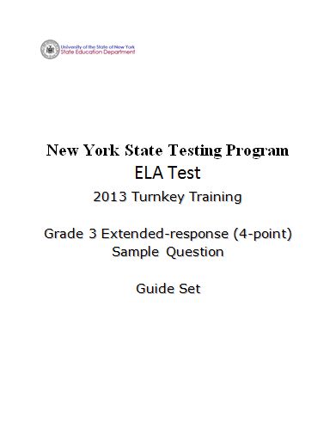
Notes:
Refer participants to the Grade 3 Extended-response (4-Point) Sample Question Guide Set packet.
Explain the rational behind the 4-point questions:
While writing from a text requires reading comprehension skills, the 4-point questions are more focused on writing – crafting an extended essay – than the 2-point questions. While each question is aligned with a specific Common Core Standard, the rubric lists all the standards that are being assessed by the 4-point questions.
Remind the participants that there are multiple ways to respond to each question – and no one “correct” way to respond to the question.
Remind the participants to take notes on their rubric and the training responses for use when delivering the training in their districts.

Slide 62
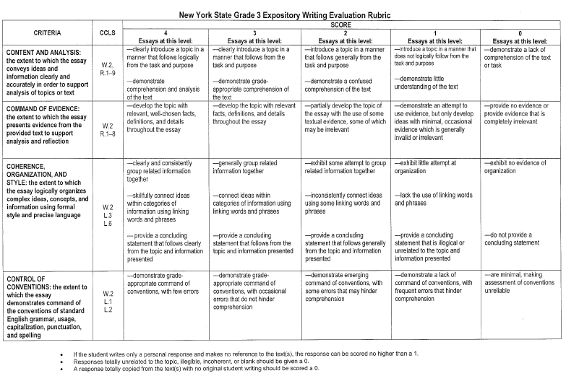
Grade 3 Expository Writing Evaluation Rubric
Notes:
Refer participants to the rubric in the Grade 3 Extended-response (4-point) Sample Guide Set packet.

Slide 63
Grade 3 Expository Writing Evaluation Rubric (Continued)
CRITERIA | CCLS | SCORE
 |  | 4 Essays at this level: | 3 Essays at this level: | 2 Essays at this level: | 1 Essays at this level: | 0 Essays at this level:
CONTENT AND ANALYSIS: the extent to which the essay conveys ideas and information clearly and accurately in order to support analysis of topics or text | W.2, R.1–9 | —clearly introduce a topic in a manner that follows logically from the task and purpose —demonstrate comprehension and analysis of the text | —clearly introduce a topic in a manner that follows from the task and purpose —demonstrate grade-appropriate comprehension of the text | —introduce a topic in a manner that follows generally from the task and purpose —demonstrate a confused comprehension of the text | —introduce a topic in a manner that does not logically follow from the task and purpose —demonstrate little understanding of the text | —demonstrate a lack of comprehension of the text or task
If the student writes only a personal response and makes no reference to the text(s), the response can be scored no higher than a 1.
Responses totally unrelated to the topic, illegible, incoherent, or blank should be given a 0.
A response totally copied from the text(s) with no original student writing should be scored a 0.
Notes:
Review the Content and Analysis section of the grade 3, 4-point rubric.
Review the criteria from left to right covering the criteria, standards assessed, and the description of each score point.
Note the differences between the score points as the rubric moves from score point 4 to score point 0.

Slide 64
Grade 3 Expository Writing Evaluation Rubric (Continued)
CRITERIA | CCLS | SCORE
 |  | 4 Essays at this level: | 3 Essays at this level: | 2 Essays at this level: | 1 Essays at this level: | 0 Essays at this level:
COMMAND OF EVIDENCE: the extent to which the essay presents evidence from the provided text to support analysis and reflection | W.2 R.1–8 | —develop the topic with relevant, well-chosen facts, definitions, and details throughout the essay | —develop the topic with relevant facts, definitions, and details throughout the essay | —partially develop the topic of the essay with the use of some textual evidence, some of which may be irrelevant | —demonstrate an attempt to use evidence, but only develop ideas with minimal, occasional evidence which is generally invalid or irrelevant | —provide no evidence or provide evidence that is completely irrelevant
If the student writes only a personal response and makes no reference to the text(s), the response can be scored no higher than a 1.
Responses totally unrelated to the topic, illegible, incoherent, or blank should be given a 0.
A response totally copied from the text(s) with no original student writing should be scored a 0.
Notes:
Review the Command of Evidence section of the grade 3, 4-point rubric.
Review the criteria from left to right covering the criteria, standards assessed, and the description of each score point.
Note the differences between the score points as the rubric moves from score point 4 to score point 0.

Slide 65
Grade 3 Expository Writing Evaluation Rubric (Continued)
CRITERIA | CCLS | SCORE
 |  | 4 Essays at this level: | 3 Essays at this level: | 2 Essays at this level: | 1 Essays at this level: | 0 Essays at this level:
COHERENCE, ORGANIZATION, AND STYLE: the extent to which the essay logically organizes complex ideas, concepts, and information using formal style and precise language | W.2 L.3 L.6 | —clearly and consistently group related information together —skillfully connect ideas within categories of information using linking words and phrases — provide a concluding statement that follows clearly from the topic and information presented | —generally group related information together —connect ideas within categories of information using linking words and phrases —provide a concluding statement that follows from the topic and information presented | —exhibit some attempt to group related information together —inconsistently connect ideas using some linking words and phrases —provide a concluding statement that follows generally from the topic and information presented | —exhibit little attempt at organization —lack the use of linking words and phrases —provide a concluding statement that is illogical or unrelated to the topic and information presented | —exhibit no evidence of organization —do not provide a concluding statement
If the student writes only a personal response and makes no reference to the text(s), the response can be scored no higher than a 1.
Responses totally unrelated to the topic, illegible, incoherent, or blank should be given a 0.
A response totally copied from the text(s) with no original student writing should be scored a 0.
Notes:
Review the Coherence, Organization, and Style section of the grade 3, 4-point rubric.
Review the criteria from left to right covering the criteria, standards assessed, and the description of each score point.
Note the differences between the score points as the rubric moves from score point 4 to score point 0.

Slide 66
Grade 3 Expository Writing Evaluation Rubric (Continued)
CRITERIA | CCLS | SCORE
 |  | 4 Essays at this level: | 3 Essays at this level: | 2 Essays at this level: | 1 Essays at this level: | 0 Essays at this level:
CONTROL OF CONVENTIONS: the extent to which the essay demonstrates command of the conventions of standard English grammar, usage, capitalization, punctuation, and spelling | W.2 L.1 L.2 | —demonstrate grade-appropriate command of conventions, with few errors | —demonstrate grade-appropriate command of conventions, with occasional errors that do not hinder comprehension | —demonstrate emerging command of conventions, with some errors that may hinder comprehension | —demonstrate a lack of command of conventions, with frequent errors that hinder comprehension | —are minimal, making assessment of conventions unreliable
If the student writes only a personal response and makes no reference to the text(s), the response can be scored no higher than a 1.
Responses totally unrelated to the topic, illegible, incoherent, or blank should be given a 0.
A response totally copied from the text(s) with no original student writing should be scored a 0.
Notes:
Review the Control of Conventions section of the grade 3, 4-point rubric.
Review the criteria from left to right covering the criteria, standards assessed, and the description of each score point.
Note the differences between the score points as the rubric moves from score point 4 to score point 0.
Emphasize the holistic nature of the 4-point rubric. Remind the participants that they are not assigning four separate scores to each response, but one overall holistic, best-fit score. The score points are made up of all the criteria and are in the columns that go down the rubric.
Be sure to cover the bullets at the bottom of the rubric.
Note: Very rarely will a response meet every bullet point for any specific score point and one bullet point does not a score point make. Participants need to find what the best-fit score for each response.
Encourage participants to remove the rubric from the packet in order to be able to refer to it while reviewing the grade 3, 4-point student responses.

Slide 67
Q&A
Notes:
Ask participants if the grade 3, 4-point rubric is clear.
Ask participants if the holistic nature of the rubric – and how to use it reading down the columns for each score point – is clear.
Remind participants that the rubric tells us what a response at each score point looks, but the guide papers show us what the responses look like at each score point. Scorers need to reference their guide papers while scoring.

Slide 68
Grade 3 Extended-response (4-point) Guide Set
Notes:
Refer participants to the Grade 3 Extended-response (4-Point) Sample Question Guide Set packet.
Time estimate:
30 minutes

Slide 69
Grade 3 Extended-response Passage
The Poplar Tree
by Flora J. Cooke
Long ago the poplar used to hold out its branches like other trees. It tried to see how far it could spread them.
Once at sunset an old man came through the forest where the poplar trees lived. The trees were going to sleep, and it was growing dark.
The man held something under his cloak. It was a pot of gold—the very pot of gold that lies at the foot of the rainbow. He had stolen it and was looking for some place to hide it. A poplar tree stood by the path.
“This is the very place to hide my treasure,” the man said. “The branches spread out straight, and the leaves are large and thick. How lucky that the trees are all asleep!”
He placed the pot of gold in the thick branches, and then ran quickly away.
1
2
3
4
5
Notes:
Refer participants to the passage in their Grade 3 Extended-response (2-point) Sample Guide Set.
Instruct participants to take 5 minutes to read the passage to themselves.

Slide 70
Grade 3 Extended-response Passage
Continued from previous page…
The gold belonged to Iris, the beautiful maiden who had a rainbow bridge to the earth. The next morning she missed her precious pot. It always lay at the foot of the rainbow, but it was not there now.
Iris hurried away to tell her father, the great Zeus, of her loss. He said that he would find the pot of gold for her.
He called a messenger, the swift-footed Mercury, and said, “Go quickly, and do not return until you have found the treasure.”
Mercury went as fast as the wind down to the earth. He soon came to the forest and awakened the trees.
“Iris has lost her precious pot of gold that lies at the foot of the rainbow. Have any of you seen it?” he asked.
The trees were very sleepy, but all shook their heads.
6
7
8
9
10
11

Slide 71
Grade 3 Extended-response Passage
Continued from previous page…
“We have not seen it,” they said.
“Hold up your branches,” said Mercury. “I must see that the pot of gold is not hidden among them.”
All of the trees held up their branches. The poplar that stood by the path was the first to hold up his. He was an honest tree and knew he had nothing to hide.
Down fell the pot of gold. How surprised the poplar tree was! He dropped his branches in shame. Then he held them high in the air.
“Forgive me,” he said. “I do not know how it came to be there; but, hereafter, I shall always hold my branches up. Then every one can see that I have nothing hidden.”
Since then the branches have always grown straight up; and every one knows that the poplar is an honest and upright tree.
www.gutenberg.org
12
13
14
15
16
17

Slide 72
Grade 3 Extended-response Question
1
Why do the poplar branches grow the way they do? Explain why the tree decides to grow them this way. How do the actions of the Old Man, Iris, Zeus, and Mercury lead to his decision? Use details from the story to support your answer.
In your response, be sure to include the following:
explain the direction in which the poplar tree’s branches grow
explain the events that made the tree’s branches grow this way
explain how the actions of the Old Man, Iris, Zeus, and Mercury lead to his decision
details from the story to support your answer
Write your answer in complete sentences.
Notes:
Refer participants to the question in the Grade 3 Extended-response (4-point) Sample Guide Set.
Introduce the question to the participants by stating the grade level and reading the question out loud to the group.
Give the participants a few minutes (2-3 minutes) to write some notes about how a 3rd grade student would/might respond to the question.
Have participants share their answers with their neighbors.
Ask one or two participants to share how they would answer the question.
Ask if any participants have any other answers – share several if participants have other answers.

Slide 73
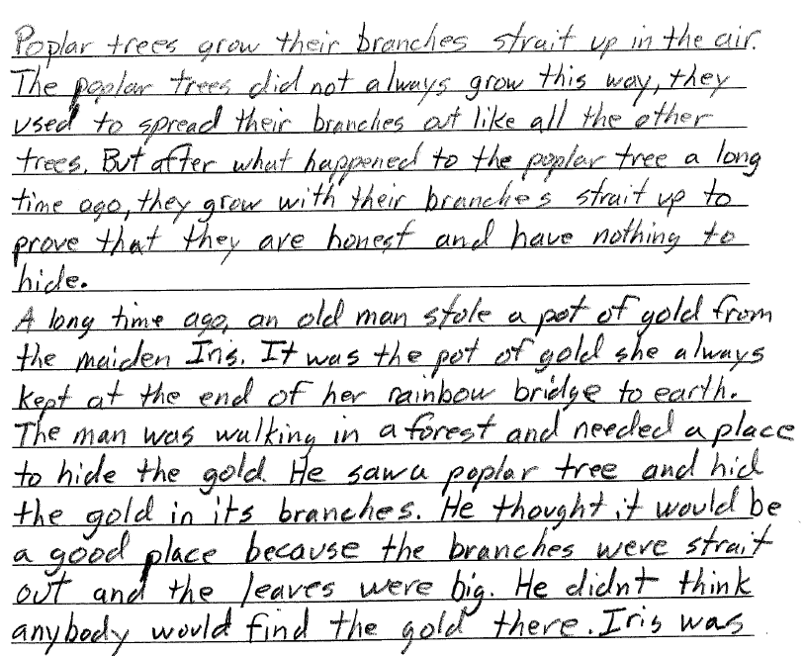
Grade 3 Extended-response Guide Paper 1a
Notes:
Refer participants to the Guide Paper 1 in their Grade 3 Extended-response (4-point) Sample Guide Set packet.
Read the response out loud to the participants.

Slide 74
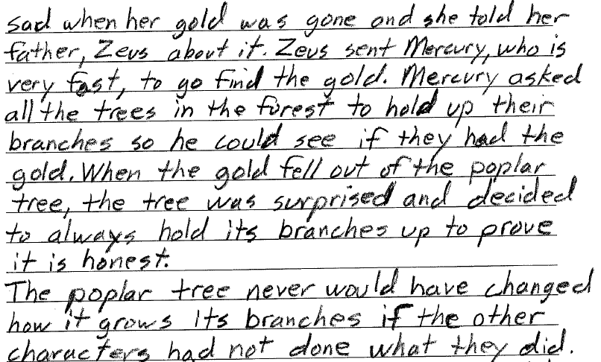
Grade 3 Extended-response Guide Paper 1b

Slide 75
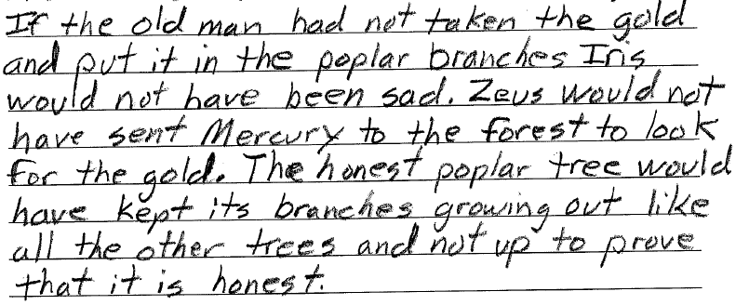
Grade 3 Extended-response Guide Paper 1c

Slide 76
Grade 3 Extended-response Guide Paper 1 Annotation
Score Point 4
This response clearly introduces a topic in a manner that follows logically from the task and purpose (But after what happened...prove that they are honest). The response demonstrates comprehension and analysis of the text (The poplar tree never would have changed how it grows its branches if the other characters had not done what they did). The topic is developed with relevant, well-chosen details throughout the essay (the branches were strait out and the leaves were big and Iris was sad when her gold was gone and she told her father, Zeus about it.). Related information is consistently grouped together (Mercury asked all the trees in the forest to hold up their branches so he could see if they had the gold. When the gold fell out of the poplar tree, the tree was surprised and decided to always hold its branches up to prove it is honest.). Ideas are skillfully connected using linking words (But after, A long time ago, When, If). The response provides a concluding statement that follows clearly from the topic (to prove that it is honest). The response demonstrates grade-appropriate command of conventions, with few errors.
Notes:
Using the bulleted annotations marks that follow, review the score for the guide response and explain why the guide paper is the approved score, covering the information given in the annotation. Refer to the passage location while reviewing the annotation. The locations are noted below.
Be sure to use rubric language when explaining the score.
The score point for this response is 4.
This response clearly introduces a topic in a manner that follows logically from the task and purpose (But after what happened...prove that they are honest). [Last sentence, 1st paragraph.]
The response demonstrates comprehension and analysis of the text (The poplar tree never would have changed how it grows its branches if the other characters had not done what they did). [1st sentence, last paragraph, middle pg. 2]
The topic is developed with relevant, well-chosen details throughout the essay (the branches were strait out and the leaves were big and Iris was sad when her gold was gone and she told her father, Zeus about it.). [Last 4 lines of pg. 1, 1st 2 lines of pg. 2]
Related information is consistently grouped together (Mercury asked all the trees in the forest to hold up their branches so he could see if they had the gold. When the gold fell out of the poplar tree, the tree was surprised and decided to always hold its branches up to prove it is honest.). [3rd line, 2nd pg. through end of paragraph]
Ideas are skillfully connected using linking words (But after, A long time ago, When, If). [Throughout - between and within paragraphs]
The response provides a concluding statement that follows clearly from the topic (to prove that it is honest). [End of 1st paragraph]
The response demonstrates grade-appropriate command of conventions, with few errors.

Slide 77
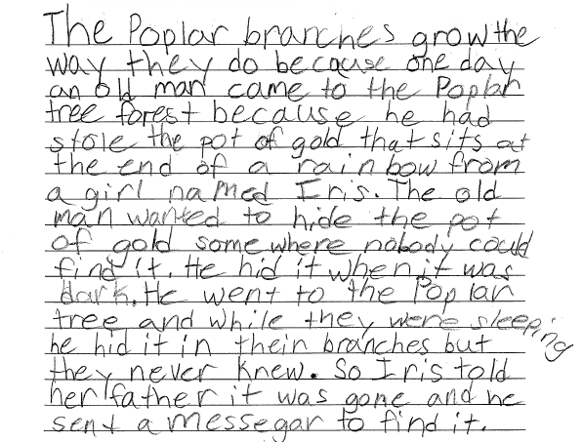
Grade 3 Extended-response Guide Paper 2a
Notes:
Refer participants to the Guide Paper 2 in their Grade 3 Extended-response (4-point) Sample Guide Set packet.
Read the response out loud to the participants.

Slide 78
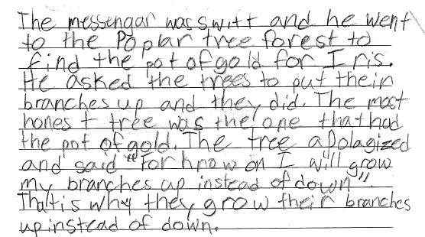
Grade 3 Extended-response Guide Paper 2b

Slide 79
Grade 3 Extended-response Guide Paper 2 Annotation
Score Point 4
This response clearly introduces a topic in a manner that follows logically from the task and purpose (The Poplar branches grow the way they do because one day on old man came to the Poplar tree forest because he had stole the pot of gold). The response demonstrates comprehension and analysis of the text (The most honest tree was the one that had the pot of gold). The topic is developed with relevant, well-chosen details throughout the essay (He hid it when it was dark. He went to the Poplar tree and while they were sleeping he hid it in their branches). Related information is consistently grouped together (Iris told her father it was gone and he sent a messegar to find it. The messengar was swift and he went to the Poplar tree forest to find the pot of gold). Ideas are skillfully connected using linking words (So, and he went, That is why). The response provides a concluding statement that follows clearly from the topic (That is why they grow their branches up instead of down). The response demonstrates grade-appropriate command of conventions, with occasional errors (Poplar, had stole, went to the Poplar tree and while they were, messegar) that do not hinder comprehension.
Notes:
Using the bulleted annotations marks that follow, review the score for the guide response and explain why the guide paper is the approved score, covering the information given in the annotation. Refer to the passage location while reviewing the annotation. The locations are noted below.
Be sure to use rubric language when explaining the score.
The score point for this passage is 4.
This response clearly introduces a topic in a manner that follows logically from the task and purpose (The Poplar branches grow the way they do because one day on old man came to the Poplar tree forest because he had stole the pot of gold). [1st sentence of response]
The response demonstrates comprehension and analysis of the text (The most honest tree was the one that had the pot of gold). [5-7th lines pg. 2]
The topic is developed with relevant, well-chosen details throughout the essay (He hid it when it was dark. He went to the Poplar tree and while they were sleeping he hid it in their branches). [6th line from the bottom of 1st pg.]
Related information is consistently grouped together (Iris told her father it was gone and he sent a messegar to find it. The messengar was swift and he went to the Poplar tree forest to find the pot of gold). [3rd line from bottom of the 1st page, 3rd line pg. 2]
Ideas are skillfully connected using linking words (So, and he went, That is why). [Bottom 1st pg. through end]
The response provides a concluding statement that follows clearly from the topic (That is why they grow their branches up instead of down). [Last sentence}
The response demonstrates grade-appropriate command of conventions, with occasional errors (Poplar, had stole, went to the Poplar tree and while they were, messegar) that do not hinder comprehension. [Throughout]

Slide 80
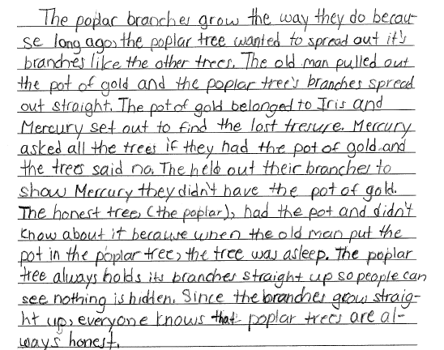
Grade 3 Extended-response Guide Paper 3
Notes:
Refer participants to the Guide Paper 3 in their Grade 3 Extended-response (4-point) Sample Guide Set packet.
Read the response out loud to the participants.

Slide 81
Grade 3 Extended-response Guide Paper 3 Annotation
Score Point 3
This response clearly introduces a topic in a manner that follows from the task and purpose (The poplar branches grow the way they do because long ago). The response demonstrates grade-appropriate comprehension of the text (The poplar tree always holds its branches straight up so people can see nothing is hidden). The topic is developed with relevant facts throughout the essay (The pot of gold belonged to Iris and Mercury set out to find the lost tresure. Mercury asked all the trees if they had the pot of gold and the trees said no). Related information is generally grouped together and connected using linking words and phrases (and Mercury set out, and didn’t know, Since the branches). The response provides a concluding statement that follows clearly from the topic (everyone knows that poplar trees are always honest).The response demonstrates grade-appropriate command of conventions, with occasional errors (it’s and tresure) that do not hinder comprehension.
Notes:
Using the bulleted annotations marks that follow, review the score for the guide response and explain why the guide paper is the approved score, covering the information given in the annotation. Refer to the passage location while reviewing the annotation. The locations are noted below.
Be sure to use rubric language when explaining the score.
The score point for this response is 3.
This response clearly introduces a topic in a manner that follows from the task and purpose (The poplar branches grow the way they do because long ago). [1st sentence through “ago”]
The response demonstrates grade-appropriate comprehension of the text (The poplar tree always holds its branches straight up so people can see nothing is hidden). [5th line from end of pg 1]
The topic is developed with relevant facts throughout the essay (The pot of gold belonged to Iris and Mercury set out to find the lost tresure. Mercury asked all the trees if they had the pot of gold and the trees said no). [3rd and 4th sentences 1/3 of way through the response]
Related information is generally grouped together and connected using linking words and phrases (and Mercury set out, and didn’t know, Since the branches). [Throughout]
The response provides a concluding statement that follows clearly from the topic (everyone knows that poplar trees are always honest). [Last sentence]
The response demonstrates grade-appropriate command of conventions, with occasional errors (it’s and tresure) that do not hinder comprehension.
Note the differences between this score point 3 response and the score point 4 responses in the guide set. Ask the participants if the difference is clear to them.

Slide 82
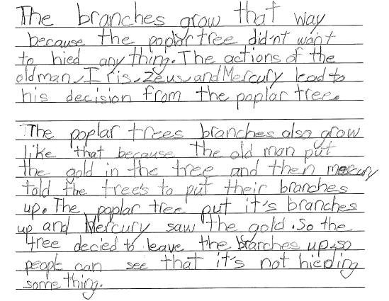
Grade 3 Extended-response Guide Paper 4a
Notes:
Refer participants to the Guide Paper 4 in their Grade 3 Extended-response (4-point) Sample Guide Set packet.
Read the response out loud to the participants.

Slide 83
Grade 3 Extended-response Guide Paper 4b

Slide 84
Grade 3 Extended-response Guide Paper 4 Annotation
Score Point 3
This response clearly introduces a topic in a manner that follows from the task and purpose (The branches grow that way because the poplar tree did’nt want to hied anything). The response demonstrates grade-appropriate comprehension of the text (The old man, Iris, Zeus, and Mercury also lead to his decision from how most of them all worked together to find the pot of gold for Iris). The topic is developed with relevant facts throughout the essay (the old man put the gold in the tree and then mercury told the tree’s to put their branches up. The poplar tree put it’s branches up and Mercury saw the gold). Related information is generally grouped together and connected using linking words and phrases (and then, So the tree, because). The response demonstrates emerging command of conventions, with some errors (did’nt, hied, mercury, tree’s, it’s for its, actions of The old) that may hinder comprehension.
Notes:
Using the bulleted annotations marks that follow, review the score for the guide response and explain why the guide paper is the approved score, covering the information given in the annotation. Refer to the passage location while reviewing the annotation. The locations are noted below.
Be sure to use rubric language when explaining the score.
The score point for this response is 3.
This response clearly introduces a topic in a manner that follows from the task and purpose (The branches grow that way because the poplar tree did’nt want to hied anything). [1st sentence]
The response demonstrates grade-appropriate comprehension of the text (The old man, Iris, Zeus, and Mercury also lead to his decision from how most of them all worked together to find the pot of gold for Iris). [Top of pg. 2]
The topic is developed with relevant facts throughout the essay (the old man put the gold in the tree and then mercury told the tree’s to put their branches up. The poplar tree put it’s branches up and Mercury saw the gold). [Beginning of paragraph 2]
Related information is generally grouped together and connected using linking words and phrases (and then, So the tree, because). [Throughout}
The response demonstrates emerging command of conventions, with some errors (did’nt, hied, mercury, tree’s, it’s for its, actions of The old) that may hinder comprehension.

Slide 85
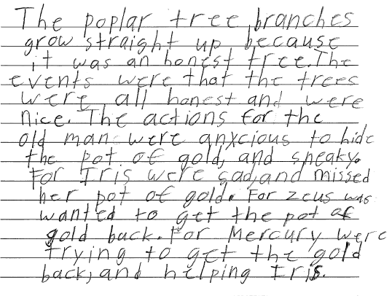
Grade 3 Extended-response Guide Paper 5
Notes:
Refer participants to the Guide Paper 5 in their Grade 3 Extended-response (4-point) Sample Guide Set packet.
Read the response out loud to the participants.

Slide 86
Grade 3 Extended-response Guide Paper 5 Annotation
Score Point 2
This response introduces a topic in a manner that follows generally from the task and purpose (The poplar tree branches grow straight up because it was an honest tree). The topic is partially developed with some textual evidence (The actions for the old man were anxcious to hide the pot of gold, and sneaky. For Iris were sad, and missed her pot of gold and For mercury were trying to get the gold back). Some attempt to group related information is demonstrated through inconsistent use of linking words to connect ideas (For Iris, For Zeus, For Mercury). The response demonstrates grade-appropriate command of conventions, with occasional errors (poplar tree branches, was wanted, Mercury were) that do not hinder comprehension.
Notes:
Using the bulleted annotations marks that follow, review the score for the guide response and explain why the guide paper is the approved score, covering the information given in the annotation. Refer to the passage location while reviewing the annotation. The locations are noted below.
Be sure to use rubric language when explaining the score.
The score point for this response is 2.
This response introduces a topic in a manner that follows generally from the task and purpose (The poplar tree branches grow straight up because it was an honest tree). [Lines 1-3]
The topic is partially developed with some textual evidence (The actions for the old man were anxcious to hide the pot of gold, and sneaky. For Iris were sad, and missed her pot of gold and For mercury were trying to get the gold back). [Lines 6-10 and lines 12-14]
Some attempt to group related information is demonstrated through inconsistent use of linking words to connect ideas (For Iris, For Zeus, For Mercury). [Throughout]
The response demonstrates grade-appropriate command of conventions, with occasional errors (poplar tree branches, was wanted, Mercury were) that do not hinder comprehension.
Note the differences between this score point 2 response and the score point 3 responses in the guide set. Ask the participants if the difference is clear to them.

Slide 87
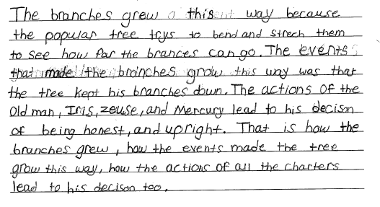
Grade 3 Extended-response Guide Paper 6
Notes:
Refer participants to the Guide Paper 6 in their Grade 3 Extended-response (4-point) Sample Guide Set packet.
Read the response out loud to the participants.

Slide 88
Grade 3 Extended-response Guide Paper 6 Annotation
Score Point 2
This response introduces a topic in a manner that follows generally from the task and purpose (The branches grew this way because the popular tree trys to bend and strech them to see how far the brances can go). The response demonstrates a confused comprehension of the text (The events that made the branches grow this way was that the tree kept his branches down). The topic is partially developed with some textual evidence (The actions of the Old man, Iris, Zeuse, and Mercury lead to his decison of being honest, and upright). The concluding statement follows generally from the information presented (That is how the branches grew). The response demonstrates emerging command of conventions, with some errors (popular, trys, strech, brances, decison) that may hinder comprehension.
Notes:
Using the bulleted annotations marks that follow, review the score for the guide response and explain why the guide paper is the approved score, covering the information given in the annotation. Refer to the passage location while reviewing the annotation. The locations are noted below.
Be sure to use rubric language when explaining the score.
The score point for this response is 2.
This response introduces a topic in a manner that follows generally from the task and purpose (The branches grew this way because the popular tree trys to bend and strech them to see how far the brances can go). [1st sentence, lines 1-3]
The response demonstrates a confused comprehension of the text (The events that made the branches grow this way was that the tree kept his branches down). [Lines 3-5]
The topic is partially developed with some textual evidence (The actions of the Old man, Iris, Zeuse, and Mercury lead to his decison of being honest, and upright). [Lines 5-7]
The concluding statement follows generally from the information presented (That is how the branches grew). [Lines 7-8]
The response demonstrates emerging command of conventions, with some errors (popular, trys, strech, brances, decison) that may hinder comprehension. [Throughout]

Slide 89
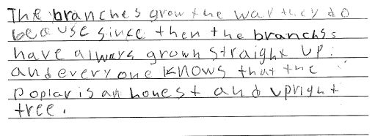
Grade 3 Extended-response Guide Paper 7
Notes:
Refer participants to the Guide Paper 7 in their Grade 3 Extended-response (4-point) Sample Guide Set packet.
Read the response out loud to the participants.

Slide 90
Grade 3 Extended-response Guide Paper 7 Annotation
Score Point 1
This response introduces a topic in a manner that follows generally from the task but demonstrates a little understanding of the text (The branches grow the way they do beause since then the branchs have always grown straight up). The response demonstrates an attempt to use evidence (every one knows that the poplar is an honest and upright tree) but only develops ideas with minimal evidence. Little attempt at organization is exhibited. This response demonstrates an emerging command of conventions, with some errors (beause, branchs, every one) that may hinder comprehension.
Notes:
Using the bulleted annotations marks that follow, review the score for the guide response and explain why the guide paper is the approved score, covering the information given in the annotation. Refer to the passage location while reviewing the annotation. The locations are noted below.
Be sure to use rubric language when explaining the score.
The score point for this response is 1.
This response introduces a topic in a manner that follows generally from the task but demonstrates a little understanding of the text (The branches grow the way they do beause since then the branchs have always grown straight up). [Lines 1-3]
The response demonstrates an attempt to use evidence (every one knows that the poplar is an honest and upright tree) but only develops ideas with minimal evidence. Little attempt at organization is exhibited. [Lines 4-6]
This response demonstrates an emerging command of conventions, with some errors (beause, branchs, every one) that may hinder comprehension.
Note the differences between this score point 1 response and the score point 2 responses in the guide set. Ask the participants if the difference is clear to them.

Slide 91
Grade 3 Extended-response Guide Paper 8
Notes:
Refer participants to the Guide Paper 8 in their Grade 3 Extended-response (4-point) Sample Guide Set packet.
Read the response out loud to the participants.

Slide 92
Grade 3 Extended-response Guide Paper 8 Annotation
Score Point 1
This response introduces a topic in a manner that follows generally from the task but demonstrates little understanding of the text (The tree decides to grow this way because he doesnt wanto hide anything from anyone). The response demonstrates an attempt to use evidence (The poplar grow that way because they tried to see how far they could spread them) but only develops ideas with minimal evidence that is generally irrelevant. Little attempt at organization is exhibited. This response demonstrates and emerging command of conventions with some errors (doesnt, wanto, grow for grows) that may hinder comprehension.
Notes:
Using the bulleted annotations marks that follow, review the score for the guide response and explain why the guide paper is the approved score, covering the information given in the annotation. Refer to the passage location while reviewing the annotation. The locations are noted below.
Be sure to use rubric language when explaining the score.
The score point for this response is 1.
This response introduces a topic in a manner that follows generally from the task but demonstrates little understanding of the text (The tree decides to grow this way because he doesnt wanto hide anything from anyone). [Lines 1-3]
The response demonstrates an attempt to use evidence (The poplar grow that way because they tried to see how far they could spread them) but only develops ideas with minimal evidence that is generally irrelevant. [Lines 3-6]
Little attempt at organization is exhibited.
This response demonstrates and emerging command of conventions with some errors (doesnt, wanto, grow for grows) that may hinder comprehension.

Slide 93
Grade 3 Extended-response Guide Paper 9
Notes:
Refer participants to the Guide Paper 9 in their Grade 3 Extended-response (4-point) Sample Guide Set packet.
Read the response out loud to the participants.

Slide 94
Grade 3 Extended-response Guide Paper 9 Annotation
Score Point 0
This response demonstrates a lack of comprehension of the text and task (The poplar tree’s branches grow in the forest because thear is gold thear that’s why they call then the poplar tree’s branches). The response provides no evidence. No organization is exhibited. The response demonstrates a lack of command of conventions, with frequent errors (thear, thear, then) that hinder comprehension.
Notes:
Using the bulleted annotations marks that follow, review the score for the guide response and explain why the guide paper is the approved score, covering the information given in the annotation. Refer to the passage location while reviewing the annotation. The locations are noted below.
Be sure to use rubric language when explaining the score.
The score point for this response is 0.
This response demonstrates a lack of comprehension of the text and task (The poplar tree’s branches grow in the forest because thear is gold thear that’s why they call then the poplar tree’s branches). [Entire response]
The response provides no evidence.
No organization is exhibited.
The response demonstrates a lack of command of conventions, with frequent errors (thear, thear, then) that hinder comprehension.
Note the differences between this score point 0 response and the score point 1 responses in the guide set. Ask the participants if the difference is clear to them.

Slide 95
Grade 3 Extended-response Guide Paper 10
Notes:
Refer participants to the Guide Paper 10 in their Grade 3 Extended-response (4-point) Sample Guide Set packet.
Read the response out loud to the participants.

Slide 96
Grade 3 Extended-response Guide Paper 10 Annotation
Score Point 0
This response demonstrates a lack of comprehension of the text and task (The Popler branches grow the way They dois becase it’s there way They can do it however They want if They want). The response provides no evidence. No organization is exhibited. The response demonstrates a lack of command of conventions, with frequent errors (Popler, They, dois, becase, there for their, They) that hinder comprehension.
Notes:
Using the bulleted annotations marks that follow, review the score for the guide response and explain why the guide paper is the approved score, covering the information given in the annotation. Refer to the passage location while reviewing the annotation. The locations are noted below.
Be sure to use rubric language when explaining the score.
The score point for this response is 0.
This response demonstrates a lack of comprehension of the text and task (The Popler branches grow the way They dois becase it’s there way They can do it however They want if They want). [Entire response]
The response provides no evidence.
No organization is exhibited.
The response demonstrates a lack of command of conventions, with frequent errors (Popler, They, dois, becase, there for their, They) that hinder comprehension.

Slide 97
Q&A
Notes:
Ask the participants if they have any questions about the guide set.
Ask the participants if the distinctions between the score points is clearly illustrated in the guide set.

Slide 98
Grades 4-5 Extended-response (4-point) Rubric/Constructed-response
Notes:
This section focuses on the grades 4-5, 4-point questions.
Instruct the participants to find their grade 4, 4-point materials, including the rubric, passage, and guide papers.
While participants find their materials, explain the rational behind the 4-point questions – While writing from a text requires reading comprehension skills, the 4-point questions are more focused on writing – crafting an extended essay – than the 2-point questions. While each question is aligned with a specific Common Core Standard, the rubric lists all the standards that are being assessed by the 4-point questions.
Remind the participants that there are multiple ways to respond to each question – and no one “correct” way to respond to the question.
Remind the participants to take notes on their rubric and the training responses for use when delivering the training in their districts.
Time estimate:
30 minutes

Slide 99
Notes:
Refer participants to the rubric in the Grade 4 Extended-response (4-Point) Sample Question Guide Set packet.

Slide 100
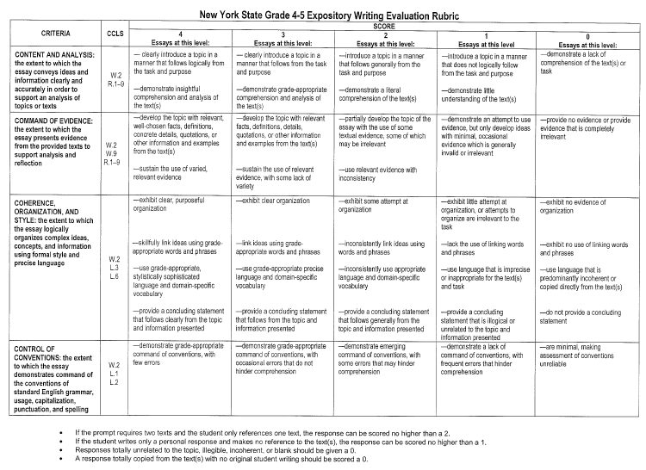
Grades 4-5 Expository Writing Evaluation Rubric
Notes:
Emphasize the holistic nature of the 4-point rubric. Remind the participants that they are not assigning four separate scores to each response, but one overall holistic, best-fit score. The score points are made up of all the criteria and are in the columns that go down the rubric.
Instruct participants to:
Read through the entire rubric.
Using a highlighter or pen, mark the changing descriptors as they move through the score points for each criterion.
Allow 2 minutes for the activity.

Slide 101
Grades 4-5 Expository Writing Evaluation Rubric (Continued)
CRITERIA | CCLS | SCORE
 |  | 4 Essays at this level: | 3 Essays at this level: | 2 Essays at this level: | 1 Essays at this level: | 0 Essays at this level:
CONTENT AND ANALYSIS: the extent to which the essay conveys ideas and information clearly and accurately in order to support analysis of topics or text | W.2, R.1–9 | — clearly introduce a topic in a manner that follows logically from the task and purpose —demonstrate insightful comprehension and analysis of the text(s) | — clearly introduce a topic in a manner that follows from the task and purpose —demonstrate grade-appropriate comprehension and analysis of the text(s) | —introduce a topic in a manner that follows generally from the task and purpose —demonstrate a literal comprehension of the text(s) | —introduce a topic in a manner that does not logically follow from the task and purpose —demonstrate little understanding of the text(s) | —demonstrate a lack of comprehension of the text(s) or task
If the prompt requires two texts and the student only references one text, the response can be scored no higher than a 2.
If the student writes only a personal response and makes no reference to the text(s), the response can be scored no higher than a 1.
Responses totally unrelated to the topic, illegible, incoherent, or blank should be given a 0.
A response totally copied from the text(s) with no original student writing should be scored a 0.
Notes:
Briefly point out the changing descriptor for each bullet at each score point.

Slide 102
Grades 4-5 Expository Writing Evaluation Rubric (Continued)
CRITERIA | CCLS | SCORE
 |  | 4 Essays at this level: | 3 Essays at this level: | 2 Essays at this level: | 1 Essays at this level: | 0 Essays at this level:
COMMAND OF EVIDENCE: the extent to which the essay presents evidence from the provided texts to support analysis and reflection | W.2 W.9 R.1–9 | —develop the topic with relevant, well-chosen facts, definitions, concrete details, quotations, or other information and examples from the text(s) —sustain the use of varied, relevant evidence | —develop the topic with relevant facts, definitions, details, quotations, or other information and examples from the text(s) —sustain the use of relevant evidence, with some lack of variety | —partially develop the topic of the essay with the use of some textual evidence, some of which may be irrelevant —use relevant evidence with inconsistency | —demonstrate an attempt to use evidence, but only develop ideas with minimal, occasional evidence which is generally invalid or irrelevant | —provide no evidence or provide evidence that is completely irrelevant
If the prompt requires two texts and the student only references one text, the response can be scored no higher than a 2.
If the student writes only a personal response and makes no reference to the text(s), the response can be scored no higher than a 1.
Responses totally unrelated to the topic, illegible, incoherent, or blank should be given a 0.
A response totally copied from the text(s) with no original student writing should be scored a 0.
Notes:
Briefly point out the changing descriptor for each bullet at each score point.

Slide 103
Grades 4-5 Expository Writing Evaluation Rubric (Continued)
CRITERIA | CCLS | SCORE
 |  | 4 Essays at this level: | 3 Essays at this level: | 2 Essays at this level: | 1 Essays at this level: | 0 Essays at this level:
COHERENCE, ORGANIZATION, AND STYLE: the extent to which the essay logically organizes complex ideas, concepts, and information using formal style and precise language | W.2 L.3 L.6 | —exhibit clear, purposeful organization —skillfully link ideas using grade-appropriate words and phrases —use grade-appropriate, stylistically sophisticated language and domain-specific vocabulary —provide a concluding statement that follows clearly from the topic and information presented | —exhibit clear organization —link ideas using grade-appropriate words and phrases —use grade-appropriate precise language and domain-specific vocabulary —provide a concluding statement that follows from the topic and information presented | —exhibit some attempt at organization —inconsistently link ideas using words and phrases —inconsistently use appropriate language and domain-specific vocabulary —provide a concluding statement that follows generally from the topic and information presented | —exhibit little attempt at organization, or attempts to organize are irrelevant to the task —lack the use of linking words and phrases —use language that is imprecise or inappropriate for the text(s) and task —provide a concluding statement that is illogical or unrelated to the topic and information presented | —exhibit no evidence of organization —exhibit no use of linking words and phrases —use language that is predominantly incoherent or copied directly from the text(s) —do not provide a concluding statement
If the prompt requires two texts and the student only references one text, the response can be scored no higher than a 2.
If the student writes only a personal response and makes no reference to the text(s), the response can be scored no higher than a 1.
Responses totally unrelated to the topic, illegible, incoherent, or blank should be given a 0.
A response totally copied from the text(s) with no original student writing should be scored a 0.
Notes:
Briefly point out the changing descriptor for each bullet at each score point.

Slide 104
Grades 4-5 Expository Writing Evaluation Rubric (Continued)
CRITERIA | CCLS | SCORE
 |  | 4 Essays at this level: | 3 Essays at this level: | 2 Essays at this level: | 1 Essays at this level: | 0 Essays at this level:
CONTROL OF CONVENTIONS: the extent to which the essay demonstrates command of the conventions of standard English grammar, usage, capitalization, punctuation, and spelling | W.2 L.1 L.2 | —demonstrate grade-appropriate command of conventions, with few errors | —demonstrate grade-appropriate command of conventions, with occasional errors that do not hinder comprehension | —demonstrate emerging command of conventions, with some errors that may hinder comprehension | —demonstrate a lack of command of conventions, with frequent errors that hinder comprehension | —are minimal, making assessment of conventions unreliable
If the prompt requires two texts and the student only references one text, the response can be scored no higher than a 2.
If the student writes only a personal response and makes no reference to the text(s), the response can be scored no higher than a 1.
Responses totally unrelated to the topic, illegible, incoherent, or blank should be given a 0.
A response totally copied from the text(s) with no original student writing should be scored a 0.
Notes:
Briefly point out the changing descriptor for each bullet at each score point.
Be sure to cover the bullets at the bottom of the rubric.
Note: Very rarely will a response meet every bullet point for any specific score point and one bullet point does not a score point make. Participants need to find what the best-fit score for each response.
Encourage participants to remove the rubric from the packet in order to be able to refer to it reviewing the grade 4, 4-point student responses.

Slide 105
Q&A
Notes:
Ask participants if the grades 4-5, 4-point rubric is clear.
Ask participants if the holistic nature of the rubric – and how to use it reading down the columns for each score point – is clear.
Remind participants that the rubric tells us what a response at each score point looks, but the guide papers show us what the responses look like at each score point. Scorers need to reference their guide papers while scoring.

Slide 106
Grade 4 Extended-response (4-point) Guide Set
Notes:
Refer participants to the Grade 4 Extended-response (4-point) Sample Guide Set in their packet.
Time estimate:
30 minutes

Slide 107
Grade 4 Extended-response Passage
Paired Passages: Myth and fact about why evergreen trees do not lose their leaves
Passage 1: Myth
Why the Evergreen Trees Never Lose Their Leaves
by Florence Holbrook
Winter was coming, and the birds had flown far to the south, where the air was warm and they could find berries to eat. One little bird had broken its wing and could not fly with the others. It was alone in the cold world of frost and snow. The forest looked warm, and it made its way to the trees as well as it could, to ask for help.
First it came to a birch-tree. “Beautiful birch-tree,” it said, “my wing is broken, and my friends have flown away. May I live among your branches till they come back to me?”
“No, indeed,” answered the birch-tree, drawing her fair green leaves away. “We of the great forest have our own birds to help. I can do nothing for you.”
“The birch is not very strong,” said the little bird to itself, “and it might be that she could not hold me easily. I will ask the oak.” So the bird said, “Great oak-tree, you are so strong, will you not let me live on your boughs till my friends come back in the springtime?”
1
2
3
4
Notes:
Give the participants 10 minutes to read the passages to themselves.
Note that there are two, paired passages for the grade 4, 4-point question. The participants will already have seen one passage during this training, but they need to review the passage again.

Slide 108
Grade 4 Extended-response Passage
Continued from previous page…
“In the springtime!” cried the oak. “That is a long way off. How do I know what you might do in all that time? Birds are always looking for something to eat, and you might even eat up some of my acorns.”
“It may be that the willow will be kind to me,” thought the bird, and it said, “Gentle willow, my wing is broken, and I could not fly to the south with the other birds. May I live on your branches till the springtime?”
The willow did not look gentle then, for she drew herself up proudly and said, “Indeed, I do not know you, and we willows never talk to people whom we do not know. Very likely there are trees somewhere that will take in strange birds. Leave me at once.”
The poor little bird did not know what to do. Its wing was not yet strong, but it began to fly away as well as it could. Before it had gone far, a voice was heard. “Little bird,” it said, “where are you going?”
“Indeed, I do not know,” answered the bird sadly. “I am very cold.”
“Come right here, then,” said the friendly spruce-tree, for it was her voice that had called. “You shall live on my warmest branch all winter if you choose.”
5
6
7
8
9
10

Slide 109
Grade 4 Extended-response Passage
Continued from previous page…
“Will you really let me?” asked the little bird eagerly.
“Indeed, I will,” answered the kind-hearted spruce-tree. “If your friends have flown away, it is time for the trees to help you. Here is the branch where my leaves are thickest and softest.”
“My branches are not very thick,” said the friendly pine-tree, “but I am big and strong, and I can keep the north wind from you and the spruce.”
“I can help too,” said a little juniper-tree. “I can give you berries all winter long, and every bird knows that juniper berries are good.”
So the spruce gave the lonely little bird a home, the pine kept the cold north wind away from it, and the juniper gave it berries to eat.
The other trees looked on and talked together scornfully.
“I would not have strange birds on my boughs,” said the birch.
“I shall not give my acorns away for any one,” said the oak.
11
12
13
14
15
16
17
18

Slide 110
Grade 4 Extended-response Passage
Continued from previous page…
“I never have anything to do with strangers,” said the willow, and the three trees drew their leaves closely about them.
In the morning all those shining green leaves lay on the ground, for the cold north wind had come in the night, and every leaf that it touched fell from the tree.
“May I touch every leaf in the forest?” asked the wind in its frolic.
“No,” said the forest king. “The trees that have been kind to the little bird with the broken wing may keep their leaves.”
This is why the leaves of the spruce, the pine, and the juniper are always green.
www.gutenberg.org
19
20
21
22
23

Slide 111
Grade 4 Extended-response Passage
Passage 2: Informational
Why are evergreen trees green all year round?
Evergreen trees (also known as conifers because of the cones that hold their seeds) include spruce, fir and pine trees. Evergreen trees do lose leaves, but not all at the same time the way that deciduous trees (trees that lose their leaves) do. These trees are specially adapted to live in climates where there may be limited annual sunshine and/or available water.
The evergreen thrives in cold climates and its leaves are adapted to make the most of its environment. The leaves of evergreen trees are often small and narrow, like needles. Evergreen leaves can remain on a tree for anywhere from 1-20 years depending on the species of tree, but most leaves remain on the tree for less than five years. It is thought that by keeping its leaves year round the plant might be able to take advantage of periods of thaw during the winter to make food. It also means that the plant does not need to waste energy re-growing a full set of leaves each year.
1
2

Slide 112
Grade 4 Extended-response Passage
Continued from previous page…
The leaves of an evergreen have the same function as leaves of other trees, mainly to make food for the plant through photosynthesis. The leaves are often a dark green color indicating that a lot of the sun-absorbing compound chlorophyll is present. By having a lot of small leaves packed with chlorophyll, the plant gathers as much energy as it can from the sparse sunlight. It uses this energy to make food in the form of glucose. The dark color also helps keep the plant warm in its cold environment (think about wearing dark clothing on sunny day versus light or white clothing. The dark clothing absorbs more sunlight and is hotter to wear).
The cold climate where evergreens often live means that even if there is a large amount of precipitation, the water is often frozen and therefore unavailable to the plant. The small surface area and the thick coating of wax on the needle-like leaves allow the plant to retain more water (there is less surface area available for evaporation). The small leaves also have small holes called stomata that are used for gas exchange; these can be closed very tightly to stop water loss. Lastly the small pointy leaves and the cone-like shape of the tree itself shed snow more easily than other trees so the evergreens are not as likely to break under the weight of snow and ice.
www.ccmr.cornell.edu
3
4

Slide 113
Grade 4 Extended-response Question
2
The myth and the article both provide explanations for why evergreen trees keep their leaves in winter. How are the explanations similar and different? Use specific examples from the myth and the article to support your answer.
In your response, be sure to do the following:
describe what the myth says about why evergreen trees keep their leaves in winter
describe what the article says about why evergreen trees keep their leaves in winter
discuss how the explanations are similar and different
include details from both the myth and the article to support your answer
Notes:
Introduce the question to the participants by stating the Grade level and question and then by reading the question out loud to the group.
Give the participants a few minutes (5 minutes) to write some notes about how a 4th grade student would/might respond to the question.
Have participants share their answers with their neighbors.
Ask one or two participants how they would answer the question.
Ask if any participants have any other answers – share several if participants have other answers.

Slide 114
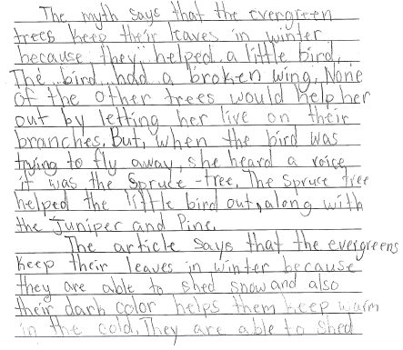
Grade 4 Extended-response Guide Paper 1a
Notes:
Refer participants to the Practice Paper 1 in their Grade 4 Extended-response (4-point) Sample Guide Set packet.
Read the entire response to the participants.

Slide 115
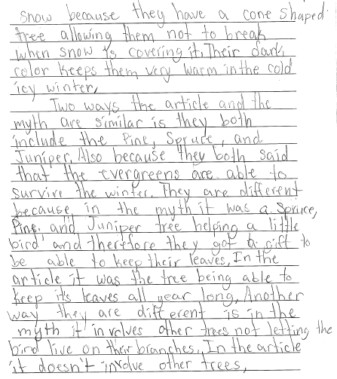
Grade 4 Extended-response Guide Paper 1b

Slide 116
Grade 4 Extended-response Guide Paper 1 Annotation
Score Point 4
This response clearly introduces a topic in a manner that follows logically from the task and purpose (The myth says that the evergreen trees keep their leaves in winter because they helped a little bird and The article says that the evergreens keep their leaves in winter because they are able to shed snow). The response demonstrates insightful comprehension and analysis of the texts (they both include the Pine, Spruce, and Juniper and They are different because in the myth it was a Spruce, Pine, and Juniper tree helping a little bird....In the article it was the tree being able to keep it’s leaves all year long). The topic is developed with relevant, well-chosen facts from the texts (None of the other trees would help her out by letting her live on their branches...The Spruce tree helped the little bird out, along with the Juniper and Pine and They are able to shed snow because they have a cone shaped tree...Their dark color keeps them very warm in the cold icy winter). Varied, relevant evidence is sustained throughout (in the myth it involves other trees not letting the bird live on their branches. In the article it doesn’t involve other trees). The response exhibits clear, purposeful organization, and skillfully links ideas using grade-appropriate words and phrases (But, when; Also because; Another way; In the article). The language used is stylistically sophisticated (therefore they got a gift). The response demonstrates grade-appropriate command of conventions, with few errors.
Notes:
Using the bulleted annotations marks that follow, review the score for the guide response and explain why the guide paper is the approved score, covering the information given in the annotation. Refer to the passage location while reviewing the annotation. The locations are noted below.
Be sure to use rubric language when explaining the score.
The score point for this response is 4.
This response clearly introduces a topic in a manner that follows logically from the task and purpose (The myth says that the evergreen trees keep their leaves in winter because they helped a little bird and The article says that the evergreens keep their leaves in winter because they are able to shed snow). [1st sentence, paragraph 1 and 1st sentence paragraph 2]
The response demonstrates insightful comprehension and analysis of the texts (they both include the Pine, Spruce, and Juniper and They are different because in the myth it was a Spruce, Pine, and Juniper tree helping a little bird....In the article it was the tree being able to keep it’s leaves all year long). [2nd line, 3rd paragraph, 6th line, 3rd paragraph]
The topic is developed with relevant, well-chosen facts from the texts (None of the other trees would help her out by letting her live on their branches...The Spruce tree helped the little bird out, along with the Juniper and Pine and They are able to shed snow because they have a cone shaped tree...Their dark color keeps them very warm in the cold icy winter). [1st paragraph lines 4-7, 2nd paragraph end of page 1, line 5, page 2]
Varied, relevant evidence is sustained throughout (in the myth it involves other trees not letting the bird live on their branches. In the article it doesn’t involve other trees). [3rd paragraph last 2 sentences]
The response exhibits clear, purposeful organization, and skillfully links ideas using grade-appropriate words and phrases (But, when; Also because; Another way; In the article). [Throughout]
The language used is stylistically sophisticated (therefore they got a gift).
The response demonstrates grade-appropriate command of conventions, with few errors.

Slide 117
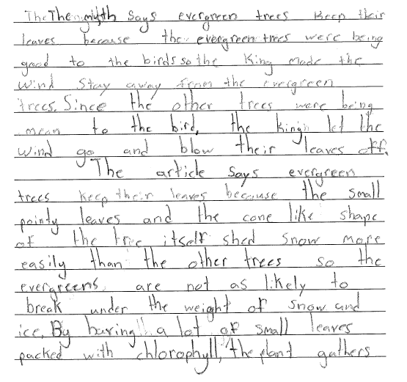
Grade 4 Extended-response Guide Paper 2a
Notes:
Refer participants to the Practice Paper 2 in their Grade 4 Extended-response (4-point) Sample Guide Set packet.
Read the entire response to the participants.

Slide 118
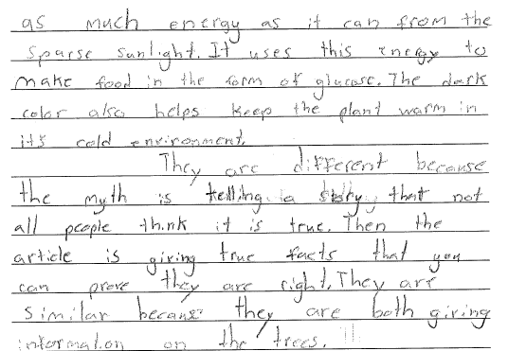
Grade 4 Extended-response Guide Paper 2b

Slide 119
Grade 4 Extended-response Guide Paper 2 Annotation
Score Point 4
This response clearly introduces a topic in a manner that follows logically from the task and purpose (The myth says evergreen trees keep their leaves because the evergreen trees were being good to the birds and The article says evergreen trees keep their leaves because the small pointy leaves and the cone like shape of the tree itself shed snow). The response demonstrates insightful analysis of the texts (They are different because the myth is telling a story that not all people think it is true...the article is giving true facts that you can prove they are right). The topic is developed with relevant, well-chosen facts and concrete details from the texts (the king made the wind stay away from the evergreen trees...the other trees were being mean to the bird, the king let the wind go and blow their leaves off and By having a lot of small leaves packed with chlorophyll, the plant gathers as much energy as it can from the sparse sunlight...The dark color also helps keep the plant warm). The response exhibits clear, purposeful organization, and skillfully links ideas with grade-appropriate words and phrases (Since the other, so the evergreens, By having, Then the article). The language is stylistically sophisticated with domain-specific vocabulary (true facts that you can prove). The response provides a concluding statement that follows from the topic and information presented (both giving information on the trees). The response demonstrates grade-appropriate command of conventions, with few errors.
Notes:
Using the bulleted annotations marks that follow, review the score for the guide response and explain why the guide paper is the approved score, covering the information given in the annotation. Refer to the passage location while reviewing the annotation. The locations are noted below.
Be sure to use rubric language when explaining the score.
The score point for this response is 4.
This response clearly introduces a topic in a manner that follows logically from the task and purpose (The myth says evergreen trees keep their leaves because the evergreen trees were being good to the birds and The article says evergreen trees keep their leaves because the small pointy leaves and the cone like shape of the tree itself shed snow). [Paragraph 1, 1st sentence and paragraph 2, 1st sentence]
The response demonstrates insightful analysis of the texts (They are different because the myth is telling a story that not all people think it is true...the article is giving true facts that you can prove they are right). [Paragraph 3, lines 1-5]
The topic is developed with relevant, well-chosen facts and concrete details from the texts (the king made the wind stay away from the evergreen trees...the other trees were being mean to the bird, the king let the wind go and blow their leaves off and By having a lot of small leaves packed with chlorophyll, the plant gathers as much energy as it can from the sparse sunlight...The dark color also helps keep the plant warm). [Paragraph 1, line 3-7 and paragraph 2, lines 8-4th line on page 2]
The response exhibits clear, purposeful organization, and skillfully links ideas with grade-appropriate words and phrases (Since the other, so the evergreens, By having, Then the article). The language is stylistically sophisticated with domain-specific vocabulary (true facts that you can prove). [Paragraph 3, lines 4-5]
The response provides a concluding statement that follows from the topic and information presented (both giving information on the trees).
The response demonstrates grade-appropriate command of conventions, with few errors.

Slide 120
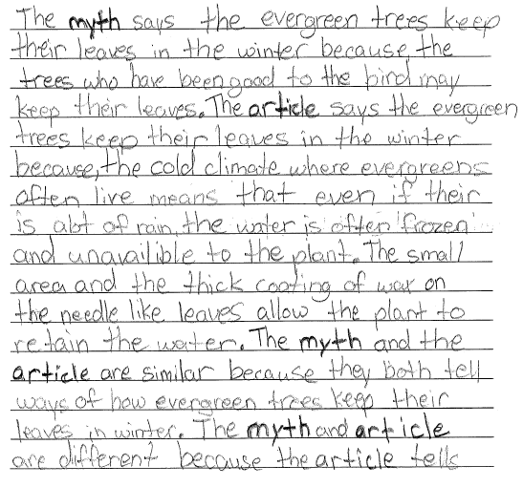
Grade 4 Extended-response Guide Paper 3a
Notes:
Refer participants to the Practice Paper 3 in their Grade 4 Extended-response (4-point) Sample Guide Set packet.
Read the entire response to the participants.

Slide 121
Grade 4 Extended-response Guide Paper 3b

Slide 122
Grade 4 Extended-response Guide Paper 3 Annotation
Score Point 3
This response clearly introduces a topic in a manner that follows from the task (because the trees who have been good to the bird may keep their leaves and because, the cold climate). The response demonstrates grade-appropriate comprehension and analysis of the texts (are different because the article tells how evergreen trees keep their leaves in the winter describing how evergreens keep their leaves. The myth just tells a of how evergreens keep their leaves, and putting parts of facts into that story). The use of relevant evidence is sustained throughout (even if their is alot of rain, the water is often frozen and unavailible to the plant. The small area and the thick coating of wax on the needle like leaves allow the plant to retain the water). The response exhibits clear organization, and links ideas using grade-appropriate words and phrases (The myth says, The article says, even if). The language is grade-appropriate with domain-specific vocabulary (have been good to the bird and describing). The response demonstrates grade-appropriate command of conventions, with occasional errors that do not hinder comprehension.
Notes:
Using the bulleted annotations marks that follow, review the score for the guide response and explain why the guide paper is the approved score, covering the information given in the annotation. Refer to the passage location while reviewing the annotation. The locations are noted below.
Be sure to use rubric language when explaining the score.
The score point for this response 3.
This response clearly introduces a topic in a manner that follows from the task (because the trees who have been good to the bird may keep their leaves and because, the cold climate). [Pg. 1, lines 2-4]
The response demonstrates grade-appropriate comprehension and analysis of the texts (are different because the article tells how evergreen trees keep their leaves in the winter describing how evergreens keep their leaves. The myth just tells a of how evergreens keep their leaves, and putting parts of facts into that story). [Last line pg. 1 to the end of pg. 2]
The use of relevant evidence is sustained throughout (even if their is alot of rain, the water is often frozen and unavailible to the plant. The small area and the thick coating of wax on the needle like leaves allow the plant to retain the water). [Pg. 1, line 7-12]
The response exhibits clear organization, and links ideas using grade-appropriate words and phrases (The myth says, The article says, even if).
The language is grade-appropriate with domain-specific vocabulary (have been good to the bird and describing). [Pg. 1, line 3 and pg. 2, line 2]
The response demonstrates grade-appropriate command of conventions, with occasional errors that do not hinder comprehension.

Slide 123
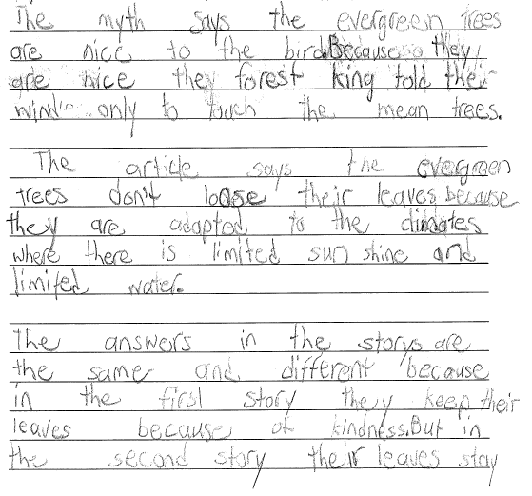
Grade 4 Extended-response Guide Paper 4a
Notes:
Refer participants to the Practice Paper 4 in their Grade 4 Extended-response (4-point) Sample Guide Set packet.
Read the entire response to the participants.

Slide 124
Grade 4 Extended-response Guide Paper 4b

Slide 125
Grade 4 Extended-response Guide Paper 4 Annotation
Score Point 3
This response clearly introduces a topic in a manner that follows from the task and purpose (The myth says the evergreen trees are nice to the bird and The article says the evergreen trees don’t loose their leaves because they are adapted to the climates). The response demonstrates grade-appropriate comprehension and analysis of the texts (The answers in the storys are the same and different because in the first story they keep their leaves because of kindness. But in the second story their leaves stay on because the trees are adapted to the cold climates). The topic is partially developed with some textual evidence (the forest king told the wind only to touch the mean trees and where there is limited sun shine and limited water). The response exhibits clear organization, and links ideas using grade-appropriate words and phrases (Because, But in the second story, And the reason). The response provides a concluding statement that follows from the topic and information presented (the answers are the same is because the both keep their leaves). The response demonstrates grade-appropriate command of conventions, with occasional errors (loose, storys, the) that do not hinder comprehension.
Notes:
Using the bulleted annotations marks that follow, review the score for the guide response and explain why the guide paper is the approved score, covering the information given in the annotation. Refer to the passage location while reviewing the annotation. The locations are noted below.
Be sure to use rubric language when explaining the score.
The score point for this response is 3.
This response clearly introduces a topic in a manner that follows from the task and purpose (The myth says the evergreen trees are nice to the bird and The article says the evergreen trees don’t loose their leaves because they are adapted to the climates). [Paragraph 1, 1st sentence, paragraph 2, 1st sentence]
The response demonstrates grade-appropriate comprehension and analysis of the texts (The answers in the storys are the same and different because in the first story they keep their leaves because of kindness. But in the second story their leaves stay on because the trees are adapted to the cold climates). [Paragraph 3, beginning through line 2, pg. 2]
The topic is partially developed with some textual evidence (the forest king told the wind only to touch the mean trees and where there is limited sun shine and limited water). [Paragraph 1, lines 3-4, paragraph 2, lines 4-5]
The response exhibits clear organization, and links ideas using grade-appropriate words and phrases (Because, But in the second story, And the reason).
The response provides a concluding statement that follows from the topic and information presented (the answers are the same is because the both keep their leaves). [last sentence]
The response demonstrates grade-appropriate command of conventions, with occasional errors (loose, storys, the) that do not hinder comprehension.

Slide 126
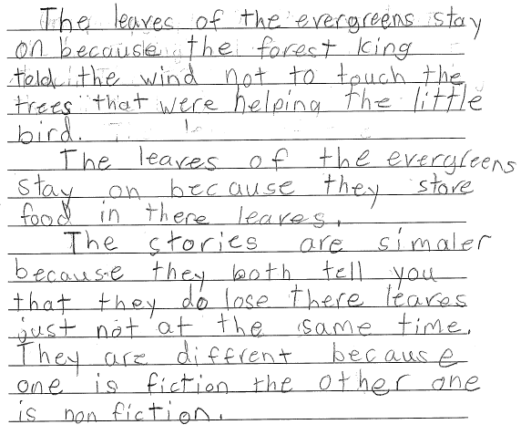
Grade 4 Extended-response Guide Paper 5
Notes:
Refer participants to the Practice Paper 5 in their Grade 4 Extended-response (4-point) Sample Guide Set packet.
Read the entire response to the participants.

Slide 127
Grade 4 Extended-response Guide Paper 5 Annotation
Score Point 2
This response introduces a topic in a manner that follows generally from the task and purpose (because the forest king told the wind not to touch the trees and because they store food in there leaves). The response demonstrates a literal comprehension of the texts (they both tell you that they do lose there leaves just not at the same time and one is fiction the other one is non fiction). The topic is partially developed with the use of some textual evidence (told the wind not to touch the trees that were helping the little bird). The response exhibits some attempt at organization and inconsistently uses words and phrases to link ideas (The stories are simaler and They are diffrent because). No concluding statement is provided. The response demonstrates grade-appropriate command of conventions, with occasional errors (there for their, simaler, diffrent) that do not hinder comprehension.
Notes:
Using the bulleted annotations marks that follow, review the score for the guide response and explain why the guide paper is the approved score, covering the information given in the annotation. Refer to the passage location while reviewing the annotation. The locations are noted below.
Be sure to use rubric language when explaining the score.
The score point for this response is 2.
This response introduces a topic in a manner that follows generally from the task and purpose (because the forest king told the wind not to touch the trees and because they store food in there leaves). [Paragraph 1, lines 2-4, paragraph 2, lines 2-3]
The response demonstrates a literal comprehension of the texts (they both tell you that they do lose there leaves just not at the same time and one is fiction the other one is non fiction). [Paragraph 3, lines 2-4 and lines 6-7]
The topic is partially developed with the use of some textual evidence (told the wind not to touch the trees that were helping the little bird). [Paragraph 1, lines 3-5]
The response exhibits some attempt at organization and inconsistently uses words and phrases to link ideas (The stories are simaler and They are diffrent because). [3rd paragraph]
No concluding statement is provided. The response demonstrates grade-appropriate command of conventions, with occasional errors (there for their, simaler, diffrent) that do not hinder comprehension.
Note the differences between this score point 2 response and the score point 3 responses in the guide set. Ask the participants if the difference is clear to them.

Slide 128
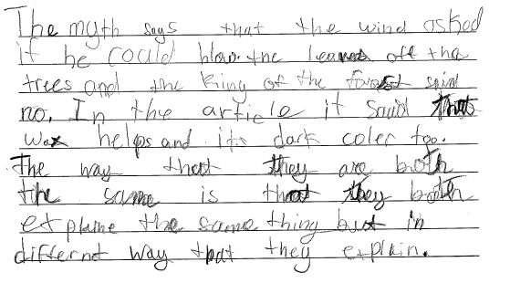
Grade 4 Extended-response Guide Paper 6
Notes:
Refer participants to the Practice Paper 6 in their Grade 4 Extended-response (4-point) Sample Guide Set packet.
Read the entire response to the participants.

Slide 129
Grade 4 Extended-response Guide Paper 6 Annotation
Score Point 2
This response introduces a topic in a manner that follows generally from the task (the wind asked if he could blow the leaves off the trees and wax helps). The response demonstrates a literal comprehension of the texts (they both explaine the same thin but in differnet way that they explain). The topic is partially developed with some textual evidence (the king of the forest said no and its dark coler too). The response exhibits some attempt at organization and inconsistently links ideas using words and phrases (The myth says and In the article). The response demonstrates emerging command of conventions, with some errors that may hinder comprehension (coler, explaine, differnet).
Notes:
Using the bulleted annotations marks that follow, review the score for the guide response and explain why the guide paper is the approved score, covering the information given in the annotation. Refer to the passage location while reviewing the annotation. The locations are noted below.
Be sure to use rubric language when explaining the score.
The score point for this response is 2.
This response introduces a topic in a manner that follows generally from the task (the wind asked if he could blow the leaves off the trees and wax helps). [Lines 1-3 and line 5]
The response demonstrates a literal comprehension of the texts (they both explaine the same thin but in differnet way that they explain). [Lines 7-9]
The topic is partially developed with some textual evidence (the king of the forest said no and its dark coler too). [Lines 3-5]
The response exhibits some attempt at organization and inconsistently links ideas using words and phrases (The myth says and In the article). [Line 1 and line 4]
The response demonstrates emerging command of conventions, with some errors that may hinder comprehension (coler, explaine, differnet).

Slide 130
Grade 4 Extended-response Guide Paper 7
Notes:
Refer participants to the Practice Paper 7 in their Grade 4 Extended-response (4-point) Sample Guide Set packet.
Read the entire response to the participants.

Slide 131
Grade 4 Extended-response Guide Paper 7 Annotation
Score Point 1
This response introduces a topic in a manner that follows generally from the task (Each story has facts). The response demonstrates little understanding of the texts (conifouris trees hav wax on thier leves so snow slips right off...ever green trees don’t lose their wings because they were good to the bird). Ideas are developed using minimal evidence (conifourios trees have adapted to the weather). This response exhibits little attempt at organization, and lacks the use of linking words to connect ideas. No concluding statement is provided. This response demonstrates emerging command of conventions, with some errors (conifouris, hav, thier, leves) that may hinder comprehension.
Notes:
Using the bulleted annotations marks that follow, review the score for the guide response and explain why the guide paper is the approved score, covering the information given in the annotation. Refer to the passage location while reviewing the annotation. The locations are noted below.
Be sure to use rubric language when explaining the score.
The score point for this response is 1.
This response introduces a topic in a manner that follows generally from the task (Each story has facts). [Line 1]
The response demonstrates little understanding of the texts (conifouris trees hav wax on thier leves so snow slips right off...ever green trees don’t lose their wings because they were good to the bird). [Line 1-4]
Ideas are developed using minimal evidence (conifourios trees have adapted to the weather). [Line 4-5]
This response exhibits little attempt at organization, and lacks the use of linking words to connect ideas.
No concluding statement is provided.
This response demonstrates emerging command of conventions, with some errors (conifouris, hav, thier, leves) that may hinder comprehension. [Throughout]

Slide 132
Grade 4 Extended-response Guide Paper 8
Notes:
Refer participants to the Practice Paper 8 in their Grade 4 Extended-response (4-point) Sample Guide Set packet.
Read the entire response to the participants.

Slide 133
Grade 4 Extended-response Guide Paper 8 Annotation
Score Point 1
This response introduces a topic in a manner that follows generally from the task but demonstrates little understanding of the texts (the Myth is they are telling you about how trees are different then other trees). The response demonstrates an attempt to use evidence (the fiction is ware the trees talk the bird talks) but the evidence is generally irrelevant (for are chrismis trees and for are air). This response exhibits little attempt at organization and does not provide a concluding statement. This response demonstrates a lack of command of conventions, with frequent errors (the Myth, then, the, ware, ceep, thare, are for our) that hinder comprehension.
Notes:
Using the bulleted annotations marks that follow, review the score for the guide response and explain why the guide paper is the approved score, covering the information given in the annotation. Refer to the passage location while reviewing the annotation. The locations are noted below.
Be sure to use rubric language when explaining the score.
The score point for this response is 1.
This response introduces a topic in a manner that follows generally from the task but demonstrates little understanding of the texts (the Myth is they are telling you about how trees are different then other trees). [Lines 1-2]
The response demonstrates an attempt to use evidence (the fiction is ware the trees talk the bird talks) [Lines 2-3] but the evidence is generally irrelevant (for are chrismis trees and for are air). This response exhibits little attempt at organization and does not provide a concluding statement. [Lines 4-5]
This response demonstrates a lack of command of conventions, with frequent errors (the Myth, then, the, ware, ceep, thare, are for our) that hinder comprehension. [Throughout]

Slide 134
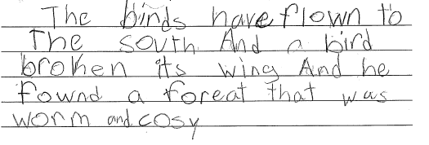
Grade 4 Extended-response Guide Paper 9
Notes:
Refer participants to the Practice Paper 9 in their Grade 4 Extended-response (4-point) Sample Guide Set packet.
Read the entire response to the participants.

Slide 135
Grade 4 Extended-response Guide Paper 9 Annotation
Score Point 0
This response demonstrates a lack of comprehension of the task. The response demonstrates an attempt to use evidence, which is generally irrelevant (The birds have flown to The south. And a bird broken its wing And he fownd a foreat that was worm and cosy). The response exhibits no evidence of organization or use of linking words. This response uses imprecise language and does not provide a concluding statement. The response demonstrates a lack of command of conventions, with frequent errors (to The south And a, wing And, fownd, foreat, worm) that hinder comprehension.
Notes:
Using the bulleted annotations marks that follow, review the score for the guide response and explain why the guide paper is the approved score, covering the information given in the annotation. Refer to the passage location while reviewing the annotation. The locations are noted below.
Be sure to use rubric language when explaining the score.
The score point for this response is 0.
This response demonstrates a lack of comprehension of the task.
The response demonstrates an attempt to use evidence, which is generally irrelevant (The birds have flown to The south. And a bird broken its wing And he fownd a foreat that was worm and cosy). [Throughout]
The response exhibits no evidence of organization or use of linking words.
This response uses imprecise language and does not provide a concluding statement.
The response demonstrates a lack of command of conventions, with frequent errors (to The south And a, wing And, fownd, foreat, worm) that hinder comprehension.

Slide 136
Grade 4 Extended-response Guide Paper 10
Notes:
Refer participants to the Practice Paper 10 in their Grade 4 Extended-response (4-point) Sample Guide Set packet.
Read the entire response to the participants.

Slide 137
Grade 4 Extended-response Guide Paper 10 Annotation
Score Point 0
This response demonstrates a lack of comprehension of the texts and task (They grew brave and they have to stay for spring). There is no evidence of organization. Language is minimal, making assessment of conventions unreliable.
Notes:
Using the bulleted annotations marks that follow, review the score for the guide response and explain why the guide paper is the approved score, covering the information given in the annotation. Refer to the passage location while reviewing the annotation. The locations are noted below.
Be sure to use rubric language when explaining the score.
The score point for this response is 0.
This response demonstrates a lack of comprehension of the texts and task (They grew brave and they have to stay for spring). [Throughout]
There is no evidence of organization.
Language is minimal, making assessment of conventions unreliable.

Slide 138
Q&A
Notes:
Ask the participants if they have any questions about the guide set.
Ask the participants if the distinctions between the score points is clearly illustrated in the guide set.

Slide 139
Grade 8 ELA Extended-response (4-point) Rubric/Constructed-response
Notes:
This section focuses on the grades 6-8, 4-point questions.
Instruct the participants to find their grade 8, 4-point materials, including the rubric, passage, guide, and practice papers.
While participants find their materials, explain the rational behind the 4-point questions – While writing from a text requires reading comprehension skills, the 4-point questions are more focused on writing – crafting an extended essay – than the 2-point questions. While each question is aligned with a specific Common Core Standard, the rubric lists all the standards that are being assessed by the 4-point questions.
Remind the participants that there are multiple ways to respond to each question – and no one “correct” way to respond to the question.
Remind the participants to take notes on their rubric and the training responses for use when delivering the training in their districts.
Time estimate:
25 minutes

Slide 140
Notes:
Refer participants to the rubric in the Grade 8 Extended-response (4-Point) Sample Question Guide Set packet.

Slide 141
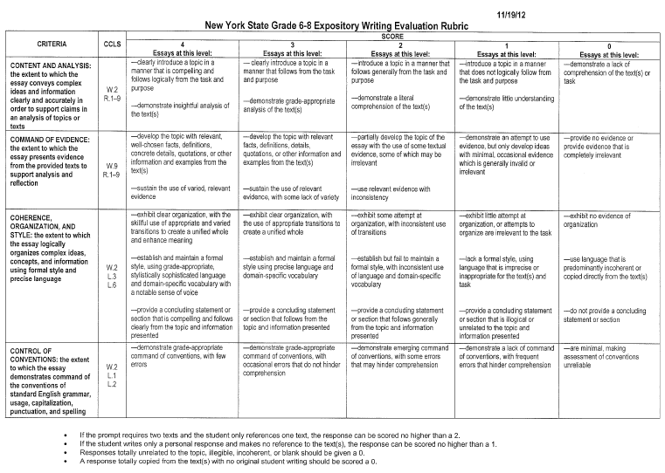
Grades 6-8 Expository Writing Evaluation Rubric
Notes:
Emphasize the holistic nature of the 4-point rubric. Remind the participants that they are not assigning four separate scores to each response, but one overall holistic, best-fit score. The score points are made up of all the criteria and are in the columns that go down the rubric.
Instruct participants to:
Read through the entire rubric.
Using a highlighter or pen, mark the changing descriptors as they move through the score points for each criterion.
Allow 2 minutes for the activity.

Slide 142
Grades 6-8 Expository Writing Evaluation Rubric (Continued)
CRITERIA | CCLS | SCORE
 |  | 4 Essays at this level: | 3 Essays at this level: | 2 Essays at this level: | 1 Essays at this level: | 0 Essays at this level:
CONTENT AND ANALYSIS: the extent to which the essay conveys complex ideas and information clearly and accurately in order to support claims in an analysis of topics or texts | W.2 R.1–9 | —clearly introduce a topic in a manner that is compelling and follows logically from the task and purpose —demonstrate insightful analysis of the text(s) | — clearly introduce a topic in a manner that follows from the task and purpose —demonstrate grade-appropriate analysis of the text(s) | —introduce a topic in a manner that follows generally from the task and purpose —demonstrate a literal comprehension of the text(s) | —introduce a topic in a manner that does not logically follow from the task and purpose —demonstrate little understanding of the text(s) | —demonstrate a lack of comprehension of the text(s) or task
If the prompt requires two texts and the student only references one text, the response can be scored no higher than a 2.
If the student writes only a personal response and makes no reference to the text(s), the response can be scored no higher than a 1.
Responses totally unrelated to the topic, illegible, incoherent, or blank should be given a 0.
A response totally copied from the text(s) with no original student writing should be scored a 0.
Notes:
Briefly point out the changing descriptor for each bullet at each score point.

Slide 143
Grades 6-8 Expository Writing Evaluation Rubric (Continued)
CRITERIA | CCLS | SCORE
 |  | 4 Essays at this level: | 3 Essays at this level: | 2 Essays at this level: | 1 Essays at this level: | 0 Essays at this level:
COMMAND OF EVIDENCE: the extent to which the essay presents evidence from the provided texts to support analysis and reflection | W.9 R.1–9 | —develop the topic with relevant, well-chosen facts, definitions, concrete details, quotations, or other information and examples from the text(s) —sustain the use of varied, relevant evidence | —develop the topic with relevant facts, definitions, details, quotations, or other information and examples from the text(s) —sustain the use of relevant evidence, with some lack of variety | —partially develop the topic of the essay with the use of some textual evidence, some of which may be irrelevant —use relevant evidence with inconsistency | —demonstrate an attempt to use evidence, but only develop ideas with minimal, occasional evidence which is generally invalid or irrelevant | —provide no evidence or provide evidence that is completely irrelevant
If the prompt requires two texts and the student only references one text, the response can be scored no higher than a 2.
If the student writes only a personal response and makes no reference to the text(s), the response can be scored no higher than a 1.
Responses totally unrelated to the topic, illegible, incoherent, or blank should be given a 0.
A response totally copied from the text(s) with no original student writing should be scored a 0.
Notes:
Briefly point out the changing descriptor for each bullet at each score point.

Slide 144
Grades 6-8 Expository Writing Evaluation Rubric (Continued)
CRITERIA | CCLS | SCORE
 |  | 4 Essays at this level: | 3 Essays at this level: | 2 Essays at this level: | 1 Essays at this level: | 0 Essays at this level:
COHERENCE, ORGANIZATION, AND STYLE: the extent to which the essay logically organizes complex ideas, concepts, and information using formal style and precise language | W.2 L.3 L.6 | —exhibit clear organization, with the skillful use of appropriate and varied transitions to create a unified whole and enhance meaning —establish and maintain a formal style, using grade-appropriate, stylistically sophisticated language and domain-specific vocabulary with a notable sense of voice —provide a concluding statement or section that is compelling and follows clearly from the topic and information presented | —exhibit clear organization, with the use of appropriate transitions to create a unified whole —establish and maintain a formal style using precise language and domain-specific vocabulary —provide a concluding statement or section that follows from the topic and information presented | —exhibit some attempt at organization, with inconsistent use of transitions —establish but fail to maintain a formal style, with inconsistent use of language and domain-specific vocabulary —provide a concluding statement or section that follows generally from the topic and information presented | —exhibit little attempt at organization, or attempts to organize are irrelevant to the task —lack a formal style, using language that is imprecise or inappropriate for the text(s) and task —provide a concluding statement or section that is illogical or unrelated to the topic and information presented | —exhibit no evidence of organization —use language that is predominantly incoherent or copied directly from the text(s) —do not provide a concluding statement or section
If the prompt requires two texts and the student only references one text, the response can be scored no higher than a 2.
If the student writes only a personal response and makes no reference to the text(s), the response can be scored no higher than a 1.
Responses totally unrelated to the topic, illegible, incoherent, or blank should be given a 0.
A response totally copied from the text(s) with no original student writing should be scored a 0.
Notes:
Briefly point out the changing descriptor for each bullet at each score point.

Slide 145
Grades 6-8 Expository Writing Evaluation Rubric (Continued)
CRITERIA | CCLS | SCORE
 |  | 4 Essays at this level: | 3 Essays at this level: | 2 Essays at this level: | 1 Essays at this level: | 0 Essays at this level:
CONTROL OF CONVENTIONS: the extent to which the essay demonstrates command of the conventions of standard English grammar, usage, capitalization, punctuation, and spelling | W.2 L.1 L.2 | —demonstrate grade-appropriate command of conventions, with few errors | —demonstrate grade-appropriate command of conventions, with occasional errors that do not hinder comprehension | —demonstrate emerging command of conventions, with some errors that may hinder comprehension | —demonstrate a lack of command of conventions, with frequent errors that hinder comprehension | —are minimal, making assessment of conventions unreliable
If the prompt requires two texts and the student only references one text, the response can be scored no higher than a 2.
If the student writes only a personal response and makes no reference to the text(s), the response can be scored no higher than a 1.
Responses totally unrelated to the topic, illegible, incoherent, or blank should be given a 0.
A response totally copied from the text(s) with no original student writing should be scored a 0.
Notes:
Briefly point out the changing descriptor for each bullet at each score point.
Be sure to cover the bullets at the bottom of the rubric.
Note: Very rarely will a response meet every bullet point for any specific score point and one bullet point does not a score point make. Participants need to find what the best-fit score for each response.
Encourage participants to remove the rubric from the packet in order to be able to refer to it reviewing the grade 8, 4-point student responses.

Slide 146
Q&A
Notes:
Ask participants if the grades 6-8, 4-point rubric is clear.
Ask participants if the holistic nature of the rubric – and how to use it reading down the columns for each score point – is clear.
Remind participants that the rubric tells us what a response at each score point looks, but the guide papers show us what the responses look like at each score point. Scorers need to reference their guide papers while scoring.

Slide 147
Grade 8 Extended-response (4-point) Guide Set
Notes:
Refer participants to the Grade 8 Extended-response (4-point) Sample Guide Set in their packet.
Time estimate:
30 minutes

Slide 148
Grade 8 Extended-response Passage
Paired Passages
The Story of My Life
by Helen Keller
The morning after my teacher came she led me into her room and gave me a doll. The little blind children at the Perkins Institution had sent it and Laura Bridgman had dressed it; but I did not know this until afterward. When I had played with it a little while, Miss Sullivan slowly spelled into my hand the word “d-o-l-l.” I was at once interested in this finger play and tried to imitate it. When I finally succeeded in making the letters correctly I was flushed with childish pleasure and pride. Running downstairs to my mother I held up my hand and made the letters for doll. I did not know that I was spelling a word or even that words existed; I was simply making my fingers go in monkey-like imitation. In the days that followed I learned to spell in this uncomprehending way a great many words, among them pin, hat, cup and a few verbs like sit, stand and walk. But my teacher had been with me several weeks before I understood that everything has a name.
5
10
Notes:
Refer participants to the passage in their Grade 8 Extended-response (4-point) Sample Guide Set.
Instruct participants to take 10 minutes to read the passage to themselves.
Note that there are two, paired passages for the grade 8, 4-point question.

Slide 149
Grade 8 Extended-response Passage
Continued from previous page…
One day, while I was playing with my new doll, Miss Sullivan put my big rag doll into my lap also, spelled “d-o-l-l” and tried to make me understand that “d-o-l-l” applied to both. Earlier in the day we had had a tussle over the words “m-u-g” and “w-a-t-e-r.” Miss Sullivan had tried to impress it upon me that “m-u-g” is mug and that “w-a-t-e-r” is water, but I persisted in confounding the two. In despair she had dropped the subject for the time, only to renew it at the first opportunity. I became impatient at her repeated attempts and, seizing the new doll, I dashed it upon the floor. I was keenly delighted when I felt the fragments of the broken doll at my feet. Neither sorrow nor regret followed my passionate outburst. I had not loved the doll. In the still, dark world in which I lived there was no strong sentiment of tenderness. I felt my teacher sweep the fragments to one side of the hearth, and I had a sense of satisfaction that the cause of my discomfort was removed. She brought me my hat, and I knew I was going out into the warm sunshine. This thought, if a wordless sensation may be called a thought, made me hop and skip with pleasure.
15
20
25

Slide 150
Grade 8 Extended-response Passage
Continued from previous page…
We walked down the path to the well-house, attracted by the fragrance of the honeysuckle with which it was covered. Some one was drawing water and my teacher placed my hand under the spout. As the cool stream gushed over one hand she spelled into the other the word water, first slowly, then rapidly. I stood still, my whole attention fixed upon the motions of her fingers. Suddenly I felt a misty consciousness as of something forgotten—a thrill of returning thought; and somehow the mystery of language was revealed to me. I knew then that “w-a-t-e-r” meant the wonderful cool something that was flowing over my hand. That living word awakened my soul, gave it light, hope, joy, set it free! There were barriers still, it is true, but barriers that could in time be swept away.
I left the well-house eager to learn. Everything had a name, and each name gave birth to a new thought. As we returned to the house every object which I touched seemed to quiver with life. That was because I saw everything with the strange, new sight that had come to me. On entering the door I remembered the doll I had broken. I felt my way to the hearth and picked up the pieces. I tried vainly to put them together. Then my eyes filled with tears; for I realized what I had done, and for the first time I felt repentance and sorrow.
30
35
40

Slide 151
Grade 8 Extended-response Passage
Paired Passages
Narrative of the Life of Frederick Douglass, an American Slave
by Frederick Douglass
I lived in Master Hugh’s family about seven years. During this time, I succeeded in learning to read and write. In accomplishing this, I was compelled to resort to various stratagems. I had no regular teacher. My mistress, who had kindly commenced to instruct me, had, in compliance with the advice and direction of her husband, not only ceased to instruct, but had set her face against my being instructed by anyone else. It is due, however, to my mistress to say of her, that she did not adopt this course of treatment immediately. She at first lacked the depravity indispensable to shutting me up in mental darkness. It was at least necessary for her to have some training in the exercise of irresponsible power, to make her equal to the task of treating me as though I were a brute.
5
10

Slide 152
Grade 8 Extended-response Passage
Continued from previous page…
My mistress was, as I have said, a kind and tender-hearted woman; and in the simplicity of her soul she commenced, when I first went to live with her, to treat me as she supposed one human being ought to treat another. In entering upon the duties of a slaveholder, she did not seem to perceive that I sustained to her the relation of a mere chattel, and that for her to treat me as a human being was not only wrong, but dangerously so. Slavery proved as injurious to her as it did to me. When I went there, she was a pious, warm, and tender-hearted woman. There was no sorrow or suffering for which she had not a tear. She had bread for the hungry, clothes for the naked, and comfort for every mourner that came within her reach. Slavery soon proved its ability to divest her of these heavenly qualities. Under its influence, the tender heart became stone, and the lamblike disposition gave way to one of tiger-like fierceness. The first step in her downward course was in her ceasing to instruct me. She now commenced to practice her husband’s precepts. She finally became even more violent in her opposition than her husband himself. She was not satisfied with simply doing as well as he had commanded; she seemed anxious to do better. Nothing seemed to make her more angry than to see me with a newspaper. She seemed to think that here lay the danger. I have had her rush at me with a face made all up of fury, and snatch from me a newspaper, in a manner that fully revealed her apprehension. She was an apt woman; and a little experience soon demonstrated, to her satisfaction, that education and slavery were incompatible with each other.
15
20
25
30

Slide 153
Grade 8 Extended-response Passage
Continued from previous page…
From this time I was most narrowly watched. If I was in a separate room any considerable length of time, I was sure to be suspected of having a book, and was at once called to give an account of myself. All this, however, was too late. The first step had been taken. Mistress, in teaching me the alphabet, had given me the inch, and no precaution could prevent me from taking the ell.
The plan which I adopted, and the one by which I was most successful, was that of making friends of all the little white boys whom I met in the street. As many of these as I could, I converted into teachers. With their kindly aid, obtained at different times and in different places, I finally succeeded in learning to read. When I was sent of errands, I always took my book with me, and by doing one part of my errand quickly, I found time to get a lesson before my return. I used also to carry bread with me, enough of which was always in the house, and to which I was always welcome; for I was much better off in this regard than many of the poor white
35
40

Slide 154
Grade 8 Extended-response Passage
Continued from previous page…
children in our neighborhood. This bread I used to bestow upon the hungry little urchins, who, in return, would give me that more valuable bread of knowledge. I am strongly tempted to give the names of two or three of those little boys, as a testimonial of the gratitude and affection I bear them; but prudence forbids;—not that it would injure me, but it might embarrass them; for it is almost an unpardonable offence to teach slaves to read in this Christian country. It is enough to say of the dear little fellows, that they lived on Philpot Street, very near Durgin and Bailey’s ship-yard. I used to talk this matter of slavery over with them. I would sometimes say to them, I wished I could be as free as they would be when they got to be men. “You will be free as soon as you are twenty-one, but I am a slave for life!
Have not I as good a right to be free as you have?” These words used to trouble them; they would express for me the liveliest sympathy, and console me with the hope that something would occur by which I might be free.
45
50
55

Slide 155
Grade 8 Extended-response Question
2
“The Story of My Life” and “Narrative of the Life of Frederick Douglass, an American Slave” share many ideas about the human condition/character. What is a major central idea that is shared by both passages? Explain the importance of the shared central idea for each narrator. Discuss similarities and differences in the role of shared central idea for each narrator. Use details from both passages to support your response.
In your response, be sure to
identify a central idea shared by both passages, “The Story of My Life” and “Narrative of the Life of Frederick Douglass, an American Slave”
explain the importance of the central idea to each narrator
explain the similarities and differences in the importance of the central idea for each narrator.
use details from both passages to support your response
Write your answer in complete sentences.
Notes:
Refer participants to the question in the Grade 8 Extended-response (4-point) Sample Guide Set.
Introduce the question to the participants by stating the grade level and reading the question out loud to the group.
Give the participants a few minutes (4-5 minutes) to write some notes about how a 8th grade student would/might respond to the question.
Have participants share their answers with their neighbors.
Ask one or two participants to share how they would answer the question.
Ask if any participants have any other answers – share several if participants have other answers.

Slide 156
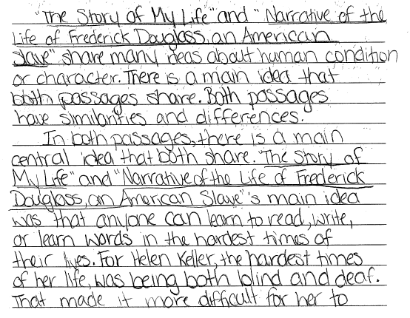
Grade 8 Extended-response Guide Paper 1a
Notes:
Refer participants to the Guide Paper 1 in their Grade 8 Extended-response (4-point) Sample Guide Set packet.
Read the entire response out loud to the participants.

Slide 157
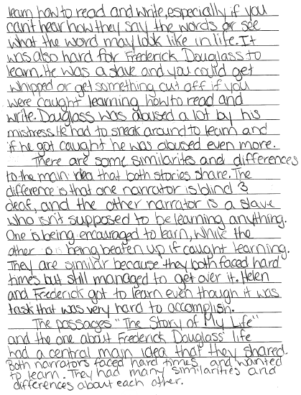
Grade 8 Extended-response Guide Paper 1b

Slide 158
Grade 8 Extended-response Guide Paper 1 Annotation
Score Point 4
This response clearly introduces a topic in a manner that follows logically from the task and purpose (There is a main idea that both passages share. Both passages have similarities and differences). The response demonstrates insightful analysis of the texts (“The Story of My Life” and “Narrative of the Life of Frederick Douglass, an American Slave”’s main idea was that anyone can learn to read, write, or learn words in the hardest times of their lives). The topic is developed with the sustained use of relevant, well-chosen evidence from the texts that is varied (For Helen Keller, the hardest times of her life, was being both blind and deaf. That made it more difficult for her to learn how to read and write, especially if you can’t hear how they way the words or see what the work may look like and He was a slave...He had to sneak around to learn and if he got caught he was abused even more). Clear organization is exhibited by the skillful use of appropriate and varied transitions (In both passages, That made it...especially if, It was also hard, One is being...while the other is being). The response maintains a formal style, using grade-appropriate and domain-specific vocabulary (the hardest times of their lives, abused, encouraged to learn, hard to accomplish). The concluding statement follows clearly from the topic and information presented (Both narrators faced hard times and wanted to learn). The response demonstrates grade-appropriate command of conventions, with few errors.
Notes:
Using the bulleted annotations marks that follow, review the score for the guide response and explain why the guide paper is the approved score, covering the information given in the annotation. Refer to the passage location while reviewing the annotation. The locations are noted below.
Be sure to use rubric language when explaining the score.
The score point for this response is 4.
This response clearly introduces a topic in a manner that follows logically from the task and purpose (There is a main idea that both passages share. Both passages have similarities and differences). [Paragraph 1, lines 4-6]
The response demonstrates insightful analysis of the texts (“The Story of My Life” and “Narrative of the Life of Frederick Douglass, an American Slave”’s main idea was that anyone can learn to read, write, or learn words in the hardest times of their lives). [Paragraph 2, lines 2-7]
The topic is developed with the sustained use of relevant, well-chosen evidence from the texts that is varied (For Helen Keller, the hardest times of her life, was being both blind and deaf. That made it more difficult for her to learn how to read and write, especially if you can’t hear how they way the words or see what the work may look like and He was a slave...He had to sneak around to learn and if he got caught he was abused even more). [Pg. 1 paragraph 2, line 7, pg. 2, line 3 and lines 5-10]
Clear organization is exhibited by the skillful use of appropriate and varied transitions (In both passages, That made it...especially if, It was also hard, One is being...while the other is being). [Throughout]
The response maintains a formal style, using grade-appropriate and domain-specific vocabulary (the hardest times of their lives, abused, encouraged to learn, hard to accomplish). [Throughout]
The concluding statement follows clearly from the topic and information presented (Both narrators faced hard times and wanted to learn).
The response demonstrates grade-appropriate command of conventions, with few errors.

Slide 159
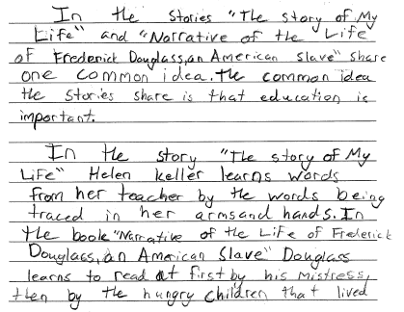
Grade 8 Extended-response Guide Paper 2a
Notes:
Refer participants to the Guide Paper 2 in their Grade 8 Extended-response (4-point) Sample Guide Set packet.
Read the entire response out loud to the participants.

Slide 160
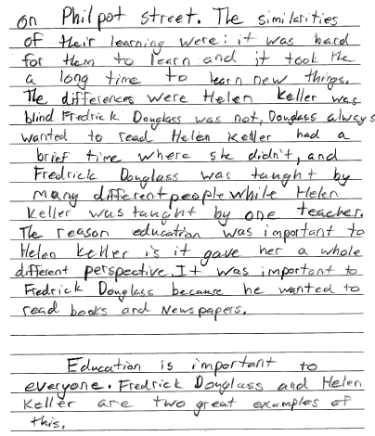
Grade 8 Extended-response Guide Paper 2b

Slide 161
Grade 8 Extended-response Guide Paper 2 Annotation
Score Point 4
This response clearly introduces a topic in a manner that follows logically from the task and purpose (The common idea the stories share is that education is important). The topic is developed with the sustained use of relevant, well-chosen evidence from the texts that is varied (Helen Keller learns words from her teacher by the words being traced in her arms and hands; Douglass learns to read at first by his mistress, then by the hungry children on Philpot street; Fredrick Douglass was taught by many different people while Helen Keller was taught by one teacher). Clear organization is exhibited by the skillful use of appropriate transitions (In the story, In the book, The similarities, The differences were, and, while, The reason) to create a unified whole. The response maintains a formal style, using grade-appropriate and domain-specific vocabulary (had a brief time, gave her a whole different perspective, two great examples of this). The concluding statement follows clearly from the topic and information presented (Education is important to everyone). The response demonstrates grade-appropriate command of conventions, with few errors.
Notes:
Using the bulleted annotations marks that follow, review the score for the guide response and explain why the guide paper is the approved score, covering the information given in the annotation. Refer to the passage location while reviewing the annotation. The locations are noted below.
Be sure to use rubric language when explaining the score.
The score point for this response is 4.
This response clearly introduces a topic in a manner that follows logically from the task and purpose (The common idea the stories share is that education is important). [1st paragraph, last sentence]
The topic is developed with the sustained use of relevant, well-chosen evidence from the texts that is varied (Helen Keller learns words from her teacher by the words being traced in her arms and hands; Douglass learns to read at first by his mistress, then by the hungry children on Philpot street; Fredrick Douglass was taught by many different people while Helen Keller was taught by one teacher). [1st pg., paragraph 2, lines 1-4, paragraph 2, 3rd line from the bottom to 1st line, 2nd page, and 2nd pg. lines 9-11]
Clear organization is exhibited by the skillful use of appropriate transitions (In the story, In the book, The similarities, The differences were, and, while, The reason) to create a unified whole. [Throughout]
The response maintains a formal style, using grade-appropriate and domain-specific vocabulary (had a brief time, gave her a whole different perspective, two great examples of this). [Throughout]
The concluding statement follows clearly from the topic and information presented (Education is important to everyone). [Last paragraph, 1st sentence]
The response demonstrates grade-appropriate command of conventions, with few errors.

Slide 162
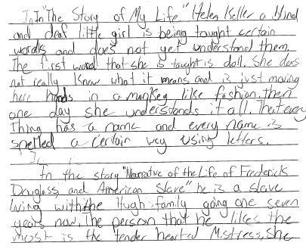
Grade 8 Extended-response Guide Paper 3a
Notes:
Refer participants to the Guide Paper 3 in their Grade 8 Extended-response (4-point) Sample Guide Set packet.
Read the entire response out loud to the participants.

Slide 163
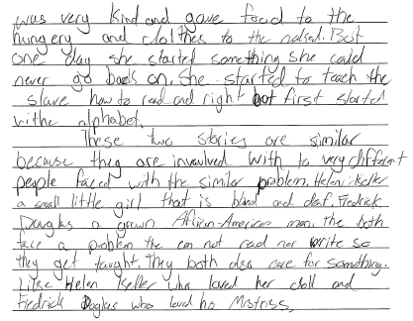
Grade 8 Extended-response Guide Paper 3b

Slide 164
Grade 8 Extended-response Guide Paper 3 Annotation
Score Point 3
This response clearly introduces a topic in a manner that follows from the task and purpose (In “The Story of My Life” Helen Keller is a and In the story “Narrative of the Life of Frederick Douglass, and American Slave” he is a slave). This response demonstrates grade-appropriate analysis of the texts (These two stories are similar because they are invaulved with to very different people faced with the similar problem). The topic is developed with relevant details from the texts (a blind and deaf little girl is being taught certain words and does not yet understand them...and is just moving her hands in a monkey like fashion and she started something she could never go back on...to teach the slave how to read and right but first started withe alphabet). The use of relevant evidence is sustained, with some lack of variety (Helen Keller a small little girl that is blind and deaf. Fredrick Douglas a grown African-American man. The both face a problem the can not read nor write). The response exhibits clear organization, with the use of appropriate transitions (The first, Then one day, In the story, But one day, They both also). A formal style is established by using precise language and domain-specific vocabulary (not yet understand, face a problem). The response demonstrates grade-appropriate command of conventions, with occasional errors (right for write, withe, invaulved, The for They) that do not hinder comprehension.
Notes:
Using the bulleted annotations marks that follow, review the score for the guide response and explain why the guide paper is the approved score, covering the information given in the annotation. Refer to the passage location while reviewing the annotation. The locations are noted below.
Be sure to use rubric language when explaining the score.
The score point for this response is 3.
This response clearly introduces a topic in a manner that follows from the task and purpose (In “The Story of My Life” Helen Keller is a and In the story “Narrative of the Life of Frederick Douglass, and American Slave” he is a slave). [1st paragraph, 1st sentence, 2nd paragraph, 1st sentence]
This response demonstrates grade-appropriate analysis of the texts (These two stories are similar because they are invaulved with to very different people faced with the similar problem). [3rd paragraph, 1st sentence]
The topic is developed with relevant details from the texts (a blind and deaf little girl is being taught certain words and does not yet understand them...and is just moving her hands in a monkey like fashion and she started something she could never go back on...to teach the slave how to read and right but first started withe alphabet). [1st paragraph, lines 1-6, and pg. 2, lines 3-6]
The use of relevant evidence is sustained, with some lack of variety (Helen Keller a small little girl that is blind and deaf. Fredrick Douglas a grown African-American man. The both face a problem the can not read nor write). [3rd paragraph, lines 3-6]
The response exhibits clear organization, with the use of appropriate transitions (The first, Then one day, In the story, But one day, They both also). [Paragraph 1, line 3]
A formal style is established by using precise language and domain-specific vocabulary (not yet understand, face a problem). [Paragraph 1, line 3 and paragraph 3, line 6]
The response demonstrates grade-appropriate command of conventions, with occasional errors (right for write, withe, invaulved, The for They) that do not hinder comprehension. [Throughout]

Slide 165
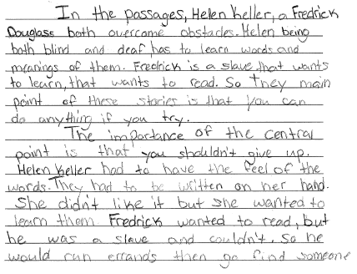
Grade 8 Extended-response Guide Paper 4a
Notes:
Refer participants to the Guide Paper 4 in their Grade 8 Extended-response (4-point) Sample Guide Set packet.
Read the entire response out loud to the participants.

Slide 166
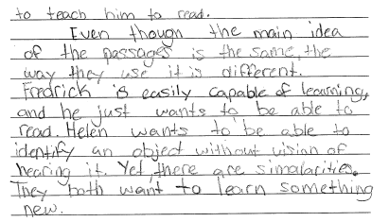
Grade 8 Extended-response Guide Paper 4b

Slide 167
Grade 8 Extended-response Guide Paper 4 Annotation
Score Point 3
This response clearly introduces a topic in a manner that follows from the task and purpose (Helen Keller, a Fredrick Douglass both overcome obstacles...they main point of these stories is that you can do anything if you try). This response demonstrates grade-appropriate analysis of the texts (the main idea of the passages is the same, the way they use it is different. Fredrick is easily capable of learning, and he just wants to be able to read. Helen wants to be able to identify an object without vision of hearing it). The topic is developed with relevant details from the texts (had to have the feel of the words. They had to be written on her hand and Fredrick wanted to read, but he was a slave and couldn’t. So he would run errands then go find someone to teach him to read). The use of relevant evidence is sustained, with some lack of variety (Helen wants to be able to identify an object without vision of hearing it). The response exhibits clear organization, with the use of appropriate transitions (The importance, So he would, Even though, Yet). A formal style is established and maintained using domain-specific vocabulary (easily capable of learning and identify an object without vision). The concluding statement follows from the topic and information presented (They both want to learn something new). The response demonstrates grade-appropriate command of conventions, with occasional errors that do not hinder comprehension.
Notes:
Using the bulleted annotations marks that follow, review the score for the guide response and explain why the guide paper is the approved score, covering the information given in the annotation. Refer to the passage location while reviewing the annotation. The locations are noted below.
Be sure to use rubric language when explaining the score.
The score point for this response is 3.
This response clearly introduces a topic in a manner that follows from the task and purpose (Helen Keller, a Fredrick Douglass both overcome obstacles...they main point of these stories is that you can do anything if you try). [1st paragraph, 1st and last sentence]
This response demonstrates grade-appropriate analysis of the texts (the main idea of the passages is the same, the way they use it is different. Fredrick is easily capable of learning, and he just wants to be able to read. Helen wants to be able to identify an object without vision of hearing it). [Paragraph 3, lines 1-8]
The topic is developed with relevant details from the texts (had to have the feel of the words. They had to be written on her hand and Fredrick wanted to read, but he was a slave and couldn’t. So he would run errands then go find someone to teach him to read). [Paragraph 2, lines 3-4 and paragraph 2, lines 6 – pg. 2, line 1]
The use of relevant evidence is sustained, with some lack of variety (Helen wants to be able to identify an object without vision of hearing it). [Paragraph 3, lines 6-8]
The response exhibits clear organization, with the use of appropriate transitions (The importance, So he would, Even though, Yet). A formal style is established and maintained using domain-specific vocabulary (easily capable of learning and identify an object without vision). [Paragraph 3, line 4 and paragraph 3, line 7]
The concluding statement follows from the topic and information presented (They both want to learn something new). [Last sentence]
The response demonstrates grade-appropriate command of conventions, with occasional errors that do not hinder comprehension.

Slide 168
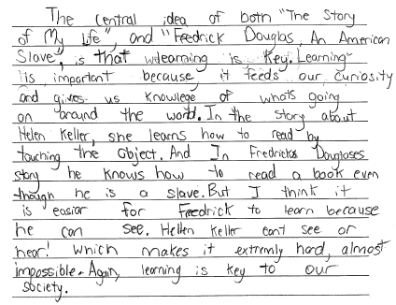
Grade 8 Extended-response Guide Paper 5
Notes:
Refer participants to the Guide Paper 5 in their Grade 8 Extended-response (4-point) Sample Guide Set packet.
Read the entire response out loud to the participants.

Slide 169
Grade 8 Extended-response Guide Paper 5 Annotation
Score Point 2
This response introduces a topic in a manner that follows generally from the task and purpose (The central idea of both... is that learning is key). The response demonstrates a literal comprehension of the texts (I think it is easiar for Fredrick to learn because he can see. Hellen Keller cant see or hear!). The topic is partially developed with the use of some textual evidence (she learns how to read by touching the object and In Fredrick Douglases story he knows how to read a book even though he is a slave). This response exhibits some attempt at organization, with inconsistent use of transitions (In the story, And In, But I think, Again). The concluding statement follows generally from the information presented (learning is key to our society). The response demonstrates an emerging command of conventions, with some errors (knowlege, whats, And In, Douglases, easiar, cant, extremly) that may hinder comprehension.
Notes:
Using the bulleted annotations marks that follow, review the score for the guide response and explain why the guide paper is the approved score, covering the information given in the annotation. Refer to the passage location while reviewing the annotation. The locations are noted below.
Be sure to use rubric language when explaining the score.
The score point for this response is 2.
This response introduces a topic in a manner that follows generally from the task and purpose (The central idea of both... is that learning is key). [Lines 1-3]
The response demonstrates a literal comprehension of the texts (I think it is easiar for Fredrick to learn because he can see. Hellen Keller cant see or hear!). [Lines 10-13]
The topic is partially developed with the use of some textual evidence (she learns how to read by touching the object and In Fredrick Douglases story he knows how to read a book even though he is a slave). [Lines 7-10]
This response exhibits some attempt at organization, with inconsistent use of transitions (In the story, And In, But I think, Again). [Lines 6, 8, 10, 14]
The concluding statement follows generally from the information presented (learning is key to our society). [Last sentence]
The response demonstrates an emerging command of conventions, with some errors (knowlege, whats, And In, Douglases, easiar, cant, extremly) that may hinder comprehension.
Note the differences between this score point 2 response and the score point 3 responses in the guide set. Ask the participants if the difference is clear to them.

Slide 170
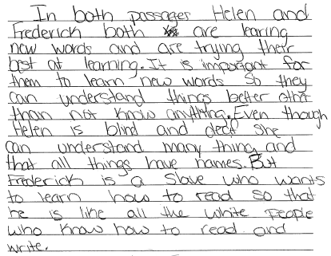
Grade 8 Extended-response Guide Paper 6
Notes:
Refer participants to the Guide Paper 6 in their Grade 8 Extended-response (4-point) Sample Guide Set packet.
Read the entire response out loud to the participants.

Slide 171
Grade 8 Extended-response Guide Paper 6 Annotation
Score Point 2
This response introduces a topic in a manner that follows generally from the task and purpose (In both passages Helen and Frederick both are learing new words and are trying their best at learning). The response demonstrates a literal comprehension of the texts (It is important for them to learn new words So they can understand things better other than not know anything). The topic is partially developed with the use of some textual evidence (Helen is blind and deaf she can understand many thing and that all things have names and Frederick is a slave who wants to learn how to read so that he is like all the white people who know how). This response exhibits some attempt at organization, with inconsistent use of transitions (Even though and But). A formal style is not maintained, with inconsistent use of domain-specific vocabulary (understand things better, understand many thing, all things). The response demonstrates grade-appropriate command of conventions, with occasional errors that do not hinder comprehension.
Notes:
Using the bulleted annotations marks that follow, review the score for the guide response and explain why the guide paper is the approved score, covering the information given in the annotation. Refer to the passage location while reviewing the annotation. The locations are noted below.
Be sure to use rubric language when explaining the score.
The score point for this response is 2.
This response introduces a topic in a manner that follows generally from the task and purpose (In both passages Helen and Frederick both are learing new words and are trying their best at learning). [1st sentence, lines 1-4]
The response demonstrates a literal comprehension of the texts (It is important for them to learn new words So they can understand things better other than not know anything). [Lines 4-7]
The topic is partially developed with the use of some textual evidence (Helen is blind and deaf she can understand many thing and that all things have names and Frederick is a slave who wants to learn how to read so that he is like all the white people who know how). [Lines 8-12]
This response exhibits some attempt at organization, with inconsistent use of transitions (Even though and But). [Lines 7, 10]
A formal style is not maintained, with inconsistent use of domain-specific vocabulary (understand things better, understand many thing, all things). [Lines 6, 9, and 10]
The response demonstrates grade-appropriate command of conventions, with occasional errors that do not hinder comprehension.

Slide 172
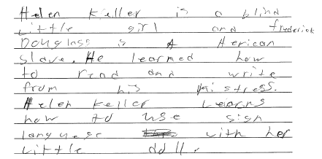
Grade 8 Extended-response Guide Paper 7
Notes:
Refer participants to the Guide Paper 7 in their Grade 8 Extended-response (4-point) Sample Guide Set packet.
Read the entire response out loud to the participants.

Slide 173
Grade 8 Extended-response Guide Paper 7 Annotation
Score Point 1
This response introduces a topic in a manner that follows generally from the task but demonstrates a little understanding of the texts (Helen Keller is a blind Little girl and frederick Douglass is a Aerican slave). The response demonstrates an attempt to use evidence (He learned how to read and write from his Mistress), but only develops ideas with minimal evidence (Helen Keller Learns how to use sign languege with her Little doll). This response exhibits little attempt at organization and lacks a formal style. The response demonstrates an emerging command of conventions, with some errors (Little, frederick, Aerican, languege) that may hinder comprehension.
Notes:
Using the bulleted annotations marks that follow, review the score for the guide response and explain why the guide paper is the approved score, covering the information given in the annotation. Refer to the passage location while reviewing the annotation. The locations are noted below.
Be sure to use rubric language when explaining the score.
The score point for this response is 1.
This response introduces a topic in a manner that follows generally from the task but demonstrates a little understanding of the texts (Helen Keller is a blind Little girl and frederick Douglass is a Aerican slave). [1st sentence, lines 1-4]
The response demonstrates an attempt to use evidence (He learned how to read and write from his Mistress), but only develops ideas with minimal evidence (Helen Keller Learns how to use sign languege with her Little doll). [Lines 4-6]
This response exhibits little attempt at organization and lacks a formal style.
The response demonstrates an emerging command of conventions, with some errors (Little, frederick, Aerican, languege) that may hinder comprehension. [Lines 7-10]
Note the differences between this score point 1 response and the score point 2 responses in the guide set. Ask the participants if the difference is clear to them.

Slide 174
Grade 8 Extended-response Guide Paper 8
Notes:
Refer participants to the Guide Paper 8 in their Grade 8 Extended-response (4-point) Sample Guide Set packet.
Read the entire response out loud to the participants.

Slide 175
Grade 8 Extended-response Guide Paper 8 Annotation
Score Point 1
This response introduces a topic in a manner that follows generally from the task (The authors central ideas is that life isn’t what it always seems). The response demonstrates little understanding of the texts (You have to find the time to learn from anyone). The response demonstrates an attempt to use minimal evidence (Words always has a meaning you just have to find it). The response exhibits little attempt at organization and does not provide a concluding statement. The response demonstrates an emerging command of conventions, with some errors (authors and Words always has) that may hinder comprehension.
Notes:
Using the bulleted annotations marks that follow, review the score for the guide response and explain why the guide paper is the approved score, covering the information given in the annotation. Refer to the passage location while reviewing the annotation. The locations are noted below.
Be sure to use rubric language when explaining the score.
The score point for this response is 1.
This response introduces a topic in a manner that follows generally from the task (The authors central ideas is that life isn’t what it always seems). [1st sentence, lines 1-2]
The response demonstrates little understanding of the texts (You have to find the time to learn from anyone). [Lines 4-5]
The response demonstrates an attempt to use minimal evidence (Words always has a meaning you just have to find it). [Lines 2-3]
The response exhibits little attempt at organization and does not provide a concluding statement.
The response demonstrates an emerging command of conventions, with some errors (authors and Words always has) that may hinder comprehension.

Slide 176
Grade 8 Extended-response Guide Paper 9
Notes:
Refer participants to the Guide Paper 9 in their Grade 8 Extended-response (4-point) Sample Guide Set packet.
Read the entire response out loud to the participants.

Slide 177
Grade 8 Extended-response Guide Paper 9 Annotation
Score Point 0
This response demonstrates a lack of comprehension of the task (in Both story’s its cool) and little understanding of the texts (if your bind and Deth you cant really no what stuff is and spell it and many slaves dont no how to read or right). There is no evidence of organization. This response uses imprecise language (no what stuff is) and does not provide a concluding statement. This response demonstrates a lack of command of conventions, with frequent errors that hinder comprehension (in, Both, Story’s, its, your, bind, Deth, cant, no, dont, right).
Notes:
Using the bulleted annotations marks that follow, review the score for the guide response and explain why the guide paper is the approved score, covering the information given in the annotation. Refer to the passage location while reviewing the annotation. The locations are noted below.
Be sure to use rubric language when explaining the score.
The score point for this response is 0.
This response demonstrates a lack of comprehension of the task (in Both story’s its cool) [Line 1] and little understanding of the texts (if your bind and Deth you cant really no what stuff is and spell it and many slaves dont no how to read or right). There is no evidence of organization. [Lines 2-6]
This response uses imprecise language (no what stuff is) and does not provide a concluding statement. [Lines 3-4]
This response demonstrates a lack of command of conventions, with frequent errors that hinder comprehension (in, Both, Story’s, its, your, bind, Deth, cant, no, dont, right). [Throughout]
Note the differences between this score point 0 response and the score point 1 responses in the guide set. Ask the participants if the difference is clear to them.

Slide 178
Grade 8 Extended-response Guide Paper 10
Notes:
Refer participants to the Guide Paper 10 in their Grade 8 Extended-response (4-point) Sample Guide Set packet.
Read the entire response out loud to the participants.

Slide 179
Grade 8 Extended-response Guide Paper 10 Annotation
Score Point 0
This response demonstrates a lack of comprehension of the task (In both of the passages...One of the differeces was that the setting was very different) and little understanding of the texts (in “The Story of My life the kid got a doll). There is no evidence of organization and no concluding statement. The response demonstrates an emerging command of conventions, with some errors (life, One, differeces) that may hinder comprehension.
Notes:
Using the bulleted annotations marks that follow, review the score for the guide response and explain why the guide paper is the approved score, covering the information given in the annotation. Refer to the passage location while reviewing the annotation. The locations are noted below.
Be sure to use rubric language when explaining the score.
The score point for this response is 0.
This response demonstrates a lack of comprehension of the task (In both of the passages...One of the differeces was that the setting was very different) [Lines 1-4] and little understanding of the texts (in “The Story of My life the kid got a doll). There is no evidence of organization and no concluding statement. [Lines 4-5]
The response demonstrates an emerging command of conventions, with some errors (life, One, differeces) that may hinder comprehension.

Slide 180
Q&A
Notes:
Ask the participants if they have any questions about the guide set.
Ask the participants if the distinctions between the score points is clearly illustrated in the guide set.

Slide 181
Grade 8 Extended-response
(4-point) Practice Set
Notes:
In this section of the training the participants will have an opportunity to practice scoring some 4-point responses.
Time estimate:
30 minutes

Slide 182
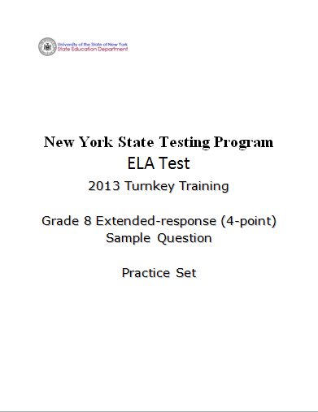
Notes:
Refer participants to the Grade 8 Extended-response (4-Point) Sample Question Practice Set packet.
Give the group 15-20 minutes to read and score the five practice responses. Remind participants to work independently and reference their guide papers while they score.
When all the participants have finished scoring the five papers, pass out the annotations for the practice set and go over each paper individually. Read each response and give the score, explaining why each response achieved the score it received.
Move forward when the 15 minutes is up or all participants have completed the scoring activity.

Slide 183
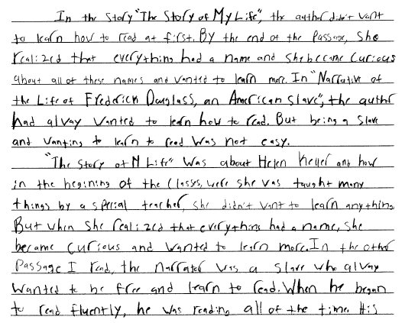
Grade 8 Extended-response Practice Paper 1a
Notes:
Refer participants to the Practice Paper 1 in their Grade 8 Extended-response (4-point) Sample Guide Set packet.
Read the entire response to the participants.

Slide 184
Grade 8 Extended-response Practice Paper 1b

Slide 185
Grade 8 Extended-response Practice Paper 1 Annotation
Score Point 3
This response clearly introduces a topic in a manner that follows from the task and purpose (she became curious about all of these names and wanted to learn more...being a slave and wanting to learn to read was not easy). This response demonstrates grade-appropriate analysis of the texts (Both narrater’s had dreams that were very hard to accomplish but they both acheived everything that they set out for). The topic is developed with relevant details from the texts (she was taught many things by a special teacher, she didn’t want to learn anything. But when she realized that everything had a name, she became curious and wanted to learn more and he began to read fluently, he was reading all of the time. His owner did not like the fact that of his slaves could read. The owners wife was the same way). The response exhibits clear organization, with the use of appropriate transitions (But when, In the other passage, When he began, In both of the stories). A formal style is established and maintained using domain-specific vocabulary (a special teacher, became curious, to read fluently). The concluding statement follows from the topic and information presented (In both of the stories that I read today, the topic was the wanting of knowledge). The response demonstrates grade-appropriate command of conventions, with occasional errors that do not hinder comprehension.
Notes:
Using the bulleted annotations marks that follow, review the score for the guide response and explain why the guide paper is the approved score, covering the information given in the annotation. Refer to the passage location while reviewing the annotation. The locations are noted below.
Be sure to use rubric language when explaining the score.
The score point for this response is 3.
This response clearly introduces a topic in a manner that follows from the task and purpose (she became curious about all of these names and wanted to learn more...being a slave and wanting to learn to read was not easy). [Paragraph 1, lines 3-7]
This response demonstrates grade-appropriate analysis of the texts (Both narrater’s had dreams that were very hard to accomplish but they both acheived everything that they set out for). [Page 2, line s 4-6]
The topic is developed with relevant details from the texts (she was taught many things by a special teacher, she didn’t want to learn anything. But when she realized that everything had a name, she became curious and wanted to learn more and he began to read fluently, he was reading all of the time. His owner did not like the fact that of his slaves could read. The owners wife was the same way). [Paragraph 2, lines 2-5 and paragraph 2, lines 7 to pg. 2, line 2]
The response exhibits clear organization, with the use of appropriate transitions (But when, In the other passage, When he began, In both of the stories). [Throughout]
A formal style is established and maintained using domain-specific vocabulary (a special teacher, became curious, to read fluently). [Paragraph 2, lines, 3, 5, and 8]
The concluding statement follows from the topic and information presented (In both of the stories that I read today, the topic was the wanting of knowledge). [Paragraph 3, line 1 and 2]
The response demonstrates grade-appropriate command of conventions, with occasional errors that do not hinder comprehension.

Slide 186
Grade 8 Extended-response Practice Paper 2a
Notes:
Read the entire response out loud to the participants.

Slide 187
Grade 8 Extended-response Practice Paper 2b

Slide 188
Grade 8 Extended-response Practice Paper 2 Annotation
Score Point 4
This response clearly introduces a topic in a manner that follows logically from the task and purpose (a central idea is formed that comprehention of words is important). The response demonstrates insightful analysis of the texts that is varied (They had to have teachers teach them instead of teaching themselves. But Hellen Keller had a teacher while Frederick Douglass had to take matters into his own hands). The topic is developed with the sustained use of relevant, well-chosen evidence from the texts (Once she understood that everything had a name she was eager to learn. When she understood this, she realized what she did to the doll and started to feel sad and He was so desperate to learn that he would do errands extra quick so one of the boys on the street could teach him in exchange for food. Frederick took his book with him everywhere just in case he had extra time). Clear organization is exhibited by the skillful use of appropriate and varied transitions (Once she understood, When she, But it was, Both, Also the two). The response maintains a formal style, using grade-appropriate and domain-specific vocabulary (eager to learn, realized, go hand and hand, desperate to learn, motives of these two people, take matters into his own hands). The concluding statement follows clearly from the topic and information presented (These two people wanted to learn how to understand words. It was importent to them both in different ways). The response demonstrates grade-appropriate command of conventions, with few errors.
Notes:
Using the bulleted annotations marks that follow, review the score for the guide response and explain why the guide paper is the approved score, covering the information given in the annotation. Refer to the passage location while reviewing the annotation. The locations are noted below.
Be sure to use rubric language when explaining the score.
The score point for this response is 4.
This response clearly introduces a topic in a manner that follows logically from the task and purpose (a central idea is formed that comprehention of words is important). [Paragraph 1, lines 3-5]
The response demonstrates insightful analysis of the texts that is varied (They had to have teachers teach them instead of teaching themselves. But Hellen Keller had a teacher while Frederick Douglass had to take matters into his own hands). [Paragraph 4, line s4-7]
The topic is developed with the sustained use of relevant, well-chosen evidence from the texts (Once she understood that everything had a name she was eager to learn. When she understood this, she realized what she did to the doll and started to feel sad and He was so desperate to learn that he would do errands extra quick so one of the boys on the street could teach him in exchange for food. Frederick took his book with him everywhere just in case he had extra time). [Paragraph 2, lines 3-6 and pg. 2, lines 2-7]
Clear organization is exhibited by the skillful use of appropriate and varied transitions (Once she understood, When she, But it was, Both, Also the two). [Throughout]
The response maintains a formal style, using grade-appropriate and domain-specific vocabulary (eager to learn, realized, go hand and hand, desperate to learn, motives of these two people, take matters into his own hands). [Throughout]
The concluding statement follows clearly from the topic and information presented (These two people wanted to learn how to understand words. It was importent to them both in different ways). [Last paragraph]
The response demonstrates grade-appropriate command of conventions, with few errors.

Slide 189
Grade 8 Extended-response Practice Paper 3
Notes:
Read the entire response out loud to the participants.

Slide 190
Grade 8 Extended-response Practice Paper 3 Annotation
Score Point 2
This response introduces a topic in a manner that follows generally from the task and purpose (“The Story of My Life” and “Narrative of the Life of Frederick Douglas, an American Slave” share many similarities and differences). The response demonstrates a literal comprehension of the texts (Fredrick was a slave, but Hellen wasn’t). The response demonstrates an attempt to use evidence (both are permantly affected by some of these hardships...These two people went through a lot, but they gave it their best shot). This response exhibits some attempt at organization, with inconsistent use of transitions (Some of the similarities, They also, The differnces, Another difference). A formal style is not maintained, with inconsistent use of domain-specific vocabulary (went through a lot and able to learn easy). The response demonstrates grade-appropriate command of conventions, with occasional errors that do not hinder comprehension.
Notes:
Using the bulleted annotations marks that follow, review the score for the guide response and explain why the guide paper is the approved score, covering the information given in the annotation. Refer to the passage location while reviewing the annotation. The locations are noted below.
Be sure to use rubric language when explaining the score.
The score point for this response is 2.
This response introduces a topic in a manner that follows generally from the task and purpose (“The Story of My Life” and “Narrative of the Life of Frederick Douglas, an American Slave” share many similarities and differences). [All of paragraph 1]
The response demonstrates a literal comprehension of the texts (Fredrick was a slave, but Hellen wasn’t). [Paragraph 3, lines 1-2] The response demonstrates an attempt to use evidence (both are permantly affected by some of these hardships...These two people went through a lot, but they gave it their best shot). [Paragraph 2, lines 3-6]
This response exhibits some attempt at organization, with inconsistent use of transitions (Some of the similarities, They also, The differnces, Another difference). A formal style is not maintained, with inconsistent use of domain-specific vocabulary (went through a lot and able to learn easy). [Paragraph 2, lines 2-3]
The response demonstrates grade-appropriate command of conventions, with occasional errors that do not hinder comprehension. [Paragraph 2, line 6 and last line]
Compare this response to the score point 2 responses in the guide set – how the concepts illustrated in the guide papers are present in this practice response.

Slide 191
Grade 8 Extended-response Practice Paper 4a
Notes:
Read the entire response out loud to the participants.

Slide 192
Grade 8 Extended-response Practice Paper 4b
Notes:
As time allows, instruct participants to perform a Talk and Turn:
Turn to a fellow participant and discuss the score point you have given the response using the rubric as a guide.
Note evidence for your score point.
You will have 2 minutes to score the item.
Activate the timer.
After the allotted 2 minutes, ask a participant to share their score point and related evidence for the response.

Slide 193
Grade 8 Extended-response Practice Paper 4 Annotation
Score Point 3
This response clearly introduces a topic in a manner that follows from the task and purpose (The central idea is that once you understand what things mean, life seems more special and alive). This response demonstrates grade-appropriate analysis of the texts (Douglass was only a slave, he could see and hear, while Helen Keller was forevermore enslaved to her condition. Fredrick sought help while Helen just recieved it). The topic is developed with relevant details from the texts (She learned what things like water, sunshine, clothing, objects and living things were. She felt no repentance for her bad actions until she understood what she had really done. Knowing about her surroundings brought a new light into her life and his mistress would surely be enraged by his skill, he would gradually learn from others. He could understand what each word and letter meant, and it made him feel good). The response exhibits clear organization, with the use of appropriate transitions (too, Although he was, However, while). A formal style is established and maintained using stylistically sophisticated, domain-specific language (felt no repentance, a new light into her live forever after, ambition to learn, persisting). The concluding statement follows from the topic and information presented (a new meaning of life was the outcome of both of them). The response demonstrates grade-appropriate command of conventions, with occasional errors that do not hinder comprehension.
Notes:
Using the bulleted annotations marks that follow, review the score for the practice response and explain why the guide paper is the approved score, covering the information given in the annotation. Refer to the passage location while reviewing the annotation. The locations are noted below.
Use rubric language to review the score point explanation.
The score point for this response is 3.
This response clearly introduces a topic in a manner that follows from the task and purpose (The central idea is that once you understand what things mean, life seems more special and alive). [Pg. 1, lines 5-8]
This response demonstrates grade-appropriate analysis of the texts (Douglass was only a slave, he could see and hear, while Helen Keller was forevermore enslaved to her condition. Fredrick sought help while Helen just recieved it). [Pg 2, lines 16-20]
The topic is developed with relevant details from the texts (She learned what things like water, sunshine, clothing, objects and living things were. She felt no repentance for her bad actions until she understood what she had really done. Knowing about her surroundings brought a new light into her life and his mistress would surely be enraged by his skill, he would gradually learn from others. He could understand what each word and letter meant, and it made him feel good). Pg. 1, line 11, pg. 2, line 3 and page 2, line s 8-12]
The response exhibits clear organization, with the use of appropriate transitions (too, Although he was, However, while). [Throughout]
A formal style is established and maintained using stylistically sophisticated, domain-specific language (felt no repentance, a new light into her live forever after, ambition to learn, persisting). [Throughout]
The concluding statement follows from the topic and information presented (a new meaning of life was the outcome of both of them). [Last sentence]
The response demonstrates grade-appropriate command of conventions, with occasional errors that do not hinder comprehension.

Slide 194
Grade 8 Extended-response Practice Paper 5
Notes:
Read the entire response out loud to the participants.

Slide 195
Grade 8 Extended-response Practice Paper 5 Annotation
Score Point 1
This response introduces a topic that follows generally from the task (they both want you to want to learn). The response demonstrates little understanding of the texts (Both of the storys have sombody that is not equal to other people or feel like there not). The response provides no evidence, exhibits little attempt at organization, and lacks a concluding statement. The response demonstrates an emerging command of conventions, with some errors (storys, the, life, frederick, sombody, there) that may hinder comprehension.
Notes:
Using the bulleted annotations marks that follow, review the score for the guide response and explain why the guide paper is the approved score, covering the information given in the annotation. Refer to the passage location while reviewing the annotation. The locations are noted below.
Be sure to use rubric language when explaining the score:
The score point for this response is 1.
This response introduces a topic that follows generally from the task (they both want you to want to learn). [Lines 3-4]
The response demonstrates little understanding of the texts (Both of the storys have sombody that is not equal to other people or feel like there not). [Lines 4-7]
The response provides no evidence, exhibits little attempt at organization, and lacks a concluding statement. [Throughout]
The response demonstrates an emerging command of conventions, with some errors (storys, the, life, frederick, sombody, there) that may hinder comprehension. [Throughout]

Slide 196
Q&A
Notes:
Ask the participants if they have any questions about the practice responses and the scores they received.
Ask if the participants see how the practice papers align with the rubric and guide papers.

Slide 197
Summary
Define holistic scoring and how scoring differs from grading.
Review of the new ELA constructed-response rubrics (2-point for all grades, 4-point rubrics for grade 3, grades 4-5, grades 6-8).
Apply the new rubrics in guide and practice papers.
Notes:
Review the information covered in the ELA training session with the participants.
Time estimate:
5 minutes

Slide 198
Resources
For questions related to assessment:
Email your question to: emscassessinfo@mail.nysed.gov
Check for additional information at the following website http://www.p12.nysed.gov/apda/
For questions related to APPR
Email your question to: educatoreval@mail.nysed.gov
Additional information regarding the common core shifts can be found at the following website:
http://engageny.org/resource/common-core-shifts/
Notes:
Point out the available resources.
Cover any “parking lot” issues/questions that were tabled during the presentation.
A video of this training has been created and will be available, along with the handouts, on EngageNY.
Thank the participants for being engaged in the training, which covered a lot of material.

