Slide 1





New York State 2013
Grades 3-8 Common Core Mathematics Rubric and Scoring Turnkey Training
Notes:
Introduce the presenters.
Ensure participants have a copy of the PowerPoint and the four sample question and student response sets.
Cover the general purpose of the Turnkey Training sessions: To give participants a thorough understanding of the new NY test constructed-response rubrics, how to apply them, and giving them the ability to perform this training in their districts.
Time estimate:
4 minutes

Slide 2
Housekeeping and Logistics
9:00-3:00
Morning and afternoon break
Lunch
Restrooms
Emergency exit locations
“Parking Lot” and Resources
2
Notes:
Take a minute to review the housekeeping and logistics for today’s training:
Today’s session will be from 9:00 until 3:00.
We will have a fifteen minute break in the morning and a fifteen minute break in the afternoon.
We will have one hour for lunch. Share suggested locations.
Review nearest restroom locations.
Review the emergency exit locations.
Review the nearest vending machines/snack bar locations.
Explain the use of the parking lot and resources you will be providing:
As we go through the training, questions will arise that we can’t answer today.
Make note of those questions and add them to our Parking Lot (point to this location).
At the end of the training, we will gather these questions and post a list of Frequently Asked Questions and their answers along with the training materials on our site.
In addition, at the end of this training, there is a slide that provides a list of resources where you can access additional information.

Slide 3

Welcome and Introductions
3
Notes:
Welcome! Today we will get an up close look at the new NYS 2-point and 3-point math rubrics and have an opportunity to apply them to sets of student responses to sample test questions measuring the NYS Common Core Math Standards.
Before we begin, it is worth taking a moment to frame our minds around the reason why we are making these changes – to truly prepare our students for college and careers – and how we are going to do this – through a new set of standards – the Common Core – and the instructional shifts. We have all grown considerably with our familiarity with these shifts, so instead of doing a training on them we are going to quickly review how these shifts will be evident in tests so that we are in a Common Core frame of mind when applying these rubrics for the first time.
Time estimate:
8 minutes

Slide 4
Instructional Shifts
Shift 1
Focus
Notes:
So to ensure we are all on the same page but to do so very briefly, if Shift 1 calls for Focus, teachers significantly narrow and deepen the scope of how time and energy is spent in the math classroom. They do so in order to focus deeply on only the concepts that are prioritized in the standards. In terms of test, priority standards will be the focus. Other standards will be deemphasized.

Slide 5
Instructional Shifts
Shift 1
Focus
Shift 2
Coherence
Notes:
If Shift 2 calls for Coherence, principals and teachers are being asked to carefully connect the learning within and across grades so that students can build new understanding onto foundations built in previous years. In terms of test, we will see this reflected through the progression of content and concepts as depicted in the standards across grade levels. Because of the way math works, if they have learned it before, they may have to use it with topics in later grades (such as using fractions learned in 3rd grade with measurement standards in 5th grade.)

Slide 6
Instructional Shifts
Shift 1
Focus
Shift 2
Coherence
Shift 3
Fluency
Notes:
With Shift 3 being Fluency, students are expected to have speed and accuracy with simple calculations; teachers structure class time and/or homework time for students to memorize, through repetition, core functions. Test implications involve an assumption that students possess the required fluencies as articulated through grade 8; this will be reflected in test questions by the number choices in real world problems.

Slide 7
Instructional Shifts
Shift 1
Focus
Shift 2
Coherence
Shift 3
Fluency
Shift 4
Deep Understanding
Notes:
With Shift 4, Deep Understanding, students deeply understand and can operate easily within a math concept before moving on. As we recall, students learn more than the trick to get the answer right. They learn the math. For the test, each standard will be assessed from multiple perspectives, while not veering from the primary target of measurement for the standard. Not only will questions infuse additional standards beyond the targeted standard, each standard will be tested in many different ways.

Slide 8
Instructional Shifts
Shift 1
Focus
Shift 2
Coherence
Shift 3
Fluency
Shift 4
Deep Understanding
Shift 5 & 6
Application and Dual Intensity
Notes:
And finally, with Shifts 5&6, Application and Dual Intensity, students are expected to use math and choose the appropriate concept for application even when they are not prompted to do so, and students are practicing and understanding. There is more than a balance between these two things in the classroom – both are occurring with intensity. On tests, students will be expected to know grade-level mathematical content with fluency and to know which mathematical concepts to employ to solve real-world mathematics problems. In other words, students will not be explicitly prompted, and they will see minimal scaffolding on tests.

Slide 9
Reflection of the Shifts in the Test Questions
When we compare the tests from the past with the present, we see that:
Questions from previous tests were simpler, one or two steps, or were heavily scaffolded. The new questions will requires multiple steps involving the interpretation of operations.
Questions from the past were heavy on pure fluency in isolation. The new questions require conceptual understanding and fluency in order to complete test questions.
Questions from past tests isolated the math. The new problems are in a real world problem context.
Questions of old relied more on the rote use of a standard algorithm for finding answers to problems. The new questions require students to do things like decompose numbers and/or shapes, apply properties of numbers, and with the information given in the problem reach an answer. Relying solely on algorithms will not be sufficient.
Notes:
When we compare the tests from the past with the present, we see that:
Questions from previous tests were simpler, one or two steps, or were heavily scaffolded. The new questions will require multiple steps involving the interpretation of operations.
Questions from the past were heavy on pure fluency in isolation. The new questions require conceptual understanding and fluency in order to complete test questions.
Questions from past tests isolated the math. The new problems are in a real world problem context.
Questions of old relied more on the rote use of a standard algorithm for finding answers to problems. The new questions require students to do things like decompose numbers and/or shapes, apply properties of numbers, and with the information given in the problem reach an answer. Relying solely on algorithms will not be sufficient.
These are the types of things we will be seeing today, and the rubrics will score accordingly. So now let’s get to the reason why we are here – the rubrics and their application.

Slide 10

The New Math 2- and 3-point Holistic Rubrics and Scoring Policies
Notes:
This training session will focus on holistically scoring student responses based on the new Common Core mathematics questions, constructed-response rubrics, and scoring policies.

Slide 11
Our Goals
Define holistic scoring and how it differs from typical grading.
Review the rubrics/scoring policies and sample student responses in detail:
    2-point holistic rubric
    3-point holistic rubric
    Scoring policies
    Review approved guide responses
Practice scoring student examples.
Notes:
Review the goals for the math training session with the participants:
Define holistic scoring and bias: 10 minutes
Review the new rubrics: 5 minutes per rubric
Review the scoring policies: 15 minutes
Review guide responses: 20 – 30 minutes per Short-response question; 30 – 40 minutes per Extended-response question
Practice scoring: 15 minutes per question
Summary: 5 minutes

Slide 12

Holistic Scoring
Notes:
This section of the training discusses holistic scoring vs. grading student responses.
Time estimate:
10 minutes

Slide 13
Holistic Scoring
Holistic scoring assigns a single, overall test score for a response as a whole.
The single score reflects the level of understanding the student demonstrates in the response.
To score holistically, you must look at the entire response, rather than evaluating the parts or individual attributes separately.
A response may have some attributes of adjacent score points, but you must assign the score that best describes the response as a whole – the “best fit” score.
Notes:
It is important to understand holistic scoring.
Holistic scoring assigns a single score to a response that reflects the overall level of understanding demonstrated. Holistic scoring does not assign points for parts and is not punitive, marking down for each individual error. The score assigned to a response indicates the level of understanding – thorough, partial, limited or not sufficient for even limited – demonstrated by that response.

Slide 14
Holistic Scoring (Continued)
When scoring holistically:
Read thoroughly to assess the level of understanding demonstrated.
Assign the score that best reflects the level of understanding the response demonstrates.
Keep in mind that some errors may detract from the level of understanding demonstrated and other errors may not detract.
Compare each response to the rubric and training papers.
Notes:
When scoring, compare each student response to the guide and practice papers. The score assigned to the student response is based on the score assigned to the training paper it most closely matches, not on how it compares to the previous response or your own standards.
Guard against the danger of comparing the ‘current student response’ you are scoring to the ‘previous student response’. Compare each response to the guide or practice set to determine its score. Doing otherwise will cause your scoring to drift.

Slide 15
Scoring versus Grading
Scoring a state test is quite different from grading classroom papers.
Scoring
    A response is assessed based on the demonstrated level of understanding and how it compares to the rubric and training papers.
Grading
    Individual errors are totaled to determine the grade assigned.
Notes:
Scoring a state test is quite different from grading classroom papers. When scoring holistically, a response is assessed based on the demonstrated level of understanding and how it compares to the rubric and training papers. When grading classroom papers, individual errors are totaled to determine the grade assigned.
When grading one purpose is to provide feedback on areas that need improvement – so a student can work on those areas – as well as identify conceptual strengths. The purpose of scoring is to assess a student’s demonstrated level of understanding at a specific point in time. This is why it is important to weigh and balance what a student does well with areas for improvement to find the best-fit score for a response.

Slide 16
Scoring versus Grading (Continued)
Remember: You are scoring, not grading.
Set aside your own grading practices while scoring.
Determine scores based only on the work in the student booklet, using state standards—not classroom standards—to score responses accurately, fairly, and consistently.
Notes:
Remembering that you are scoring—not grading—is essential. Although you may be experienced in reviewing student work, you need to set aside your own grading practices while scoring. Determine scores based only on the work in the student booklet, using state standards – not classroom standards – to score student responses accurately, fairly, and consistently.

Slide 17
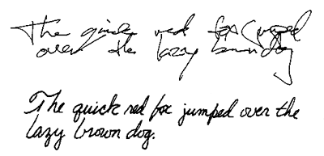
Guarding Against Scoring Biases
Appearance of response
The quality of the handwriting, the use of cursive or printing, margins, editing marks, cross-outs, and overall neatness are not part of the scoring criteria.
Response Length
Many factors can contribute to how long or short a response appears to be, including size and style of the handwriting, spacing, or placement on the page.
As you score, follow the standards of the guide papers and rubric rather than being influenced by the length of the response.
If the response fulfills the requirements defined by the guide for a specific score point, it should receive that score.
Notes:
Review common biases and ways to guard against them.

Slide 18
Guarding Against Scoring Biases (Continued)
Response Organization
Some responses will seem haphazardly or illogically organized. For many of these responses, however, the necessary work is present and can be followed. Your responsibility is to carefully examine such responses to determine whether the necessary steps and information are included.
Alternate Approaches
Students may use unique or unusual–yet acceptable–methods to solve mathematical problems. They may use methods not covered in training materials or not familiar to you as a scorer. Be sure to objectively evaluate all approaches based on the scoring standards, and ask your table leader if you have questions.
Notes:
Continue to review common biases and ways to guard against them.

Slide 19

Short-response (2-point)
Rubric and Scoring Policies
Notes:
We will next discuss the 2-point holistic rubric and the 2- and 3-point Scoring Policies.
Time estimate:
20 minutes

Slide 20
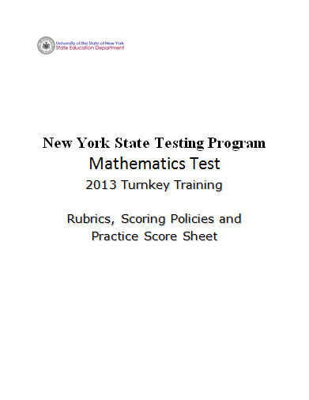
Notes:
Refer participants to the Rubrics, Scoring Policies and Practice Score Sheet packet.

Slide 21
Mathematics 2-point Holistic Rubric
Score Point | Description
2 Points | A two-point response answers the question correctly. This response demonstrates a thorough understanding of the mathematical concepts but may contain errors that do not detract from the demonstration of understanding indicates that the student has completed the task correctly, using mathematically sound procedures
1 Point | A one-point response is only partially correct. This response indicates that the student has demonstrated only a partial understanding of the mathematical concepts and/or procedures in the task correctly addresses some elements of the task may contain an incorrect solution but applies a mathematically appropriate process may contain correct numerical answer(s) but required work is not provided
0 Points | A zero-point response is incorrect, irrelevant, incoherent, or contains a correct response arrived using an obviously incorrect procedure. Although some parts may contain correct mathematical procedures, holistically they are not sufficient to demonstrate even a limited understanding of the mathematical concepts embodied in the task.
Notes:
Refer participants to the 2-point Holistic Rubric in their packet.
Explanation of 2-point, short-response, rubric.
The 2-point rubric applies to all grade 3 – 8 short-response questions. Responses that demonstrate ‘thorough understanding’, ‘partial understanding’, ‘incorrect, irrelevant, incoherent’ and ‘insufficient for limited understanding’ are further defined by the approved guide papers. It is important to understand the differences in the language at each score point on the rubric. The Guide papers will show how the student responses are held to the criteria in the rubric.

Slide 22
Mathematics 2-point Holistic Rubric (Continued)
Score Point | Description
2 Points | A two-point response answers the question correctly. This response demonstrates a thorough understanding of the mathematical concepts but may contain errors that do not detract from the demonstration of understanding indicates that the student has completed the task correctly, using mathematically sound procedures
Notes:
Read through the rubric. Read all text from score point 2 first and then move down the score scale.
A two-point response answers the question correctly and demonstrates a thorough understanding. A two-point response may not necessarily be without minor errors.
Note the 2-point description is changed from “…complete and correct” in the old rubric to “…answers the question correctly” in the Common Core based rubric. A 2-point response will still have the correct answer, but does not have to be flawless if a thorough understanding is clearly demonstrated.

Slide 23
Mathematics 2-point Holistic Rubric (Continued)
Score Point | Description
1 Point | A one-point response is only partially correct. This response indicates that the student has demonstrated only a partial understanding of the mathematical concepts and/or procedures in the task correctly addresses some elements of the task may contain an incorrect solution but applies a mathematically appropriate process may contain correct numerical answer(s) but required work is not provided
Notes:
Note the differences between score point 2 language and score point 1 language as you discuss score point 1 from the rubric.

Slide 24
Mathematics 2-point Holistic Rubric (Continued)
Score Point | Description
0 Points | A zero-point response is incorrect, irrelevant, incoherent, or contains a correct response arrived using an obviously incorrect procedure. Although some parts may contain correct mathematical procedures, holistically they are not sufficient to demonstrate even a limited understanding of the mathematical concepts embodied in the task.
Notes:
Read and explain the 0 point score point.

Slide 25
2- and 3-point Mathematics Scoring Policies
Below are the policies to be followed while scoring the mathematics tests for all grades:
If a student does the work in other than a designated “Show your work” area, that work should still be scored. (Additional paper is an allowable accommodation for a student with disabilities if indicated on the student’s Individualized Education Program or Section 504 Accommodation Plan.)
If the question requires students to show their work, and the student shows appropriate work and clearly identifies a correct answer but fails to write that answer in the answer blank, the student should still receive full credit.
If the question requires students to show their work, and the student shows appropriate work and arrives at the correct answer but writes an incorrect answer in the answer blank, the student should not receive full credit.
In questions that provide ruled lines for students to write an explanation of their work, mathematical work shown elsewhere on the page should be considered and scored.
If the student provides one legible response (and one response only), teachers should score the response, even if it has been crossed out.
Notes:
The pre-Common Core Scoring Polices and Scoring Clarifications have been reduced from 23 to 12 policy statements for the Common Core based test. Make special note that only the policies in this document may be used when scoring student responses based on the Common Core Standards.
Read through the scoring policies.
Policy 4 is modified from the previous policy, where work outside the ruled lines could not be considered.

Slide 26
2- and 3-point Mathematics Scoring Policies (Continued)
If the student has written more than one response but has crossed some out, teachers should score only the response that has not been crossed out.
Trial-and-error responses are not subject to Scoring Policy #6 above, since crossing out is part of the trial-and-error process.
If a response shows repeated occurrences of the same conceptual error within a question, the student should not be penalized more than once.
In questions that require students to provide bar graphs:
    In Grades 3 and 4 only, touching bars are acceptable.
    In Grades 3 and 4 only, space between bars does not need to be uniform.
    In all grades, widths of the bars must be consistent.
    In all grades, bars must be aligned with their labels.
    In all grades, scales must begin at zero (0), but the 0 does not need to be written.
Notes:
Read through the scoring policies.

Slide 27
2- and 3-point Mathematics Scoring Policies (Continued)
In questions requiring number sentences, the number sentences must be written horizontally.
In pictographs, the student is permitted to use a symbol other than the one in the key, provided that the symbol is used consistently in the pictograph; the student does not need to change the symbol in the key. The student may not, however, use multiple symbols within the chart, nor may the student change the value of the symbol in the key.
If students are not directed to show work, any work shown will not be scored. This applies to items that do not ask for any work and items that ask for work for one part and do not ask for work in another part.
Notes:
Read through the scoring policies.

Slide 28
Q&A
Notes:
Ask teachers if there are any questions with regards to the new Common Core aligned rubric and scoring policies. Keep discussion to the text provided in these documents. Allow the following training responses to clarify text in the rubric and Scoring Policies documents.

Slide 29

Grade 6 Short-response (2-point)
Sample Question Guide Set
Notes:
We will now look at student responses to the grade 6 2-point question.
Refer participants to the Grade 6 Short-response (2-point) Sample Guide Set packet.
We will review eight guide papers before we practice scoring five student responses.
The first page after the cover sheet is the question. The second page is the Common Core Learning Standard the question assesses. (Show the next slide.)
Time estimate:
20 minutes

Slide 30
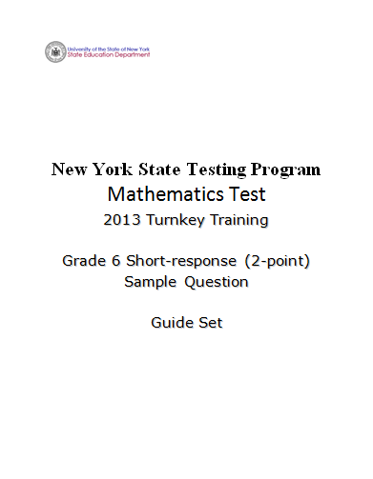
Notes:
Refer participants to the Grade 6 Short-response (2-point) Sample Guide Set packet.

Slide 31
Grade 6 Short-response Question
What is the value of 2x³ + 4x² – 3x² – 6x when x = 3?
Show your work.
Answer ____________________
1
Notes:
Refer participants to the question in the Grade 6 Short-response (2-point) Sample Guide Set packet.
Show briefly and explain to teachers that this is a sample of a grade 6 0 – 2-point question that is aligned with Common Core learning standard 6.EE.2c, Evaluate expressions at specific values of their variables. Include expressions that arise from formulas used in real-world problems. Perform arithmetic operations, including those involving whole-number exponents, in the conventional order when there are no parentheses to specify a particular order (Order of Operations). For example, use the formulas V = s³ and A = 6s² to find the volume and surface area of a cube with sides of length s = ½.
Move to next slide.

Slide 32
Grade 6 Short-response
Common Core Learning Standard Assessed
CCLS 6.EE.2c
Evaluate expressions at specific values of their variables. Include expressions that arise from formulas used in real-world problems. Perform arithmetic operations, including those involving whole-number exponents, in the conventional order when there are no parentheses to specify a particular order (Order of Operations). For example, use the formulas
V = s³ and A = 6s² to find the volume and surface area of a cube with sides of length s = ½.
Notes:
Read aloud to participants. Ask if there are questions. A second training option is to read the standard to participants.

Slide 33
Grade 6 Short-response Question
What is the value of 2x³ + 4x² – 3x² – 6x when x = 3?
Show your work.
Answer ____________________
1
How would you answer this question?
Notes:
Take a couple minutes to think about how you would answer the question. (Allow participants 3 – 4 minutes to answer the question and reflect.)
Ask yourself what a typical 2-point student response might look like.
What will a typical 1-point and a common 0-point student response possibly look like.
Guide the discussion by asking a few teachers for potential ways they would answer the question.
Note: Calculators are permitted for all constructed-response questions in grades 6, 7 and 8.

Slide 34
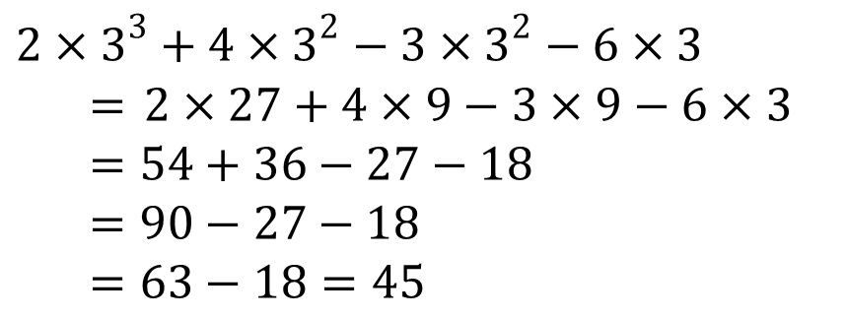
Grade 6 Short-response Exemplar
What is the value of 2x³ + 4x² – 3x² – 6x when x = 3?
Show your work.
Answer ____________________
1
45
Notes:
Talk through the response:
Three is correctly substituted into the expression. The exponential terms are simplified; the multiplication operations are completed; 54 and 36 are added; 27 is subtracted from 90; 18 is subtracted from 63; the answer is 45.
This is what we would expect as a common, but not the only, 2-point response.
Guide the discussion by asking a few teachers for other ways this question may be answered correctly or what we might expect as common 1-point and 0-point responses.

Slide 35
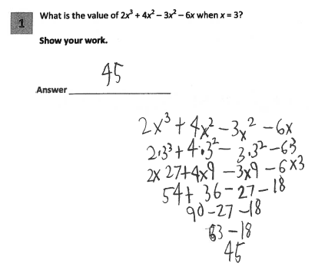
Grade 6 Short-response Guide Paper 1
Notes:
Refer participants to Guide Paper 1 in the Grade 6 Short-response (2-point) Sample Guide Set packet.
This is a 2-pt response; 3 is correctly substituted, the order of operations is followed and the calculations are correct.
Once teachers complete reading the response you may move onto the next page and discuss the annotation affiliated to this response. (This step will be repeated for all Guide papers.)
Guide papers interpret the rubrics and define the NYS scoring criteria for the question.

Slide 36
Grade 6 Short-response Guide Paper 1 Annotation
Score Point 2
This response answers the question correctly and demonstrates a thorough understanding of the mathematical concepts. Three is correctly substituted into the expression, the order of operations is correctly followed, all calculations and the final answer are correct.
Notes:
Direct the participants to read the annotation; ask if there are any questions. A second training option is to read or paraphrase the annotation for participants while viewing the response slide.
Make note that the annotations are used to describe the reasoning the response received the approved score using rubric language.

Slide 37
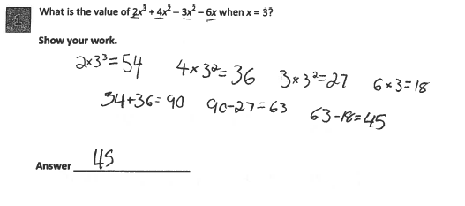
Grade 6 Short-response Guide Paper 2
Notes:
Refer participants to Guide Paper 2 in the Grade 6 Short-response (2-point) Sample Guide Set packet.
The value for each term is calculated separately; however, the calculations are all done in the proper order and correctly. The answer is correct.

Slide 38
Grade 6 Short-response Guide Paper 2 Annotation
Score Point 2
This response answers the question correctly and indicates that the student has completed the task correctly, using mathematically sound procedures. The individual operations are calculated separately; however, they are all done correctly and in the proper order, resulting in the correct answer.
Notes:
Direct the participants to read the annotation; ask if there are any questions. A second training option is to read or paraphrase the annotation for participants while viewing the response slide.

Slide 39
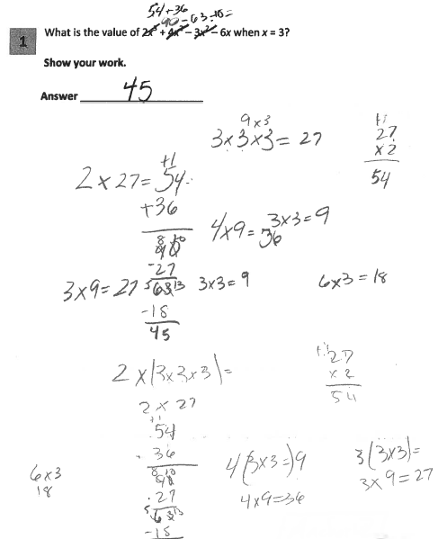
Grade 6 Short-response Guide Paper 3
Notes:
Refer participants to Guide Paper 3 in the Grade 6 Short-response (2-point) Sample Guide Set packet.
The value for each term is calculated separately; however, the calculations are all done in the proper order and correctly. The answer is correct.

Slide 40
Grade 6 Short-response Guide Paper 3 Annotation
Score Point 2
This response answers the question correctly and demonstrates a thorough understanding of the mathematical concepts. The individual operations are calculated separately; however, they are done correctly and in the proper order, resulting in the correct answer. One calculation shown is incorrect (4(3 × 3 =) 9), but the following line shows the correct calculation and this inaccurate statement within the work does not detract from the demonstration of a thorough understanding.
Notes:
Direct the participants to read the annotation; ask if there are any questions. A second training option is to read or paraphrase the annotation for participants while viewing the response slide.

Slide 41
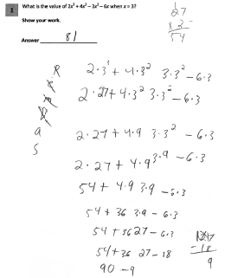
Grade 6 Short-response Guide Paper 4
Notes:
Refer participants to Guide Paper 4 in the Grade 6 Short-response (2-point) Sample Guide Set packet.
Three is correctly substituted into the expression; the operations on the exponents are performed first followed by the multiplication operations; 54 and 36 are correctly added. However, instead of subtracting 27 from 90 or subtracting 18 from -27, 18 is subtracted from 27. The absence of the first subtraction symbol does not detract from the partial understanding of the problem.

Slide 42
Grade 6 Short-response Guide Paper 4 Annotation
Score Point 1
This response is only partially correct. Three is correctly substituted into the expression; the operations on the exponents are performed first, followed by the multiplication operations. The numbers 54 and 36 are correctly added. However, instead of subtracting 27 from 90 or subtracting 18 from -27, 18 is subtracted from 27, resulting in an incorrect answer. The absence of the first subtraction symbol does not detract from the partial understanding of the problem.
Notes:
Direct the participants to read the annotation; ask if there are any questions. A second training option is to read or paraphrase the annotation for participants while viewing the response slide.

Slide 43
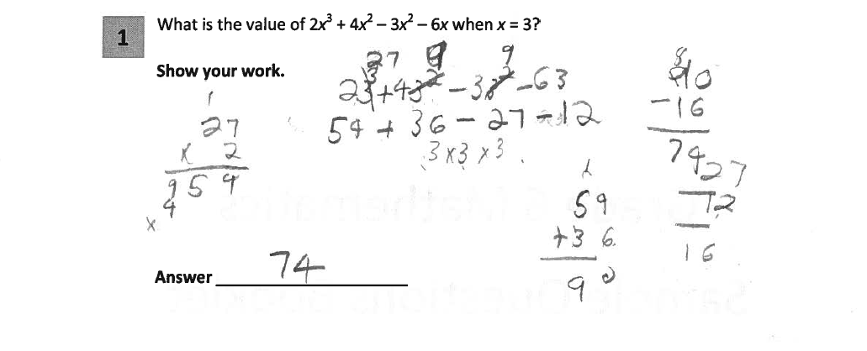
Grade 6 Short-response Guide Paper 5
Notes:
Refer participants to Guide Paper 5 in the Grade 6 Short-response (2-point) Sample Guide Set packet.
This response demonstrates only a partial understanding. Three is correctly substituted into the expression; the exponents are simplified first then the multiplication operations are completed. However, the multiplication error 6x3=12 and the subtraction error 27-12 =16 (should be -27-12) result in an incorrect answer. The absence of the multiplication symbols does not detract from the demonstrated level of understanding.

Slide 44
Grade 6 Short-response Guide Paper 5 Annotation
Score Point 1
This response is only partially correct. Three is correctly substituted into the expression, the exponents are simplified first and then the multiplication operations are completed. However, the multiplication error 6x3=12 and the subtraction error 27-12 =16 and the change of -27 to 27 result in an incorrect answer. The absence of the multiplication symbols does not detract from the demonstrated level of understanding.
Notes:
Direct the participants to read the annotation; ask if there are any questions. A second training option is to read or paraphrase the annotation for participants while viewing the response slide.

Slide 45
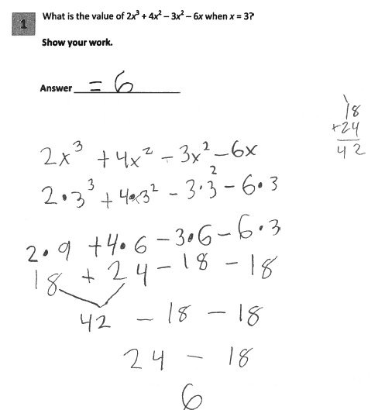
Grade 6 Short-response Guide Paper 6
Notes:
Refer participants to Guide Paper 6 in the Grade 6 Short-response (2-point) Sample Guide Set packet.
This response is only partially correct. Three is correctly substituted into the expression and the order of operations is correct. However, the simplification of the exponential terms is incorrect; the base is multiplied by the exponent. The answer is also incorrect.

Slide 46
Grade 6 Short-response Guide Paper 6 Annotation
Score Point 1
This response is only partially correct and indicates that the student has demonstrated only a partial understanding of the mathematical concepts in the task. Three is correctly substituted into the expression and the order of operations is correct. However, the simplification of the exponential terms is incorrect; the base is multiplied by the exponent. The resultant answer is also incorrect.
Notes:
Direct the participants to read the annotation; ask if there are any questions. A second training option is to read or paraphrase the annotation for participants while viewing the response slide.

Slide 47
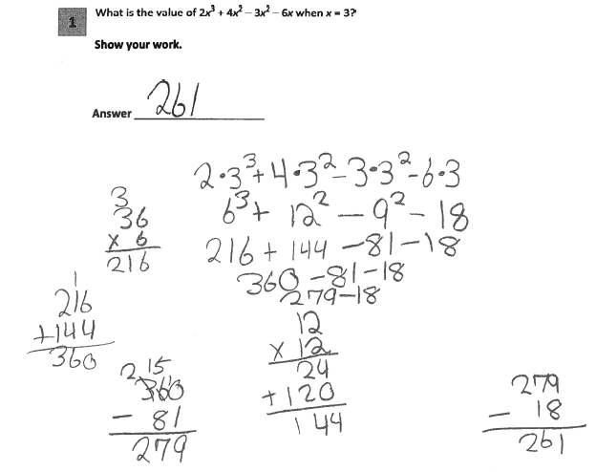
Grade 6 Short-response Guide Paper 7
Notes:
Refer participants to Guide Paper 7 in the Grade 6 Short-response (2-point) Sample Guide Set packet.
This response is incorrect. The order of operations is incorrect; the multiplication operations are completed prior to the exponent calculations.

Slide 48
Grade 6 Short-response Guide Paper 7 Annotation
Score Point 0
This response is incorrect. The order of operations is incorrect; the multiplication operations are completed prior to the exponent calculations.
Notes:
Direct the participants to read the annotation; ask if there are any questions. A second training option is to read or paraphrase the annotation for participants while viewing the response slide.

Slide 49
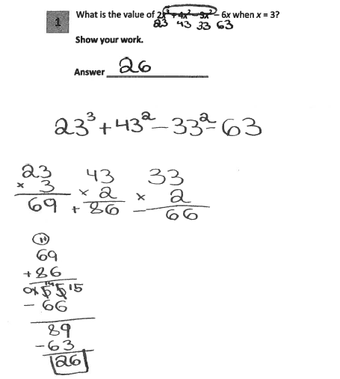
Grade 6 Short-response Guide Paper 8
Notes:
Refer participants to Guide Paper 8 in the Grade 6 Short-response (2-point) Sample Guide Set packet.
This response is incorrect. An incorrect procedure is used for the substitution of 3 into the expression, the exponents are incorrectly simplified, and the answer is incorrect.

Slide 50
Grade 6 Short-response Guide Paper 8 Annotation
Score Point 0
This response is incorrect. An incorrect procedure is used for the substitution of 3 into the expression, the exponents are incorrectly simplified, and the answer is incorrect.
Notes:
Direct the participants to read the annotation; ask if there are any questions. A second training option is to read or paraphrase the annotation for participants while viewing the response slide.

Slide 51
Q&A
Notes:
Ask participants if there are any questions about why each paper has its respective score.

Slide 52
Grade 6 Short-response (2-point)
Sample Question Practice Set
Notes:
Inform participants they will now practice scoring sample student responses, applying the rubric, scoring policies and guide papers.
Time estimate:
15 minutes

Slide 53
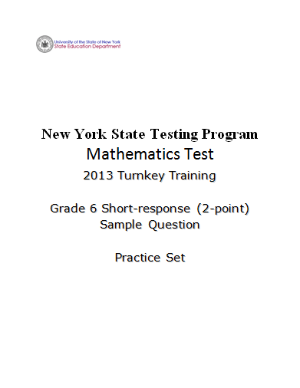
Notes:
Refer participants to the Grade 6 Short-response (2-Point) Sample Question Practice Set packet.
Have teachers read and score the entire practice set prior to reviewing the responses in the set.
For each response in the set you may ask teachers to raise their hands when you call the score they assigned.
Ask the group who thought the score of each response was a 0, 1, or 2.
Give teachers time to raise their hand prior to calling the next score point. This will give you an idea of where the bulk of the teachers feel this response fits.
If time allows, you can ask for a teacher to give the reason he or she assigned the selected score. Start with a teacher who assigned the response the approved score.

Slide 54
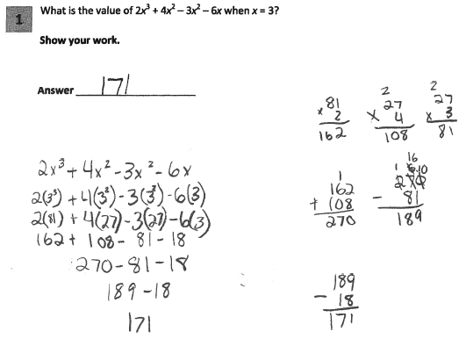
Grade 6 Short-response Practice Paper 1
Notes:
Refer participants to Practice Paper 1 in the Grade 6 Short-response (2-point) Sample Practice Set packet.
This response is only partially correct. The substitution is correctly made for x; however, the simplification of exponential terms is incorrect; an extra base value is multiplied by the product (3³ = 81 instead of 27; 3² = 27 instead of 9). The resultant answer is also incorrect.

Slide 55
Grade 6 Short-response Practice Paper 1 Annotation
Score Point 1
This response is only partially correct and indicates that the student has demonstrated only a partial understanding of the mathematical concepts in the task. The substitution is correctly made for x; however, the simplification of exponential terms is incorrect; an extra base value is multiplied by the product (3³ = 81 instead of 27; 3² = 27 instead of 9). The resultant answer is also incorrect.
Notes:
Direct the participants to read the annotation; ask if there are any questions. A second training option is to read or paraphrase the annotation for participants while viewing the response slide.

Slide 56
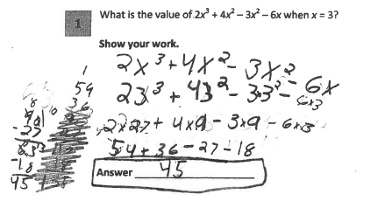
Grade 6 Short-response Practice Paper 2
Notes:
Refer participants to Practice Paper 2 in the Grade 6 Short-response (2-point) Sample Practice Set packet.
This response answers the question correctly and demonstrates a thorough understanding of the mathematical concepts. The order of operations, all calculations, and the final answer are correct. The missing multiplication symbols from 2×3³ and 4×3² do not detract from the demonstration of a thorough understanding.

Slide 57
Grade 6 Short-response Practice Paper 2 Annotation
Score Point 2
This response answers the question correctly and demonstrates a thorough understanding of the mathematical concepts. The order of operations, all calculations, and the final answer are correct. The missing multiplication symbols from 2×3³ and 4×3² do not detract from the demonstration of a thorough understanding.
Notes:
Direct the participants to read the annotation; ask if there are any questions. A second training option is to read or paraphrase the annotation for participants while viewing the response slide.

Slide 58
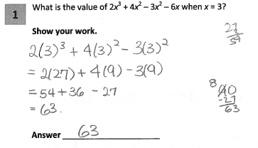
Grade 6 Short-response Practice Paper 3
Notes:
Refer participants to Practice Paper 3 in the Grade 6 Short-response (2-point) Sample Practice Set packet.
This response is only partially correct and contains an incorrect solution but applies a mathematically appropriate process. The final term (-6x) is not included in the solution. However, the order of operations for the remaining terms in the expression is correctly followed and all calculations are correct. The answer is correct for the expression used in the work.

Slide 59
Grade 6 Short-response Practice Paper 3 Annotation
Score Point 1
This response is only partially correct and contains an incorrect solution but applies a mathematically appropriate process. The final term (-6x) is not included in the solution. However, the order of operations for the remaining terms in the expression is correctly followed and all calculations are correct. The answer is correct for the expression used in the work.
Notes:
Direct the participants to read the annotation; ask if there are any questions. A second training option is to read or paraphrase the annotation for participants while viewing the response slide.

Slide 60
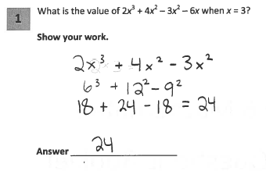
Grade 6 Short-response Practice Paper 4
Notes:
Refer participants to Practice Paper 4 in the Grade 6 Short-response (2-point) Sample Practice Set packet.
This response is incorrect. The final term is dropped. The order of operations is incorrect; the multiplication steps are completed prior to the exponent calculations. The exponential terms are incorrectly simplified. The answer is incorrect.

Slide 61
Grade 6 Short-response Practice Paper 4 Annotation
Score Point 0
This response is incorrect. The final term is dropped. The order of operations is incorrect; the multiplication steps are completed prior to the exponent calculations. The exponential terms are incorrectly simplified. The answer is incorrect.
Notes:
Direct the participants to read the annotation; ask if there are any questions. A second training option is to read or paraphrase the annotation for participants while viewing the response slide.

Slide 62
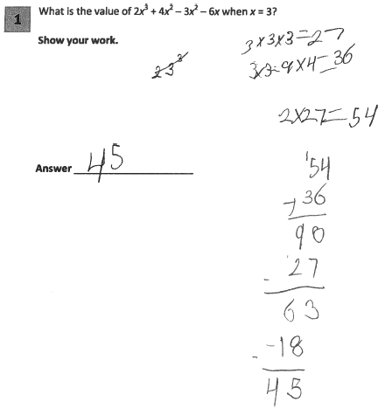
Grade 6 Short-response Practice Paper 5
Notes:
Refer participants to Practice Paper 5 in the Grade 6 Short-response (2-point) Sample Practice Set packet.
This response answers the question correctly and indicates that the student has completed the task correctly, using mathematically sound procedures. The individual operations are calculated separately and correctly in the proper order, resulting in the correct answer. While the work contains a run-on equation (3 × 3 = 9 × 4 = 36), this is considered part of the work process and does not detract from the demonstration of understanding.

Slide 63
Grade 6 Short-response Practice Paper 5 Annotation
Score Point 2
This response answers the question correctly and indicates that the student has completed the task correctly, using mathematically sound procedures. The individual operations are calculated separately and correctly in the proper order, resulting in the correct answer. While the work contains a run-on equation (3 × 3 = 9 × 4 = 36), this is considered part of the work process and does not detract from the demonstration of understanding.
Notes:
Direct the participants to read the annotation; ask if there are any questions. A second training option is to read or paraphrase the annotation for participants while viewing the response slide.

Slide 64
Q&A
Notes:
Ask participants what questions they have about the 2-point rubric or scoring a short-response.

Slide 65
Grade 8 Short-response (2-point)
Sample Question Guide Set
Notes:
We will now look at student responses to the grade 8 2-point question.
Time estimate:
30 minutes

Slide 66
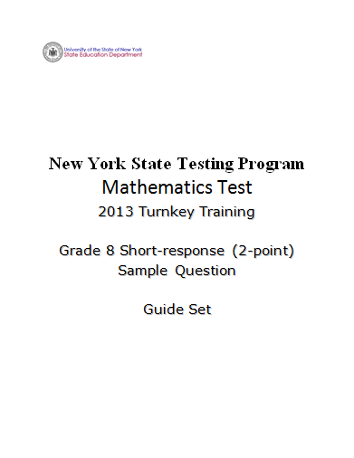
Notes:
Refer participants to the Grade 8 Short-response (2-Point) Sample Question Guide Set packet.
The first page after the cover sheet is the question. The second page is the Common Core Learning standard the question assesses. (Show the next slide.)

Slide 67
Grade 8 Short-response Question
1
David currently has a square garden. He wants to redesign his garden and make it into a rectangle with a length that is 3 feet shorter than twice its width. He decides that the perimeter should be 60 feet.
Determine the dimensions, in feet, of his new garden.
Show your work.
Answer ___________________________
Notes:
Show briefly and explain to teachers that this is a sample of a grade 8 0 – 2-point question that is aligned with Common Core learning standard 8.EE.7b – Solve linear equations with rational number coefficients, including equations whose solutions require expanding expressions using the distributive property and collecting like terms.
Move to next slide.

Slide 68
Grade 8 Short-response
Common Core Learning Standard Assessed
CCLS 8.EE.7b
Solve linear equations with rational number coefficients, including equations whose solutions require expanding expressions using the distributive property and collecting like terms.
Notes:
Allow participants time to read the standard. Ask if there are any questions. A second training option is to read or the standard for participants.

Slide 69
Grade 8 Short-response Question
1
David currently has a square garden. He wants to redesign his garden and make it into a rectangle with a length that is 3 feet shorter than twice its width. He decides that the perimeter should be 60 feet.
Determine the dimensions, in feet, of his new garden.
Show your work.
Answer ___________________________
How would you answer this question?
Notes:
Take a couple minutes to think about how you would answer the question. (Allow participants 3 – 4 minutes to answer the question and reflect.)
Ask yourself what a typical 2-point student response might look like.
What will a typical 1-point and a common 0-point student response possibly look like.
Guide the discussion by asking a few teachers for potential ways they would answer the question.

Slide 70
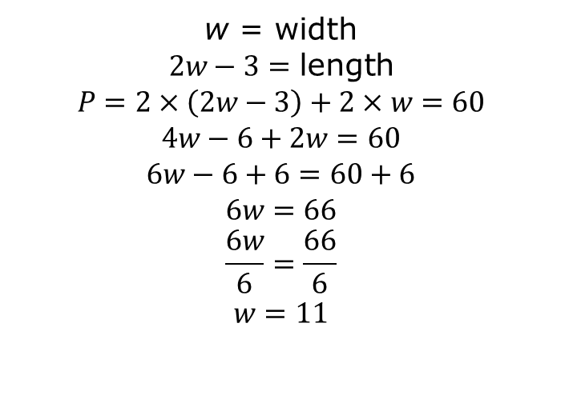
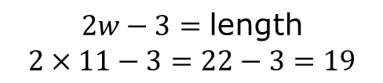
Grade 8 Short-response Exemplar
1
David currently has a square garden. He wants to redesign his garden and make it into a rectangle with a length that is 3 feet shorter than twice its width. He decides that the perimeter should be 60 feet.
Determine the dimensions, in feet, of his new garden.
Show your work.
Answer ___________________________
Width = 11 ft; Length = 19 ft
Notes:
Talk through the response:
w is defined as width and 2w-3 is defined as length. Two times the length (2w-3) and two times the width (w) equals the perimeter, 60. Applies the distributive property and solves for w, w = 11. 11 is substituted into the expression for length and simplified, 2w-3 = 19
This is what we would expect as a common, but not the only, 2-point response.
Guide the discussion by asking a few teachers for other ways this question may be answered correctly or what we might expect as common 1-point and 0-point responses.

Slide 71
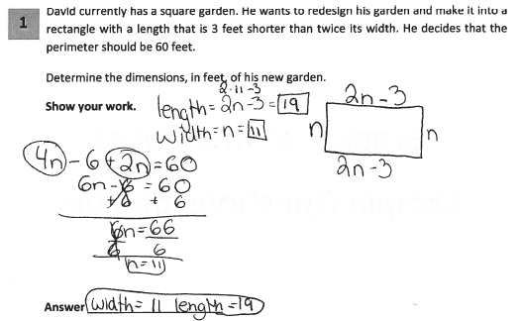
Grade 8 Short-response Guide Paper 1
Notes:
Refer participants to Guide Paper 1 in the Grade 8 Short-response (2-point) Sample Guide Set packet.
This response answers the question correctly and demonstrates a thorough understanding of the mathematical concepts. The lengths of each side are shown in terms of n (n, 2n-3) and are correctly used with the given perimeter to solve for n. The answer for both dimensions is correct. Units in the answer are not required since the question directs students to “determine the dimensions, in feet….”

Slide 72
Grade 8 Short-response Guide Paper 1 Annotation
Score Point 2
This response answers the question correctly and demonstrates a thorough understanding of the mathematical concepts. The lengths of each side are shown in terms of n (n, 2n-3) and are correctly used with the given perimeter to solve for n. The answer for both dimensions is correct. Units in the answer are not required since the question directs students to “determine the dimensions, in feet….”
Notes:
Direct the participants to read the annotation; ask if there are any questions. A second training option is to read or paraphrase the annotation for participants while viewing the response slide.

Slide 73
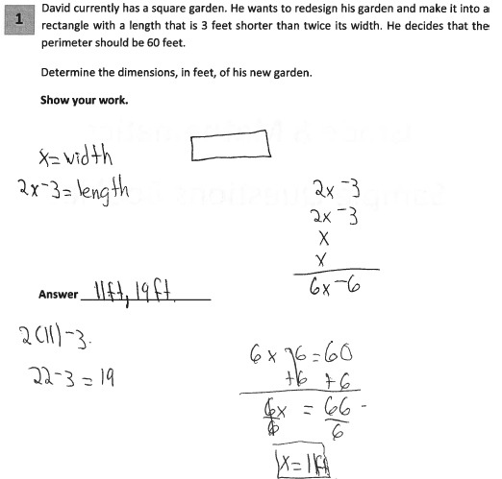
Grade 8 Short-response Guide Paper 2
Notes:
Refer participants to Guide Paper 2 in the Grade 8 Short-response (2-point) Sample Guide Set packet.
This response answers the question correctly and indicates that the student has completed the task correctly, using mathematically sound procedures. The lengths of each side are correctly shown in terms of x and are appropriately used with the given perimeter to solve for x. The answer for both dimensions is correct.

Slide 74
Grade 8 Short-response Guide Paper 2 Annotation
Score Point 2
This response answers the question correctly and indicates that the student has completed the task correctly, using mathematically sound procedures. The lengths of each side are correctly shown in terms of x and are appropriately used with the given perimeter to solve for x. The answer for both dimensions is correct.
Notes:
Direct the participants to read the annotation; ask if there are any questions. A second training option is to read or paraphrase the annotation for participants while viewing the response slide.

Slide 75
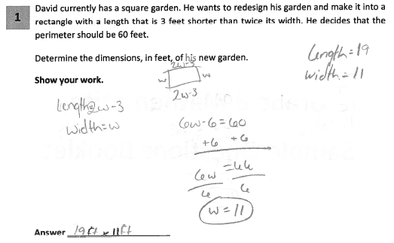
Grade 8 Short-response Guide Paper 3
Notes:
Refer participants to Guide Paper 3 in the Grade 8 Short-response (2-point) Sample Guide Set packet.
This response answers the question correctly and demonstrates a thorough understanding of the mathematical concepts. The lengths of each side are correctly shown in terms of w and are used correctly with the given perimeter to solve for w.

Slide 76
Grade 8 Short-response Guide Paper 3 Annotation
Score Point 2
This response answers the question correctly and demonstrates a thorough understanding of the mathematical concepts. The lengths of each side are correctly shown in terms of w and are used correctly with the given perimeter to solve for w.
Notes:
Direct the participants to read the annotation; ask if there are any questions. A second training option is to read or paraphrase the annotation for participants while viewing the response slide.

Slide 77
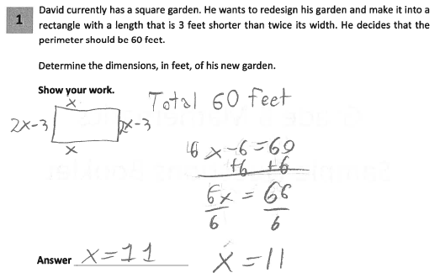
Grade 8 Short-response Guide Paper 4
Notes:
Refer participants to Guide Paper 4 in the Grade 8 Short-response (2-point) Sample Guide Set packet.
This response is only partially correct and correctly addresses most elements of the task. The length of each side is correctly determined in terms of x and the equation is set up correctly and solved for x. However, the value given for x is not used to calculate the length of the garden, (2x – 3). Therefore, only one dimension – the width – is given in the answer. The absence of units in the answer does not detract from the demonstration of understanding.

Slide 78
Grade 8 Short-response Guide Paper 4 Annotation
Score Point 1
This response is only partially correct and correctly addresses most elements of the task. The length of each side is correctly determined in terms of x and the equation is set up correctly and solved for x. However, the value given for x is not used to calculate the length of the garden,
(2x – 3). Therefore, only one dimension – the width – is given in the answer. The absence of units in the answer does not detract from the demonstration of understanding.
78
Notes:
Direct the participants to read the annotation; ask if there are any questions. A second training option is to read or paraphrase the annotation for participants while viewing the response slide.

Slide 79
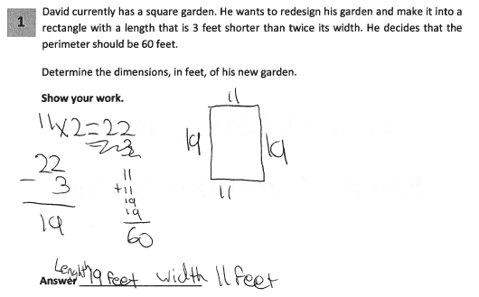
Grade 8 Short-response Guide Paper 5
79
Notes:
Refer participants to Guide Paper 5 in the Grade 8 Short-response (2-point) Sample Guide Set packet.
This response shows only partial understanding and contains correct numerical answers, but the required work is not provided. The correct numerical answers are given and a check of the answers is provided. However, it is not clear from the work provided how the width (11) was initially determined.

Slide 80
Grade 8 Short-response Guide Paper 5 Annotation
Score Point 1
This response shows only partial understanding and contains correct numerical answers, but the required work is not provided. The correct numerical answers are given and a check of the answers is provided. However, it is not clear from the work provided how the width (11) was initially determined.
80
Notes:
Direct the participants to read the annotation; ask if there are any questions. A second training option is to read or paraphrase the annotation for participants while viewing the response slide.

Slide 81
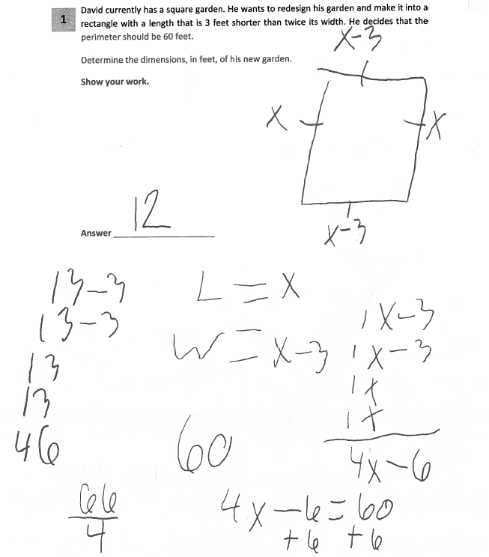
Grade 8 Short-response Guide Paper 6
81
Notes:
Refer participants to Guide Paper 6 in the Grade 8 Short-response (2-point) Sample Guide Set packet.
This response is only partially correct and demonstrates only a partial understanding of the mathematical concepts. The rectangle’s length and width are incorrectly expressed as x and x-3, respectively. However, these incorrect expressions are then correctly used in the perimeter equation, solving x = 66/4. The calculations are incorrectly completed.

Slide 82
Grade 8 Short-response Guide Paper 6 Annotation
Score Point 1
This response is only partially correct and demonstrates only a partial understanding of the mathematical concepts. The rectangle’s length and width are incorrectly expressed as x and x-3, respectively. However, these incorrect expressions are then correctly used in the perimeter equation, solving x = 66/4. The calculations are incorrectly completed.
82
Notes:
Direct the participants to read the annotation; ask if there are any questions. A second training option is to read or paraphrase the annotation for participants while viewing the response slide.

Slide 83
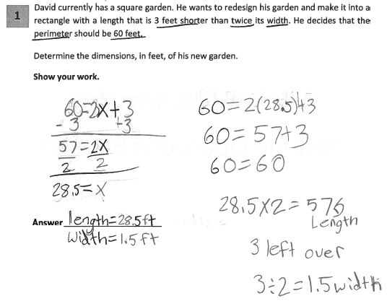
Grade 8 Short-response Guide Paper 7
83
Notes:
Refer participants to Guide Paper 7 in the Grade 8 Short-response (2-point) Sample Guide Set packet.
This response is incorrect. The incorrect equation is used for perimeter and the procedure used to determine the width is not sufficient to demonstrate even a limited understanding of the mathematical concepts.

Slide 84
Grade 8 Short-response Guide Paper 7 Annotation
Score Point 0
This response is incorrect. The incorrect equation is used for perimeter and the procedure used to determine the width is not sufficient to demonstrate even a limited understanding of the mathematical concepts.
84
Notes:
Direct the participants to read the annotation; ask if there are any questions. A second training option is to read or paraphrase the annotation for participants while viewing the response slide.

Slide 85
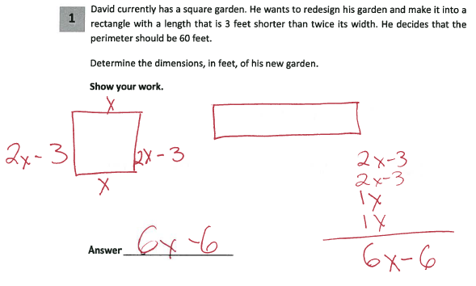
Grade 8 Short-response Guide Paper 8
85
Notes:
Refer participants to Guide Paper 8 in the Grade 8 Short-response (2-point) Sample Guide Set packet.
This response is incorrect. The correct dimensions are determined in terms of x and the four sides are added. However, this expression (6x-6) is never equated to the value given for the perimeter and no final values are determined for the dimensions. While this response contains some correct mathematical procedures, there is not enough work completed to demonstrate even a limited understanding of the mathematical concepts embodied in the task.

Slide 86
Grade 8 Short-response Guide Paper 8 Annotation
Score Point 0
This response is incorrect. The correct dimensions are determined in terms of x and the four sides are added. However, this expression (6x-6) is never equated to the value given for the perimeter and no final values are determined for the dimensions. While this response contains some correct mathematical procedures, there is not enough work completed to demonstrate even a limited understanding of the mathematical concepts embodied in the task.
86
Notes:
Direct the participants to read the annotation; ask if there are any questions. A second training option is to read or paraphrase the annotation for participants while viewing the response slide.

Slide 87
Q&A
87
Notes:
Ask participants if there are any questions about why each paper has its respective score.

Slide 88
Grade 8 Short Response (2-point)
Sample Question Practice Set
88
Notes:
Inform participants they will now practice scoring sample student responses, applying the rubric, scoring policies and guide papers.
Have teachers read and score the entire practice set prior to reviewing the responses in the set.
After the set is scored individually, have participants turn-and-talk with their neighbors, comparing scores.
For any responses that neighbors do not have the same score, direct participants to explain to one another why each respectively selected the chosen score.
Participants should use language from the rubric and site guide paper comparisons.
Time estimate:
15 minutes

Slide 89

89
Notes:
Refer participants to the Grade 8 Short-response (2-Point) Sample Question Practice Set packet.

Slide 90
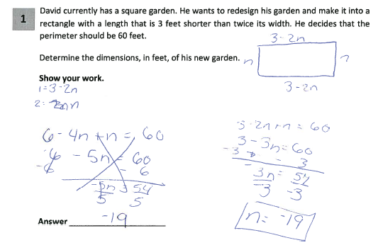
Grade 8 Short-response Practice Paper 1
90
Notes:
Refer participants to Practice Paper 1 in the Grade 8 Short-response (2-point) Sample Practice Set packet.
This response is incorrect. The incorrect dimension for length is determined in terms of n (3-2n). The perimeter equation to solve for n is incorrect (3 - 2n + n = 60) and it is solved incorrectly. Additionally, only the incorrect, physically impossible answer for the width is given.

Slide 91
Grade 8 Short-response Practice Paper 1 Annotation
Score Point 0
This response is incorrect. The incorrect dimension for length is determined in terms of n (3-2n). The perimeter equation to solve for n is incorrect (3 - 2n + n = 60) and it is solved incorrectly. Additionally, only the incorrect, physically impossible answer for the width is given.
91
Notes:
Direct the participants to read the annotation; ask if there are any questions. A second training option is to read or paraphrase the annotation for participants while viewing the response slide.

Slide 92
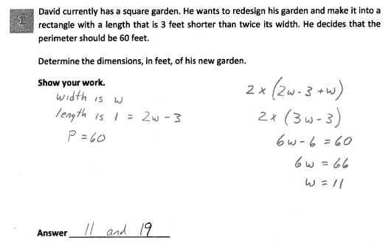
Grade 8 Short-response Practice Paper 2
92
Notes:
Refer participants to Practice Paper 2 in the Grade 8 Short-response (2-point) Sample Practice Set packet.
This response answers the question correctly and indicates that the student has completed the task correctly, using mathematically sound procedures. The dimensions are expressed in terms of w and used appropriately in the equation for perimeter; the equation is correctly solved for w. The absence of calculating 19 does not detract from the level of understanding.
Under the previous rubric and scoring policy, even though this response demonstrates a thorough understanding, it would have been scored a 1 because the required bridging step is not shown. Multiplying 11 by 2 and subtracting 3 is a grade 8 mental arithmetic computational fluency skill.

Slide 93
Grade 8 Short-response Practice Paper 2 Annotation
Score Point 2
This response answers the question correctly and indicates that the student has completed the task correctly using mathematically sound procedures. The dimensions are expressed in terms of w and used appropriately in the equation for perimeter; the equation is correctly solved for w. The absence of calculating 19 does not detract from the level of understanding.
93
Notes:
Direct the participants to read the annotation; ask if there are any questions. A second training option is to read or paraphrase the annotation for participants while viewing the response slide.

Slide 94
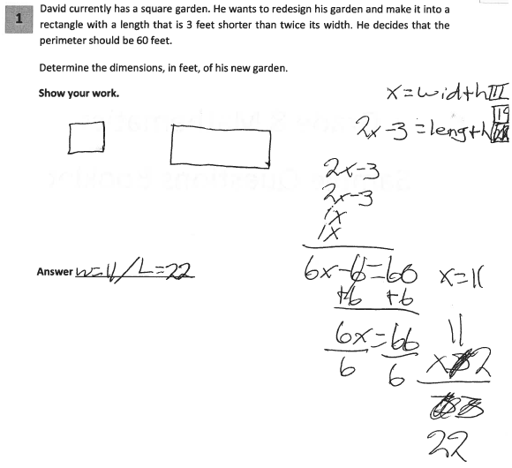
Grade 8 Short-response Practice Paper 3
94
Notes:
Refer participants to Practice Paper 3 in the Grade 8 Short-response (2-point) Sample Practice Set packet.
This response shows only partial understanding of the mathematical procedures in the task. The length of each side is correctly determined in terms of x and the perimeter equation is appropriate, resulting in the correct value for x. However, the value given for x is multiplied by 2 rather than being substituted back into the initial expression for the length (2x-3). Therefore, only the width dimension is correct. The absence of units does not detract from the demonstrated level of understanding.

Slide 95
Grade 8 Short-response Practice Paper 3 Annotation
Score Point 1
This response shows only partial understanding of the mathematical procedures in the task. The length of each side is correctly determined in terms of x and the perimeter equation is appropriate, resulting in a correct value for x. However, the value given for x is multiplied by 2 rather than being substituted back into the initial expression for the length (2x-3). Therefore, only the width dimension is correct. The absence of units does not detract from the demonstrated level of understanding.
95
Notes:
Direct the participants to read the annotation; ask if there are any questions. A second training option is to read or paraphrase the annotation for participants while viewing the response slide.

Slide 96
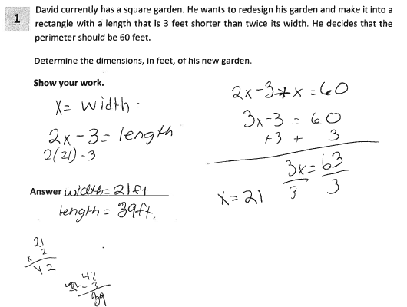
Grade 8 Short-response Practice Paper 4
96
Notes:
Refer participants to Practice Paper 4 in the Grade 8 Short-response (2-point) Sample Practice Set packet.
This response demonstrates only a partial understanding of the mathematical concepts. The dimensions are correctly expressed in terms of x (x = width; 2x – 3 = length). However, the perimeter equation is incorrect (2x – 3 + x = 60); two sides instead of four are added together. The equation written is correctly solved for x and the value of x (21) is used in the expression for length (2x – 3) to determine the length’s value.

Slide 97
Grade 8 Short-response Practice Paper 4 Annotation
Score Point 1
This response demonstrates only a partial understanding of the mathematical concepts. The dimensions are correctly expressed in terms of x (x = width; 2x – 3 = length). However, the perimeter equation is incorrect (2x – 3 + x = 60); two sides instead of four are added together. The equation written is correctly solved for x and the value of x (21) is used in the expression for length (2x – 3) to determine the length’s value.
97
Notes:
Direct the participants to read the annotation; ask if there are any questions. A second training option is to read or paraphrase the annotation for participants while viewing the response slide.

Slide 98
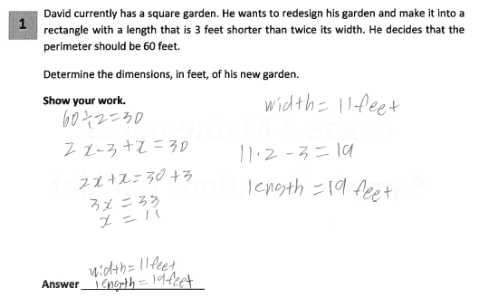
Grade 8 Short-response Practice Paper 5
98
Notes:
Refer participants to Practice Paper 5 in the Grade 8 Short-response (2-point) Sample Practice Set packet.
This response answers the question correctly and indicates that the student has completed the task correctly, using mathematically sound procedures. The perimeter is divided in half and then equated to the sum of the expressions for the length (2x-3) and width (x). This is an appropriate mathematical procedure for completing this task and the dimensions are determined correctly.

Slide 99
Grade 8 Short-response Practice Paper 5 Annotation
Score Point 2
This response answers the question correctly and indicates that the student has completed the task correctly, using mathematically sound procedures. The perimeter is divided in half and then equated to the sum of the expressions for the length (2x-3) and width (x). This is an appropriate mathematical procedure for completing this task and the dimensions are determined correctly.
99
Notes:
Direct the participants to read the annotation; ask if there are any questions. A second training option is to read or paraphrase the annotation for participants while viewing the response slide.

Slide 100
Q&A
100
Notes:
Ask participants what questions they have about the 2-point rubric or scoring a short-response.

Slide 101
Extended-response (3-point) Rubric
101
Notes:
We will now review the 3-point holistic rubric.
Time estimate:
6 minutes

Slide 102
Notes:
Refer participants to the Rubrics, Scoring Policies and Practice Score Sheet packet.

Slide 103
Mathematics 3-point Holistic Rubric
Score Point | Description
3 Points | A three-point response answers the question correctly. This response demonstrates a thorough understanding of the mathematical concepts but may contain errors that do not detract from the demonstration of understanding indicates that the student has completed the task correctly, using mathematically sound procedures
2 Points | A two-point response is partially correct. This response demonstrates partial understanding of the mathematical concepts and/or procedures embodied in the task addresses most aspects of the task, using mathematically sound procedures may contain an incorrect solution but provides complete procedures, reasoning, and/or explanations may reflect some misunderstanding of the underlying mathematical concepts and/or procedures
1 Point | A one-point response is incomplete and exhibits many flaws but is not completely incorrect. This response demonstrates only a limited understanding of the mathematical concepts and/or procedures embodied in the task may address some elements of the task correctly but reaches an inadequate solution and/or provides reasoning that is faulty or incomplete exhibits multiple flaws related to misunderstanding of important aspects of the task, misuse of mathematical procedures, or faulty mathematical reasoning reflects a lack of essential understanding of the underlying mathematical concepts may contain correct numerical answer(s) but required work is not provided
0 Points | A zero-point response is incorrect, irrelevant, incoherent, or contains a correct response arrived at using an obviously incorrect procedure. Although some parts may contain correct mathematical procedures, holistically they are not sufficient to demonstrate even a limited understanding of the mathematical concepts embodied in the task.
103
Notes:
Explanation of 3-point, extended-response, rubric.
The 3-point rubric applies to all grade 3 – 8 extended-response questions. Responses that demonstrate ‘thorough understanding’, ‘partial understanding’, ‘limited understanding’, ‘incorrect, irrelevant, incoherent’ and ‘insufficient for limited understanding’ are further defined by the approved guide papers. It is important to understand the differences in the language at each score point on the rubric. The Guide papers will show how the student responses are held to the criteria in the rubric.

Slide 104
Mathematics 3-point Holistic Rubric (Continued)
Score Point | Description
3 Points | A three-point response answers the question correctly. This response demonstrates a thorough understanding of the mathematical concepts but may contain errors that do not detract from the demonstration of understanding indicates that the student has completed the task correctly, using mathematically sound procedures
104
Notes:
Read through the rubric. Read all text from score point 3 first and then move down the score scale. Note the differences between score point 3 language and score point 2 language, and the differences between score point 2 language and score point 1 language as you discuss score points 2 and 1 from the rubric.
A three-point response answers the question correctly and demonstrates a thorough understanding. A three-point response may not necessarily be without minor errors.

Slide 105
Mathematics 3-point Holistic Rubric (Continued)
Score Point | Description
2 Points | A two-point response is partially correct. This response demonstrates partial understanding of the mathematical concepts and/or procedures embodied in the task addresses most aspects of the task, using mathematically sound procedures may contain an incorrect solution but provides complete procedures, reasoning, and/or explanations may reflect some misunderstanding of the underlying mathematical concepts and/or procedures
105
Notes:
Review 2-point score point.

Slide 106
Mathematics 3-point Holistic Rubric (Continued)
Score Point | Description
1 Point | A one-point response is incomplete and exhibits many flaws but is not completely incorrect. This response demonstrates only a limited understanding of the mathematical concepts and/or procedures embodied in the task may address some elements of the task correctly but reaches an inadequate solution and/or provides reasoning that is faulty or incomplete exhibits multiple flaws related to misunderstanding of important aspects of the task, misuse of mathematical procedures, or faulty mathematical reasoning reflects a lack of essential understanding of the underlying mathematical concepts may contain correct numerical answer(s) but required work is not provided
106
Notes:
Review the 1-point score point.

Slide 107
Mathematics 3-point Holistic Rubric (Continued)
Score Point | Description
0 Points | A zero-point response is incorrect, irrelevant, incoherent, or contains a correct response arrived at using an obviously incorrect procedure. Although some parts may contain correct mathematical procedures, holistically they are not sufficient to demonstrate even a limited understanding of the mathematical concepts embodied in the task.
107
Notes:
Review the 0-point score point.

Slide 108
Q&A
108
Notes:
Ask teachers if there are any questions with regards to the new Common Core aligned rubric and scoring policies. Keep discussion to the text provided in these documents. Allow the following training responses to clarify text in the rubric and Scoring Policies documents.
The scoring policies discussed after the 2-point holistic rubric discussion apply to scoring extended-responses, as well.

Slide 109
Grade 4 Extended-response (3-point)
Sample Question Guide Set
Notes:
We will now look at student responses to the grade 4 3-point question.
Refer participants to the Grade 4 Extended-response (3-point) Sample Question Guide Set.
The first page after the cover sheet is the 3-point Holistic Rubric. The second page is the question.
Time estimate:
30 minutes

Slide 110
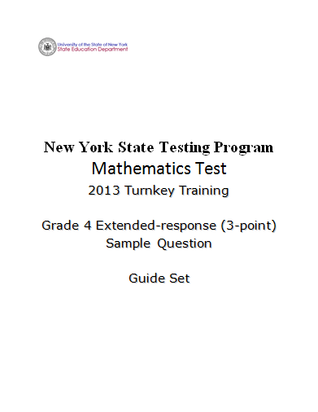
Notes:
Refer participants to the Grade 4 Extended-response (3-point) Sample Guide Set packet.

Slide 111
Grade 4 Extended-response Question
2
Candy wants to buy herself a new bicycle that cost $240. Candy has already saved $32, but she needs to make a plan so she can save the rest of the money she needs. She decides to save the same amount of money, x dollars, each month for the next four months.
Write an equation that helps Candy determine the amount of money she must save each month.
Equation ___________________________________________________
Solve the equation to find the amount of money she must save each month to meet her goal of buying a bicycle.
Show your work.
Answer $_________________________________________________
111
Notes:
Show briefly and explain to teachers that this is a sample of a grade 4 0 – 3 point question that is aligned with Common Core learning standard 4.OA.3 – Solve multistep word problems posed with whole numbers and having whole-number answers using the four operations, including problems in which remainders must be interpreted. Represent these problems using equations with a letter standing for the unknown quantity. Assess the reasonableness of answers using mental computation and estimation strategies including rounding.
Move to next slide.

Slide 112
Grade 4 Extended-response
Common Core Learning Standard Assessed
CCLS 4.OA.3
Solve multistep word problems posed with whole numbers and having whole-number answers using the four operations, including problems in which remainders must be interpreted. Represent these problems using equations with a letter standing for the unknown quantity. Assess the reasonableness of answers using mental computation and estimation strategies including rounding.
Notes:
Allow participants time to read the standard. Ask if there are any questions. A second training option is to read the standard to participants.

Slide 113
Grade 4 Extended-response Question
2
Candy wants to buy herself a new bicycle that cost $240. Candy has already saved $32, but she needs to make a plan so she can save the rest of the money she needs. She decides to save the same amount of money, x dollars, each month for the next four months.
Write an equation that helps Candy determine the amount of money she must save each month.
Equation ___________________________________________________
Solve the equation to find the amount of money she must save each month to meet her goal of buying a bicycle.
Show your work.
Answer $_________________________________________________
How would you answer this question?
113
Notes:
Take a couple minutes to think about how you would answer the question. (Allow participants 3 – 4 minutes to answer the questions and reflect.)
Ask yourself what a typical 3-point student response might look like.
What will a typical 2 or 1-point and a common 0-point student response possibly look like.
Guide the discussion by asking a few teachers for potential ways they would answer the question.

Slide 114

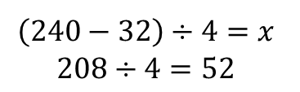

Grade 4 Extended-response Exemplar
2
Candy wants to buy herself a new bicycle that cost $240. Candy has already saved $32, but she needs to make a plan so she can save the rest of the money she needs. She decides to save the same amount of money, x dollars, each month for the next four months.
Write an equation that helps Candy determine the amount of money she must save each month.
Equation ___________________________________________________
Solve the equation to find the amount of money she must save each month to meet her goal of buying a bicycle.
Show your work.
Answer $_________________________________________________
114
Notes:
Talk through the response:
The equation is correct, (240 – 32)/4 = x. The equation is correctly solved and the answer is correct.
This is what we would expect as a common, but not the only, 3-point response.
Guide the discussion by asking a few teachers for other ways this question may be answered correctly or what we might expect as common 2-point, 1-point and 0-point responses.

Slide 115
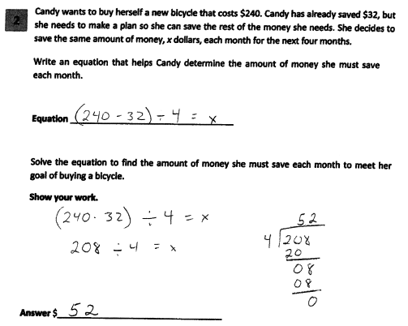
Grade 4 Extended-response Guide Paper 1
115
Notes:
Refer participants to Guide Paper 1 in the Grade 4 Extended-response (3-point) Sample Guide Set packet.
This response answers the question correctly and demonstrates a thorough understanding of the mathematical concepts. The written equation is correct, the mathematical procedure used to solve the equation is appropriate with all necessary work shown, and the final answer is correct.

Slide 116
Grade 4 Extended-response Guide Paper 1 Annotation
Score Point 3
This response answers the question correctly and demonstrates a thorough understanding of the mathematical concepts. The written equation is correct, the mathematical procedure used to solve the equation is appropriate with all necessary work shown, and the final answer is correct.
116
Notes:
Direct the participants to read the annotation; ask if there are any questions. A second training option is to read or paraphrase the annotation for participants while viewing the response slide.

Slide 117
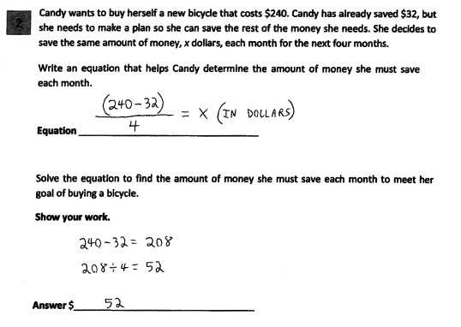
Grade 4 Extended-response Guide Paper 2
117
Notes:
Refer participants to Guide Paper 2 in the Grade 4 Extended-response (3-point) Sample Guide Set packet.
This response answers the question correctly and indicates that the student has completed the task correctly, using mathematically sound procedures. The written equation is correct, the mathematical procedure used to solve the equation is appropriate with all necessary work shown, and the final answer is correct.

Slide 118
Grade 4 Extended-response Guide Paper 2 Annotation
Score Point 3
This response answers the question correctly and indicates that the student has completed the task correctly, using mathematically sound procedures. The written equation is correct, the mathematical procedure used to solve the equation is appropriate with all necessary work shown, and the final answer is correct.
118
Notes:
Direct the participants to read the annotation; ask if there are any questions. A second training option is to read or paraphrase the annotation for participants while viewing the response slide.

Slide 119
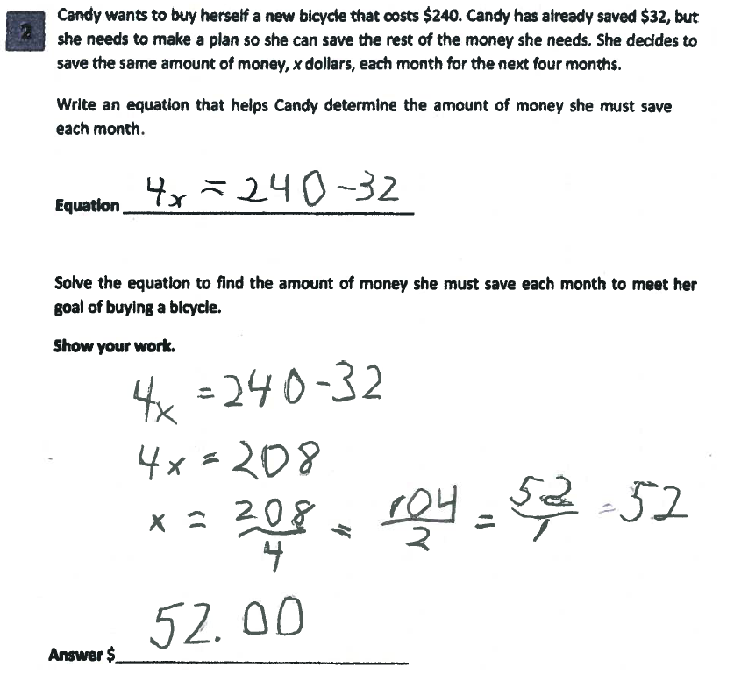
Grade 4 Extended-response Guide Paper 3
119
Notes:
Refer participants to Guide Paper 3 in the Grade 4 Extended-response (3-point) Sample Guide Set packet.
This response answers the question correctly and demonstrates a thorough understanding of the mathematical concepts. The written equation is correct, the mathematical procedure used to solve the equation is appropriate with all necessary work shown, and the final answer is correct.

Slide 120
Grade 4 Extended-response Guide Paper 3 Annotation
Score Point 3
This response answers the question correctly and demonstrates a thorough understanding of the mathematical concepts. The written equation is correct, the mathematical procedure used to solve the equation is appropriate with all necessary work shown, and the final answer is correct.
120
Notes:
Direct the participants to read the annotation; ask if there are any questions. A second training option is to read or paraphrase the annotation for participants while viewing the response slide.

Slide 121
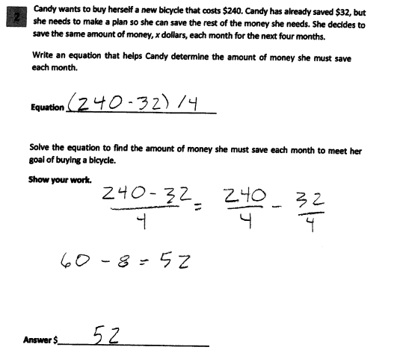
Grade 4 Extended-response Guide Paper 4
121
Notes:
Refer participants to Guide Paper 4 in the Grade 4 Extended-response (3-point) Sample Guide Set packet.
This response answers the question correctly and demonstrates a thorough understanding of the mathematical concepts. The written equation is correct, the mathematical procedure used to solve the equation is appropriate with all necessary work shown, and the final answer is correct.

Slide 122
Grade 4 Extended-response Guide Paper 4 Annotation
Score Point 2
This response is partially correct and addresses most aspects of the task, using mathematically sound procedures. An expression rather than an equation is written and it does not include a variable. However, the expression has been simplified correctly and the final answer is correct.
122
Notes:
Direct the participants to read the annotation; ask if there are any questions. A second training option is to read or paraphrase the annotation for participants while viewing the response slide.

Slide 123
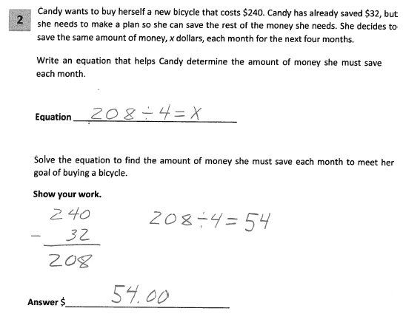
Grade 4 Extended-response Guide Paper 5
123
Notes:
Refer participants to Guide Paper 5 in the Grade 4 Extended-response (3-point) Sample Guide Set packet.
This response demonstrates partial understanding and addresses most aspects of the task, using mathematically sound procedures. The equation is partially correct; it does not account for the 208. The mathematical procedure used to determine the amount of money to be saved each month is mathematically sound; however, the division error results in an incorrect answer.

Slide 124
Grade 4 Extended-response Guide Paper 5 Annotation
Score Point 2
This response demonstrates partial understanding and addresses most aspects of the task, using mathematically sound procedures. The equation is partially correct; it does not account for the 208. The mathematical procedure used to determine the amount of money to be saved each month is mathematically sound; however, the division error results in an incorrect answer.
124
Notes:
Direct the participants to read the annotation; ask if there are any questions. A second training option is to read or paraphrase the annotation for participants while viewing the response slide.

Slide 125
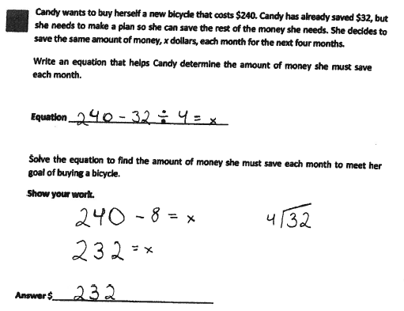
Grade 4 Extended-response Guide Paper 6
125
Notes:
Refer participants to Guide Paper 6 in the Grade 4 Extended-response (3-point) Sample Guide Set packet.
This response demonstrates partial understanding. The equation is missing the parentheses around 240 - 32. However, the correct order of operations is followed to solve the incorrect equation.

Slide 126
Grade 4 Extended-response Guide Paper 6 Annotation
Score Point 2
This response demonstrates partial understanding. The equation is missing the parentheses around 240 - 32. However, the correct order of operations is followed to solve the incorrect equation.
126
Notes:
Direct the participants to read the annotation; ask if there are any questions. A second training option is to read or paraphrase the annotation for participants while viewing the response slide.

Slide 127
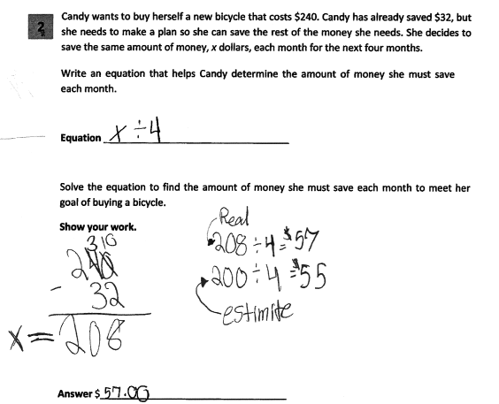
Grade 4 Extended-response Guide Paper 7
127
Notes:
Refer participants to Guide Paper 7 in the Grade 4 Extended-response (3-point) Sample Guide Set packet.
This response exhibits many flaws and demonstrates only a limited understanding of the question. There is no equation given and the expression (x ÷ 4) does not show any understanding. The procedure used to solve the equation is appropriate; however, there are two division errors – both for the estimate (200 ÷ 4 = $55) and for the equation identified as “real” (208 ÷ 4 = $57). The final answer (57.00) is incorrect.

Slide 128
Grade 4 Extended-response Guide Paper 7 Annotation
Score Point 1
This response exhibits many flaws and demonstrates only a limited understanding of the question. There is no equation given and the expression (x ÷ 4) does not show any understanding. The procedure used to solve the equation is appropriate; however, there are two division errors – both for the estimate (200 ÷ 4 = $55) and for the equation identified as “real” (208 ÷ 4 = $57). The final answer (57.00) is incorrect.
128
Notes:
Direct the participants to read the annotation; ask if there are any questions. A second training option is to read or paraphrase the annotation for participants while viewing the response slide.

Slide 129
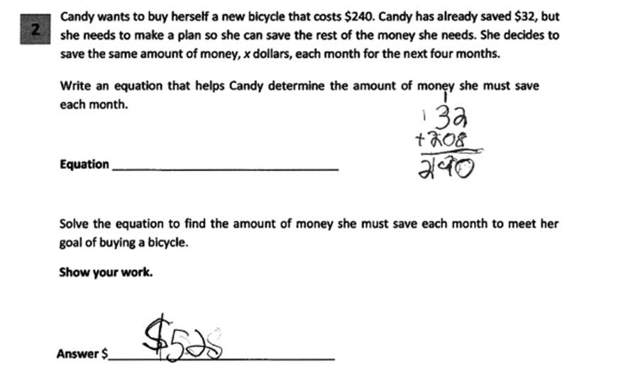
Grade 4 Extended-response Guide Paper 8
129
Notes:
Refer participants to Guide Paper 8 in the Grade 4 Extended-response (3-point) Sample Guide Set packet.
This response demonstrates only a limited understanding of the mathematical concepts. The equation is not provided and while the answer is correct, not all of the required work is provided.

Slide 130
Grade 4 Extended-response Guide Paper 8 Annotation
Score Point 1
This response demonstrates only a limited understanding of the mathematical concepts. The equation is not provided and while the answer is correct, not all of the required work is provided.
130
Notes:
Direct the participants to read the annotation; ask if there are any questions. A second training option is to read or paraphrase the annotation for participants while viewing the response slide.

Slide 131
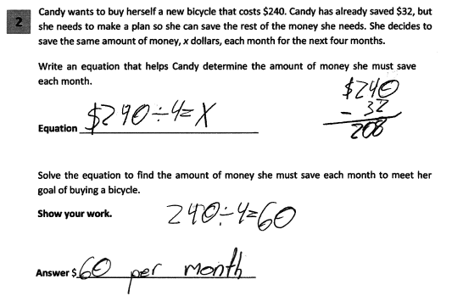
Grade 4 Extended-response Guide Paper 9
131
Notes:
Refer participants to Guide Paper 9 in the Grade 4 Extended-response (3-point) Sample Guide Set packet.
This response demonstrates only a limited understanding. While some aspects of the task are addressed correctly, faulty reasoning results in an inadequate solution. The equation is incorrect and does not take into account the $32 already saved. This reflects a lack of essential understanding of the underlying mathematical concept. However, that incorrect equation is solved correctly.

Slide 132
Grade 4 Extended-response Guide Paper 9 Annotation
Score Point 1
This response demonstrates only a limited understanding. While some aspects of the task are addressed correctly, faulty reasoning results in an inadequate solution. The equation is incorrect and does not take into account the $32 already saved. This reflects a lack of essential understanding of the underlying mathematical concept. However, that incorrect equation is solved correctly.
132
Notes:
Direct the participants to read the annotation; ask if there are any questions. A second training option is to read or paraphrase the annotation for participants while viewing the response slide.

Slide 133
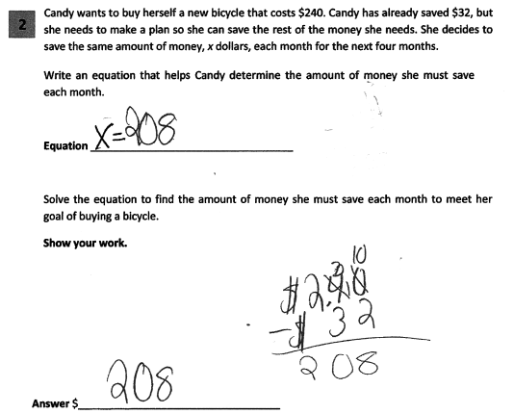
Grade 4 Extended-response Guide Paper 10
133
Notes:
Refer participants to Guide Paper 10 in the Grade 4 Extended-response (3-point) Sample Guide Set packet.
This response is incorrect. The initial equation is not correct and only the very first step of the process is completed. This results in an incorrect answer. Holistically, this is not sufficient to demonstrate even a limited understanding of the mathematical concepts embodied in the task.

Slide 134
Grade 4 Extended-response Guide Paper 10 Annotation
Score Point 0
This response is incorrect. The initial equation is not correct and only the very first step of the process is completed. This results in an incorrect answer. Holistically, this is not sufficient to demonstrate even a limited understanding of the mathematical concepts embodied in the task.
Notes:
Direct the participants to read the annotation; ask if there are any questions. A second training option is to read or paraphrase the annotation for participants while viewing the response slide.

Slide 135
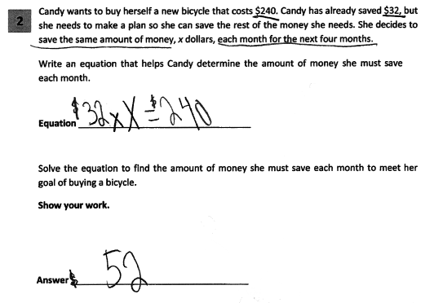
Grade 4 Extended-response Guide Paper 11
135
Notes:
Refer participants to Guide Paper 11 in the Grade 4 Extended-response (3-point) Sample Guide Set packet.
This response is incorrect. The equation given is incorrect and while the final answer is correct, no correct work or mathematically appropriate process is shown that would lead to that answer.

Slide 136
Grade 4 Extended-response Guide Paper 11 Annotation
Score Point 0
This response is incorrect. The equation given is incorrect and while the final answer is correct, no correct work or mathematically appropriate process is shown that would lead to that answer.
136
Notes:
Direct the participants to read the annotation; ask if there are any questions. A second training option is to read or paraphrase the annotation for participants while viewing the response slide.

Slide 137
Q&A
137
Notes:
Ask participants if there are any questions about why each paper has its respective score.

Slide 138
Grade 4 Extended-response (3-point)
Sample Question Practice Set
138
Notes:
Inform participants they will now practice scoring sample student responses, applying the rubric, scoring policies and guide papers.
Have teachers read and score the entire practice set prior to reviewing the responses in the set.
After participants have individually scored the five response, have them turn-and-talk to their neighbors to compare scores.
Neighbors should use rubric language and the guide papers to explain why they selected the scores for each response.
Select pairs to explain to the rest of the participants why each response has the specific score point.
Time estimate:
15 minutes

Slide 139
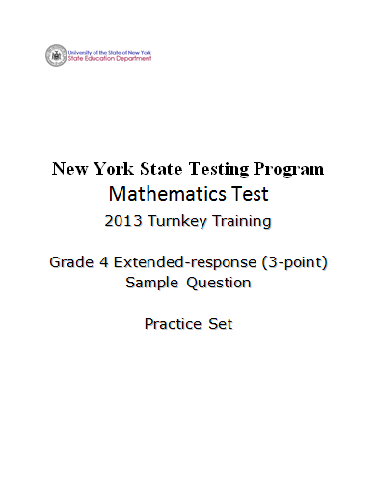
139
Notes:
Refer participants to Grade 4 Extended-response (3-point) Sample Practice Set packet.

Slide 140
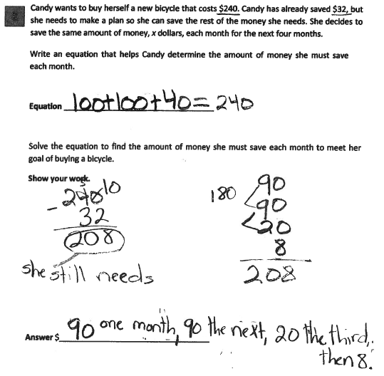
Grade 4 Extended-response Practice Paper 1
140
Notes:
Refer participants to Practice Paper 1 in the Grade 4 Extended-response (3-point) Sample Practice Set packet.
This response is incorrect. The equation does not contain a variable and is irrelevant. While the initial step in the solution is correct (240 – 32 = 208), the question’s direction specifying that the same amount of money is saved every month is disregarded, resulting in incorrect work and an incorrect answer. While some parts contain correct mathematical procedures, holistically, they are not sufficient to demonstrate even a limited understanding of the mathematical concepts embodied in the task.

Slide 141
Grade 4 Extended-response Practice Paper 1 Annotation
Score Point 0
This response is incorrect. The equation does not contain a variable and is irrelevant. While the initial step in the solution is correct (240 – 32 = 208), the question’s direction specifying that the same amount of money is saved every month is disregarded, resulting in incorrect work and an incorrect answer. While some parts contain correct mathematical procedures, holistically, they are not sufficient to demonstrate even a limited understanding of the mathematical concepts embodied in the task.
141
Notes:
Direct the participants to read the annotation; ask if there are any questions. A second training option is to read or paraphrase the annotation for participants while viewing the response slide.

Slide 142
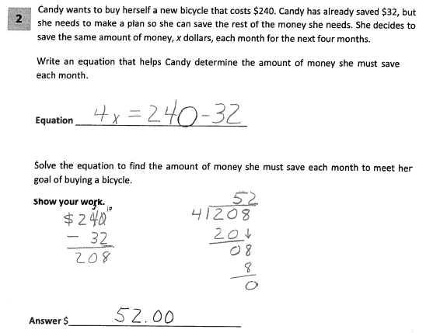
Grade 4 Extended-response Practice Paper 2
142
Notes:
Refer participants to Practice Paper 2 in the Grade 4 Extended-response (3-point) Sample Practice Set packet.
This response answers the question correctly and indicates that the student has completed the task correctly, using mathematically sound procedures. The equation given is correct. The mathematical procedure used to solve the equation is appropriate with all necessary work shown, and the final answer is correct.

Slide 143
Grade 4 Extended-response Practice Paper 2 Annotation
Score Point 3
This response answers the question correctly and indicates that the student has completed the task correctly, using mathematically sound procedures. The equation given is correct. The mathematical procedure used to solve the equation is appropriate with all necessary work shown, and the final answer is correct.
143
Notes:
Direct the participants to read the annotation; ask if there are any questions. A second training option is to read or paraphrase the annotation for participants while viewing the response slide.

Slide 144

Grade 4 Extended-response Practice Paper 3
144
Notes:
Refer participants to Practice Paper 3 in the Grade 4 Extended-response (3-point) Sample Practice Set packet.
This response is incorrect. The equation is incorrect. Though some correct operations are indicated in the work, subtraction followed by division, only the subtraction is correctly completed. Holistically, this is not sufficient to demonstrate even a limited understanding of the mathematical concepts embodied in the task.

Slide 145
Grade 4 Extended-response Practice Paper 3 Annotation
Score Point 0
This response is incorrect. The equation is incorrect. Though some correct operations are indicated in the work, subtraction followed by division, only the subtraction is correctly completed. Holistically, this is not sufficient to demonstrate even a limited understanding of the mathematical concepts embodied in the task.
145
Notes:
Direct the participants to read the annotation; ask if there are any questions. A second training option is to read or paraphrase the annotation for participants while viewing the response slide.

Slide 146

Grade 4 Extended-response Practice Paper 4
146
Notes:
Refer participants to Practice Paper 4 in the Grade 4 Extended-response (3-point) Sample Practice Set packet.
This response demonstrates partial understanding and addresses most aspects of the task using mathematically sound procedures. The equation is not correct. However, the mathematical procedure used and the answer are correct.

Slide 147
Grade 4 Extended-response Practice Paper 4 Annotation
Score Point 2
This response demonstrates partial understanding and addresses most aspects of the task using mathematically sound procedures. The equation is not correct. However, the mathematical procedure used and the answer are correct.
147
Notes:
Direct the participants to read the annotation; ask if there are any questions. A second training option is to read or paraphrase the annotation for participants while viewing the response slide.

Slide 148

Grade 4 Extended-response Practice Paper 5
148
Notes:
Refer participants to Practice Paper 5 in the Grade 4 Extended-response (3-point) Sample Practice Set packet.
This response exhibits many flaws but is not completely incorrect. The written equation is an acceptable equation; however, the mathematical procedure used to solve the equation and the answer are flawed and incorrect.

Slide 149
Grade 4 Extended-response Practice Paper 5 Annotation
Score Point 1
This response exhibits many flaws but is not completely incorrect. The written equation is an acceptable equation; however, the mathematical procedure used to solve the equation and the answer are flawed and incorrect.
149
Notes:
Direct the participants to read the annotation; ask if there are any questions.

Slide 150
Q&A
150
Notes:
Ask participants what questions they have about the 3-point rubric or scoring an extended-response.

Slide 151
Grade 6 Extended-response (3-point)
Sample Question Guide Set
151
Notes:
We will now look at student responses to the grade 6 3-point question
Time estimate:
40 minutes

Slide 152

Notes:
Refer participants to the Grade 6 Extended-response (3-Point) Sample Question Guide Set packet.
The first page after the cover sheet is the question. The second page is the Common Core Learning Standard. (Show the next slide.)

Slide 153
Grade 6 Extended-response Question
2
A closed box in the shape of a rectangular prism has a length of 13 cm, a width of 5.3 cm, and a height of 7.1 cm.
Draw a net of the box and find its surface area in square centimeters.
Show your work.
Answer .
153
Notes:
Show briefly and explain to teachers that this is a sample of a grade 6 0 – 3 point question that is aligned with Common Core learning standard 6.G.4 .
Represent three-dimensional figures using nets made up of rectangles and triangles, and use the nets to find the surface area of these figures. Apply these techniques in the context of solving real-world and mathematical problems.
Move to next slide.

Slide 154
Grade 6 Extended-response
Common Core Learning Standard Assessed
CCLS 6.G.4
Represent three-dimensional figures using nets made up of rectangles and triangles, and use the nets to find the surface area of these figures. Apply these techniques in the context of solving real-world and mathematical problems.
Notes:
Allow participants time to read the standard. Ask if there are any questions. A second training option is to read the standard to participants.

Slide 155
Grade 6 Extended-response Question
2
A closed box in the shape of a rectangular prism has a length of 13 cm, a width of 5.3 cm, and a height of 7.1 cm.
Draw a net of the box and find its surface area in square centimeters.
Show your work.
Answer .
How would you answer this question?
155
Notes:
Take a couple minutes to think about how you would answer the question.
Ask yourself what a typical 3-point student response might look like.
What will a typical 2 or 1-point and a common 0-point student response possibly look like.
Guide the discussion by asking a few teachers for potential ways they would answer the question.

Slide 156




Grade 6 Extended-response Exemplar
2
A closed box in the shape of a rectangular prism has a length of 13 cm, a width of 5.3 cm, and a height of 7.1 cm.
Draw a net of the box and find its surface area in square centimeters.
Show your work.
Answer .
$$2×\left(13×7.1\right)=2×92.3=184.6$$
$$2×\left(5.3×7.1\right)=2×37.63=75.26$$
$$2×\left(5.3×13\right)=137.8$$
$$184.6+75.26+137.8=397.66$$
397.66 sq. cm.
156
Notes:
Talk through the response:
The net is correctly drawn and appropriately labeled. The work is shown for calculating the surface area. The total surface area is correct.
This is what we would expect as a common, but not the only, 3-point response.
Guide the discussion by asking a few teachers for other ways this question may be answered correctly or what we might expect as common 2-point, 1-point and 0-point responses.

Slide 157

Grade 6 Extended-response Guide Paper 1
157
Notes:
Refer participants to Guide Paper 1 in the Grade 6 Extended-response (3-Point) Sample Question Guide Set packet.
This response answers the question correctly and demonstrates a thorough understanding of the mathematical concepts. A complete net is drawn and accurately labeled, and all calculations for each of the rectangles are shown. The final answer, the sum of the area of all six rectangles, is correct.

Slide 158
Grade 6 Extended-response Guide Paper 1 Annotation
Score Point 3
This response answers the question correctly and demonstrates a thorough understanding of the mathematical concepts. A complete net is drawn and accurately labeled, and all calculations for each of the rectangles are shown. The final answer, the sum of the area of all six rectangles, is correct.
Notes:
Direct the participants to read the annotation; ask if there are any questions. A second training option is to read or paraphrase the annotation for participants while viewing the response slide.

Slide 159

Grade 6 Extended-response Guide Paper 2
159
Notes:
Refer participants to Guide Paper 2 in the Grade 6 Extended-response (3-Point) Sample Question Guide Set packet.
This response answers the question correctly and indicates that the student has completed the task correctly, using mathematically sound procedures. A complete net is drawn and accurately labeled. The calculations for each of the three sizes of rectangles are shown, multiplied by two, and then added. The final answer is correct.

Slide 160
Grade 6 Extended-response Guide Paper 2 Annotation
Score Point 3
This response answers the question correctly and indicates that the student has completed the task correctly, using mathematically sound procedures. A complete net is drawn and accurately labeled. The calculations for each of the three sizes of rectangles are shown, multiplied by two, and then added. The final answer is correct.
Notes:
Direct the participants to read the annotation; ask if there are any questions. A second training option is to read or paraphrase the annotation for participants while viewing the response slide.

Slide 161

Grade 6 Extended-response Guide Paper 3
161
Notes:
Refer participants to Guide Paper 3 in the Grade 6 Extended-response (3-Point) Sample Question Guide Set packet.
This response answers the question correctly and demonstrates a thorough understanding of the mathematical concepts. A complete net is drawn. The calculations for each of the three sizes of rectangles are shown, multiplied by two, and then added. The final answer is correct. Labeling the dimensions of the net is not required for demonstration of a thorough understanding of the problem. The run-on number sentences and the cm³ label do not detract from the demonstration of a thorough understanding of the concepts.

Slide 162
Grade 6 Extended-response Guide Paper 3 Annotation
Score Point 3
This response answers the question correctly and demonstrates a thorough understanding of the mathematical concepts. A complete net is drawn. The calculations for each of the three sizes of rectangles are shown, multiplied by two, and then added. The final answer is correct. Labeling the dimensions of the net is not required for demonstration of a thorough understanding of the problem. The run-on equations and the cm³ label do not detract from the demonstration of a thorough understanding of the mathematical concepts.
Notes:
Direct the participants to read the annotation; ask if there are any questions. A second training option is to read or paraphrase the annotation for participants while viewing the response slide.

Slide 163

Grade 6 Extended-response Guide Paper 4
163
Notes:
Refer participants to Guide Paper 4 in the Grade 6 Extended-response (3-Point) Sample Question Guide Set packet.
This response is partially correct and addresses most aspects of the task, using mathematically sound procedures. A complete net is drawn and accurately labeled, and the correct procedure for the area calculations for each of the rectangles is used. However, a multiplication error is made while calculating one of the areas (13 × 2 × 5.3 = 157.8) and an addition error is made when determining the total area (157.8 + 184.6 + 75.26 = 387.66). The lines that appear to be extra flaps on the net are indicators of the lengths of the sides.

Slide 164
Grade 6 Extended-response Guide Paper 4 Annotation
Score Point 2
This response is partially correct and addresses most aspects of the task, using mathematically sound procedures. A complete net is drawn and accurately labeled, and the correct procedure for the area calculations for each of the rectangles is used. However, a multiplication error is made while calculating one of the areas (13 × 2 × 5.3 = 157.8) and an addition error is made when determining the total area (157.8 + 184.6 + 75.26 = 387.66). The lines that appear to be extra flaps on the net are indicators of the lengths of the sides.
Notes:
Direct the participants to read the annotation; ask if there are any questions. A second training option is to read or paraphrase the annotation for participants while viewing the response slide.

Slide 165

Grade 6 Extended-response Guide Paper 5
165
Notes:
Refer participants to Guide Paper 5 in the Grade 6 Extended-response (3-Point) Sample Question Guide Set packet.
This response demonstrates partial understanding of the mathematical procedures embodied in the task. The net, missing the rectangle that represents one side (5.3 by 7.1) of the box, is only partially correct. The surface area calculated is for an open, rather than a closed, box; the area representing the top of the box is not included.

Slide 166
Grade 6 Extended-response Guide Paper 5 Annotation
Score Point 2
This response demonstrates partial understanding of the mathematical procedures embodied in the task. The net, missing the rectangle that represents one side (5.3 by 7.1) of the box, is only partially correct. The surface area calculated is for an open, rather than a closed, box; the area representing the top of the box is not included.
Notes:
Direct the participants to read the annotation; ask if there are any questions. A second training option is to read or paraphrase the annotation for participants while viewing the response slide.

Slide 167

Grade 6 Extended-response Guide Paper 6
167
Notes:
Refer participants to Guide Paper 6 in the Grade 6 Extended-response (3-Point) Sample Question Guide Set packet.
This response is partially correct and addresses most aspects of the task, using mathematically sound procedures. A complete net is drawn and accurately labeled, and the correct procedure for the total area calculation is shown in the work. However, minor calculation errors result in an incorrect answer.

Slide 168
Grade 6 Extended-response Guide Paper 6 Annotation
Score Point 2
This response is partially correct and addresses most aspects of the task, using mathematically sound procedures. A complete net is drawn and accurately labeled, and the correct procedure for the total area calculation is shown in the work. However, minor calculation errors result in an incorrect answer.
Notes:
Direct the participants to read the annotation; ask if there are any questions. A second training option is to read or paraphrase the annotation for participants while viewing the response slide.

Slide 169

Grade 6 Extended-response Guide Paper 7
169
Notes:
Refer participants to Guide Paper 7 in the Grade 6 Extended-response (3-Point) Sample Question Guide Set packet.
This response is incomplete and exhibits many flaws but is not completely incorrect; it addresses some elements of the task correctly but reaches an inadequate solution and provides reasoning that is incomplete. No net is shown. The area calculations for each size rectangle are shown and are correctly added together. However, the determined value is not multiplied by 2 to determine the total surface area.

Slide 170
Grade 6 Extended-response Guide Paper 7 Annotation
Score Point 1
This response is incomplete and exhibits many flaws but is not completely incorrect; it addresses some elements of the task correctly but reaches an inadequate solution and provides reasoning that is incomplete. No net is shown. The area calculations for each size rectangle are shown and are correctly added together. However, the determined value is not multiplied by two to determine the total surface area.
Notes:
Direct the participants to read the annotation; ask if there are any questions. A second training option is to read or paraphrase the annotation for participants while viewing the response slide.

Slide 171

Grade 6 Extended-response Guide Paper 8
171
Notes:
Refer participants to Guide Paper 8 in the Grade 6 Extended-response (3-Point) Sample Question Guide Set packet.
This response exhibits many flaws but is not completely incorrect and demonstrates only a limited understanding of the mathematical procedures embodied in the task. No net is shown. While the work shows the correct procedures for the calculation of the total surface area, multiplication errors for all three sizes of rectangles result in an incorrect answer.

Slide 172
Grade 6 Extended-response Guide Paper 8 Annotation
Score Point 1
This response exhibits many flaws but is not completely incorrect and demonstrates only a limited understanding of the mathematical procedures embodied in the task. No net is shown. While the work shows the correct procedures for the calculation of the total surface area, multiplication errors for all three sizes of rectangles result in an incorrect answer.
Notes:
Direct the participants to read the annotation; ask if there are any questions. A second training option is to read or paraphrase the annotation for participants while viewing the response slide.

Slide 173

Grade 6 Extended-response Guide Paper 9
173
Notes:
Refer participants to Guide Paper 9 in the Grade 6 Extended-response (3-Point) Sample Question Guide Set packet.
This response exhibits many flaws but is not completely incorrect and reflects a lack of essential understanding of the underlying mathematical concepts. An appropriate net is shown. However, an inappropriate mathematical process is used to determine the surface area and the answer is incorrect.

Slide 174
Grade 6 Extended-response Guide Paper 9 Annotation
Score Point 1
This response exhibits many flaws but is not completely incorrect and reflects a lack of essential understanding of the underlying mathematical concepts. An appropriate net is shown. However, an inappropriate mathematical process is used to determine the surface area and the answer is incorrect.
174
Notes:
Direct the participants to read the annotation; ask if there are any questions. A second training option is to read or paraphrase the annotation for participants while viewing the response slide.

Slide 175

Grade 6 Extended-response Guide Paper 10
175
Notes:
Refer participants to Guide Paper 10 in the Grade 6 Extended-response (3-Point) Sample Question Guide Set packet.
This response is incorrect. A net is shown; however, the size of all 6 rectangles is approximately the same. This net is not an appropriate representation of the original three-dimensional figure. No other work is shown and the answer given is incorrect.

Slide 176
Grade 6 Extended-response Guide Paper 10 Annotation
Score Point 0
This response is incorrect. A net is shown; however, the size of all six rectangles is approximately the same. This net is not an appropriate representation of the original three-dimensional figure. No other work is shown and the answer given is incorrect.
176
Notes:
Direct the participants to read the annotation; ask if there are any questions. A second training option is to read or paraphrase the annotation for participants while viewing the response slide.

Slide 177

Grade 6 Extended-response Guide Paper 11
177
Notes:
Refer participants to Guide Paper 11 in the Grade 6 Extended-response (3-Point) Sample Question Guide Set packet.
This response is irrelevant. No net is shown and the volume is calculated, rather than the surface area.

Slide 178
Grade 6 Extended-response Guide Paper 11 Annotation
Score Point 0
This response is irrelevant. No net is shown and the volume is calculated, rather than the surface area.
178
Notes:
Direct the participants to read the annotation; ask if there are any questions. A second training option is to read or paraphrase the annotation for participants while viewing the response slide.

Slide 179
Q&A
179
Notes:
Ask participants if there are any questions about why each paper has its respective score.

Slide 180
Grade 6 Extended-response (3-point)
Sample Practice Set
180
Notes:
Inform participants they will now practice scoring sample student responses, applying the rubric, scoring policies and guide papers.
Have teachers read and score the entire practice set prior to reviewing the responses in the set.
After participants have individually scored the five responses, have them turn-and-talk to their neighbors to compare scores.
Neighbors should use rubric language and the guide papers to explain why they selected the scores for each response.
Select pairs to explain to the rest of the participants why each response has the specific score point.
Time estimate:
25 minutes

Slide 181

Notes:
Refer participants to the Grade 6 Extended-response (3-Point) Sample Question Practice Set packet.

Slide 182

Grade 6 Extended-response Practice Paper 1
182
Notes:
Refer participants to Practice Paper 1 in the Grade 6 Extended-response (3-Point) Sample Question Practice Set packet.
This response is partially correct and demonstrates partial understanding of the mathematical procedures embodied in the task. A net is drawn and the dimensions are correctly labeled; however, there are two missing lines which result in four rectangles instead of six. The area of each labeled rectangle is correct. The areas of the four rectangles shown on the incorrect net are added correctly and the final answer is correct.

Slide 183
Grade 6 Extended-response Practice Paper 1 Annotation
Score Point 2
This response is partially correct and demonstrates partial understanding of the mathematical procedures embodied in the task. A net is drawn and the dimensions are correctly labeled; however, there are two missing lines which result in four rectangles instead of six. The area of each labeled rectangle is correct. The areas of the four rectangles shown on the incorrect net are added correctly and the final answer is correct.
183
Notes:
Direct the participants to read the annotation; ask if there are any questions. A second training option is to read or paraphrase the annotation for participants while viewing the response slide.

Slide 184

Grade 6 Extended-response Practice Paper 2
184
Notes:
Refer participants to Practice Paper 2 in the Grade 6 Extended-response (3-Point) Sample Question Practice Set packet.
This response exhibits many flaws but is not completely incorrect and reflects a lack of essential understanding of the underlying mathematical concepts. Although not all of the labels are accurate, an appropriate net is shown. However, an inappropriate mathematical process is used to determine the surface area and the answer is incorrect.

Slide 185
Grade 6 Extended-response Practice Paper 2 Annotation
Score Point 1
This response exhibits many flaws but is not completely incorrect and reflects a lack of essential understanding of the underlying mathematical concepts. Although not all of the labels are accurate, an appropriate net is shown. However, an inappropriate mathematical process is used to determine the surface area and the answer is incorrect.
185
Notes:
Direct the participants to read the annotation; ask if there are any questions. A second training option is to read or paraphrase the annotation for participants while viewing the response slide.

Slide 186

Grade 6 Extended-response Practice Paper 3
186
Notes:
Refer participants to Practice Paper 3 in the Grade 6 Extended-response (3-Point) Sample Question Practice Set packet.
This response is irrelevant. No net is shown and the volume is calculated and then divided by 4. The surface area is not determined.

Slide 187
Grade 6 Extended-response Practice Paper 3 Annotation
Score Point 0
This response is irrelevant. No net is shown and the volume is calculated and then divided by four. The surface area is not determined.
187
Notes:
Direct the participants to read the annotation; ask if there are any questions. A second training option is to read or paraphrase the annotation for participants while viewing the response slide.

Slide 188

Grade 6 Extended-response Practice Paper 4
188
Notes:
Refer participants to Practice Paper 4 in the Grade 6 Extended-response (3-Point) Sample Question Practice Set packet.
This response answers the question correctly and demonstrates a thorough understanding of the mathematical concepts. A complete net is drawn and accurately labeled. The areas are shown on a three-dimensional box with labeled sides, indicating the values used to determine the areas. These areas are multiplied by two and then added, resulting in the correct answer.

Slide 189
Grade 6 Extended-response Practice Paper 4 Annotation
Score Point 3
This response answers the question correctly and demonstrates a thorough understanding of the mathematical concepts. A complete net is drawn and accurately labeled. The areas are shown on a three-dimensional box with labeled sides, indicating the values used to determine the areas. These areas are multiplied by two and then added, resulting in the correct answer.
189
Notes:
Direct the participants to read the annotation; ask if there are any questions. A second training option is to read or paraphrase the annotation for participants while viewing the response slide.

Slide 190

Grade 6 Extended-response Practice Paper 5
190
Notes:
This response exhibits many flaws but is not completely incorrect and demonstrates only a limited understanding of the mathematical procedures embodied in the task. No net is shown. While the areas of the rectangles are all calculated correctly, an addition error and an inappropriate truncation result in an incorrect answer (396.6).

Slide 191
Grade 6 Extended-response Practice Paper 5 Annotation
Score Point 1
This response exhibits many flaws but is not completely incorrect and demonstrates only a limited understanding of the mathematical procedures embodied in the task. No net is shown. While the areas of the rectangles are all calculated correctly, an addition error and an inappropriate truncation result in an incorrect answer (396.6).
191
Notes:
Direct the participants to read the annotation; ask if there are any questions. A second training option is to read or paraphrase the annotation for participants while viewing the response slide.

Slide 192
Q&A
192
Notes:
Ask participants what questions they have about the 3-point rubric or scoring an extended-response.

Slide 193
Summary
Holistic scoring
2-point and 3-point holistic rubrics and scoring policies
Practice scoring two 2-point and two 3-point student responses
Training example
193
Notes:
Holistic Scoring: Guard against our own biases; apply state scoring guidelines – training materials; a single score that reflects the level of understanding demonstrated; compare each student response to the guide and practice papers only.
Rubrics describe the general attributes and characteristics of a response at each score point.
Policies ensure consistency in scoring across the state.
The process used today can be used as a model when you train the teachers in your regions, districts, and schools.
Time estimate:
5 minutes

Slide 194
Resources
For questions related to assessment:
    Email your question to: emscassessinfo@mail.nysed.gov
    Check for additional information at the following website http://www.p12.nysed.gov/apda/
For questions related to APPR
    Email your question to: educatoreval@mail.nysed.gov
Additional information regarding the common core shifts can be found at the following website:
    http://engageny.org/resource/common-core-shifts/
194
Notes:
Point out the available resources.
Cover any “parking lot” issues/questions that were tabled during the presentation.
A video of this training has been created and will be available, along with the handouts, on EngageNY.
Thank the participants for being engaged in the training, which covered a lot of material.

