Slide 1
March 27, 2015

Slide 2
Test Times by Modality: Kindergarten
The table below shows the estimated testing time. A test form will consist of either one modality
(Speaking) or a combination of modalities (Listening, Reading, and Writing). The latter will all be
contained in a single test booklet. The testing times given are for planning purposes only. The time
allotment indicated should be adequate for most students to complete testing. However, if necessary,
additional time should be allowed for a student to complete the test. Provide students with as much
time as they need to complete the test while still working productively
Session | Grade Band | Number of Items/Tasks | Total Number of Items/Tasks | Estimated Testing Time (minutes)
Speaking | K | 13 questions | 13 | 15
Listening/Reading/Writing Session 1 | K | Listening: 7 | 17 | 30-35
 |  | Reading: 6
 |  | Writing: 4 Short CR
Listening/Reading/Writing Session 2 | K | Listening: 6 | 15 | 30-35
 |  | Reading: 6
 |  | Writing: 3 Short CR
Listening/Reading/Writing Session 3 | K | Listening: 6 | 15 | 30-35
 |  | Reading: 6
 |  | Writing: 3 Short CR

Slide 3
Test Times by Modality: Grades 1–12
The table below shows the estimated testing time. A test form will consist of either one modality
(Speaking) or a combination of modalities (Listening, Reading, and Writing). The latter will all be
contained in a single test booklet. The testing times given are for planning purposes only. The time
allotment indicated should be adequate for most students to complete testing. However, if necessary,
additional time should be allowed for a student to complete the test. Provide students with as much
time as they need to complete the test while still working productively
Session | Grade Band | Number of Items/Tasks | Total Number of Items/Tasks | Estimated Testing Time (minutes)
Speaking | 1–12 | 13 questions | 13 | 15
Listening/Reading/Writing Session 1 | 1–12 | Listening: 8 | 17 | 35-55
 |  | Reading: 8
 |  | Writing: 1 Short CR
Listening/Reading/Writing Session 2 | 1–12 | Listening: 8 | 17 | 35-55
 |  | Reading: 8
 |  | Writing: 1 Short CR
Listening/Reading/Writing Session 3 | 1–12 | Listening: 8 | 20 | 35-55
 |  | Reading: 11
 |  | Writing: 1 Extended CR

Slide 4
What is the NYSESLAT?
NYSESLAT annually assesses English language proficiency of NYS English Language Learners (ELLs) in Grades K–12
Provides information about ELL's English language development which drives instruction aligned to:
The NYS Common Core Learning Standards (CCLS)
Bilingual Common Core Initiative (BCCI)
New Language Arts Progressions (NLAP)

Slide 5
Who and What NYSESLAT Measures
Primary Test Design Goal:
To measure student English language proficiency relative to the linguistic demands of the grade-level classroom, which then drives the provision of ELL services
To be administered in six grade bands:
K
1–2
3–4
5–6
7–8
9–12

Slide 6
Administration Highlights
Similarities
Speaking test is separate from Listening/Reading/Writing (L/R/W) test administration windows
Still four testing sessions: One for Speaking and three for L/R/W, although L/R/W now have an integrated configuration
Test remains untimed
Speaking test administered individually
L/R/W administered to groups of students
Rubric-based scoring of Speaking and Writing

Slide 7
Administration Highlights
Differences
Three L/R/W test booklets, each containing a theme-based Listening, Reading, and Writing section
Each L/R/W booklet administered in a separate session
A CD player is necessary for the Listening portion of each of the three L/R/W testing sessions
Braille checklist available for all grades
3 student identification labels—one for each L/R/W booklet
All test booklets to be returned to MetriTech after scoring

Slide 8
How the NYSESLAT is Changing
The NYSESLAT measures the linguistic demands of grade-level Common Core instruction delivered to ELLs.
There are 5 fundamental changes or shifts:
Measures CCLS and New Language Arts Progressions
Performance levels
Integrated approach to modalities
Text complexity
Instructionally relevant academic language
1
2
3
4
5

Slide 9
1: Measures CCLS and New Language Arts Progressions
New Language Arts Progressions—analysis of CCLS showing Academic Demands vs. Linguistic Demands
Linguistic Demands—the words, phrases, and forms of language that students will need to understand and use in order to participate successfully in instruction
Targets of Measurement (ToMs)—information distilled from the linguistic demands and presented at a level for the four modalities of Reading, Listening, Writing, and Speaking that is necessary for the development of an assessment
Performance Levels—the five levels (Entering, Emerging, Transitioning, Expanding, Commanding) at which each student is identified by the NYSESLAT to describe the student’s academic English language proficiency

Slide 10
NYSESLAT Foundations: ToMs
ToMs are the linguistic demands of the CCLS.
Items align to the ToMs.
READING FOR INFORMATION: GRADE BAND 3–4
Claim | Anchor | Target of Measurement | Language Purpose/Function | ELA Construct (in order to...)
GENERAL CLAIM 1 Students can determine information in a grade-level text. | ANCHOR 1 Students can determine key details, narrative elements, and central ideas in a grade-level text | ToM.R.3-4.1 Students can identify grade-appropriate words, phrases, or sentences that signal point of view, people, ideas, concepts, events, and the main topic or message in a grade-level text. | identify, introduce, describe, signal, target: characters and events actions, motivations, feelings an event, a topic the subject of an event a main topic, central message, lesson, moral, theme | demonstrate understanding of grade-level informational texts
 | ANCHOR 2 Students can identify words and phrases used to structure and develop ideas in a grade-level text. | ToM.R.3-4.2 Students can identify grade-appropriate words, phrases, or sentences that signal or convey key elements, sequence, connections, relationships, and point of view in a grade-level text. | signal, suggest: a sequence of events connections cause and effect comparison or contrast of information problem and solution various points of view (own, author, reader, 1st/3rd person) | interpret information from grade-level informational texts
 | ANCHOR 3 Students can determine the meaning of grade-appropriate vocabulary in a graded-level text | ToM.R.3-4.3 Students can determine the literal or figurative meaning of grade-appropriate Tier 1 and some Tier 2 and Tier 3 vocabulary in a grade-level text. | explain, identify, use: Tier 1, Tier 2, and Tier 3 vocabulary literal and non-literal meanings of words | determine the meaning of grade-level informational texts
GENERAL CLAIM 2 Students can determine the development of ideas in grade-level texts. | ANCHOR 4 Students can identify words and phrases that indicate key details, narrative elements, and central ideas in grade-level texts. | ToM.R.3-4.4 Students can identify grade-appropriate text structures that provide details, explain events, describe relationships, or develop a topic in grade-level texts. | convey, determine, explain: the development of key details or ideas the development of a topic the development of cause and effect relationships the development of problem and solution relationships how a character contributes to events | understand text development in grade-level informational texts
 | ANCHOR 5 Students can determine how text structures work together to develop ideas, events, and relationships in grade-level texts. | ToM.R.3-4.5 Students can determine how the structure of grade-appropriate language develops details, connections, and topics in grade-level texts. | to refer to a stanza or scene to identify explicit details to support an idea to describe connections between sentences or paragraphs | analyze the structure of grade-level informational texts

Slide 11
NYSESLAT Foundations: ToMs
Formerly SLDs; Items focus on the Language Purpose/Function.
READING FOR INFORMATION: GRADE BAND 3–4
Claim | Anchor | Target of Measurement | Language Purpose/Function | ELA Construct (in order to...)
GENERAL CLAIM 1 Students can determine information in a grade-level text. | ANCHOR 1 Students can determine key details, narrative elements, and central ideas in a grade-level text | ToM.R.3-4.1 Students can identify grade-appropriate words, phrases, or sentences that signal point of view, people, ideas, concepts, events, and the main topic or message in a grade-level text. | identify, introduce, describe, signal, target: characters and events actions, motivations, feelings an event, a topic the subject of an event a main topic, central message, lesson, moral, theme | demonstrate understanding of grade-level informational texts
 | ANCHOR 2 Students can identify words and phrases used to structure and develop ideas in a grade-level text. | ToM.R.3-4.2 Students can identify grade-appropriate words, phrases, or sentences that signal or convey key elements, sequence, connections, relationships, and point of view in a grade-level text. | signal, suggest: a sequence of events connections cause and effect comparison or contrast of information problem and solution various points of view (own, author, reader, 1st/3rd person) | interpret information from grade-level informational texts
 | ANCHOR 3 Students can determine the meaning of grade-appropriate vocabulary in a graded-level text | ToM.R.3-4.3 Students can determine the literal or figurative meaning of grade-appropriate Tier 1 and some Tier 2 and Tier 3 vocabulary in a grade-level text. | explain, identify, use: Tier 1, Tier 2, and Tier 3 vocabulary literal and non-literal meanings of words | determine the meaning of grade-level informational texts
GENERAL CLAIM 2 Students can determine the development of ideas in grade-level texts. | ANCHOR 4 Students can identify words and phrases that indicate key details, narrative elements, and central ideas in grade-level texts. | ToM.R.3-4.4 Students can identify grade-appropriate text structures that provide details, explain events, describe relationships, or develop a topic in grade-level texts. | convey, determine, explain: the development of key details or ideas the development of a topic the development of cause and effect relationships the development of problem and solution relationships how a character contributes to events | understand text development in grade-level informational texts
 | ANCHOR 5 Students can determine how text structures work together to develop ideas, events, and relationships in grade-level texts. | ToM.R.3-4.5 Students can determine how the structure of grade-appropriate language develops details, connections, and topics in grade-level texts. | to refer to a stanza or scene to identify explicit details to support an idea to describe connections between sentences or paragraphs | analyze the structure of grade-level informational texts

Slide 12
2: Performance Levels
Student performance will be reliably identified as:
Entering (approximates Beginning)
Emerging (approximates Low Intermediate)
Transitioning (approximates Intermediate)
Expanding (approximates Advanced)
Commanding (approximates Proficient)

Slide 13
NYSESLAT Foundations: PLDs
3-4 | Target of Measurement | Entering (Formerly Beginning) | Emerging (Formerly Intermediate) | Transitioning (Formerly High Intermediate) | Expanding (Formerly Advanced) | Commanding (Formerly Proficient)
READING GENERAL CLAIM 1: Students can determine information in grade-level text. | ToM.R.3-4.1 Students can identify grade-appropriate words, phrases, or sentences that signal point of view, people, ideas, concepts, events, and the main topic or message in a grade-level text. | Student cannot or can identify a few grade-appropriate words or short phrases that signal point of view, people, ideas, concepts, events, and the main topic or message in a grade-level text. | Student can identify some grade-appropriate words and phrases, and a few simple sentences that signal point of view, people, ideas, concepts, events, and the main topic or message in a grade-level text. | Student can identify most grade-appropriate phrases and simple sentences, and a few complex sentences that signal point of view, people, ideas, concepts, events, and the main topic or message in a grade-level text. | Student can identify most grade-appropriate simple and some complex sentences that signal point of view, people, ideas, concepts, events, and the main topic or message in a grade-level text. | Student can identify most grade-appropriate complex sentences that signal point of view, people, ideas, concepts, events, and the main topic or message in a grade-level text.
 | ToM.R.3-4.2 Students can identify grade-appropriate words, phrases, or sentences that signal or convey key elements, sequence, connections, relationships, and point of view in a grade-level text. | Student cannot or can identify a few grade-appropriate words or short phrases that signal or convey key elements, sequence, connections, relationships, and point of view in a grade-level text. | Student can identify some grade-appropriate words and phrases, and a few simple sentences that signal or convey key elements, sequence, connections, relationships, and point of view in a grade-level text. | Student can identify most grade-appropriate phrases and simple sentences, and a few complex sentences that signal or convey key elements, sequence, connections, relationships, and point of view in a grade-level text. | Student can identify most grade-appropriate simple and some complex sentences that signal or convey key elements, sequence, connections, relationships, and point of view in a grade-level text. | Student can identify most grade-appropriate complex sentences that signal or convey key elements, sequence, connections, relationships, and point of view in a grade-level text.

Slide 14
3: Integrated Approach to Modalities
Students integrate their listening, reading, writing, and speaking abilities in the classroom
Organized themes and topics underlie the NYSESLAT Listening and Reading passages, the Writing prompts that are grounded in the Reading passages, and the Speaking stimuli
The NYSESLAT provides a cohesive assessment experience similar to the instructional experience found in a well-developed unit of study
The NYSESLAT is designed to measure the language that is embedded in content rather than the content itself

Slide 15
4: Text Complexity
The Common Core Learning Standards require students to engage with text of grade-level complexity in order to effectively prepare students to be on track for college and successful careers
The Spring 2015 NYSESLAT focuses on aspects of instruction that students encounter in content-area classrooms, with close attention paid to text complexity, thus reflecting the CCLS requirements

Slide 16
5: Instructionally Relevant Academic Language
NYSESLAT test questions reflect content-area classroom activities
Questions are firmly based in academics as opposed to personal experience or background
Due to the constructs being measured—and in alignment with the purpose of the exam—the questions focus on the language and language structures that support the content as opposed to the content itself

Slide 17
Summary
Details regarding Spring 2015 NYSESLAT will be found in:
School Administrator’s Manual (SAM)
Directions for Administration (DFA)
Materials will also be available on the EngageNY website:
www.engageny.org/resource/spring-2015-NYSESLAT-resources

Slide 18
Application of the Holistic Writing Rubrics
The score assigned is the overall proficiency level of the language in the written response.
Best describes the entire response
Reflects the descriptors of the writing dimensions that best define the response
Become familiar with the prompt
Become familiar with the rubric associated with the prompt
Read the response to the prompt
Focus on the linguistic make-up of the response: the words, phrases, and sentences used by the student. The content of the response is not scored
Consider the five Writing dimensions as they apply to the response
Score the response based on the best proficiency level for the majority of the dimensions

Slide 19
Kindergarten: Letter Writing Rubric
This type of constructed-response question (for Kindergarten only) requires the student to write the letter dictated by the examiner
Score Point 0
Letter forming: Student does not produce letters accurately.
Legibility: Student production of letters is not recognizable.
Score Point 1
Letter forming: Student produces letters accurately.
Legibility: Student production of single letters is recognizable as the correct letter.

Slide 20
Kindergarten: Letter Writing
SAY
Now you will write a letter.
Write the letter h as in hat on the blank line.
Pause. Give the students time to write the letter h.

Slide 21
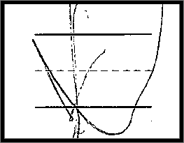
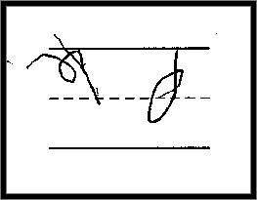
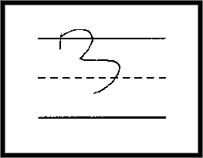
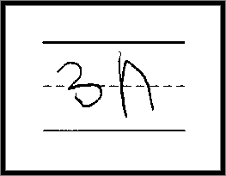
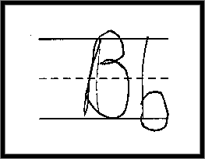
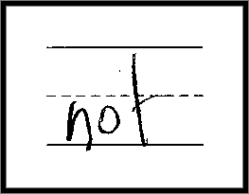
Kindergarten: Letter Writing
Score Point 0
Letter forming: Student does not produce letters accurately.
Legibility: Student production of letters is not recognizable.
1
2
3
4
5
6
7
8

Slide 22
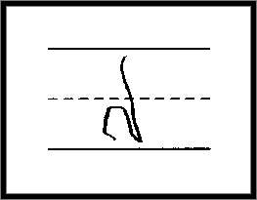
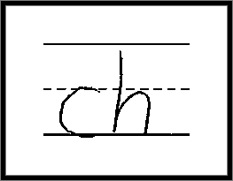
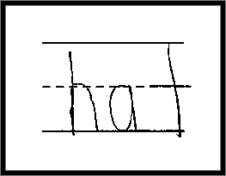
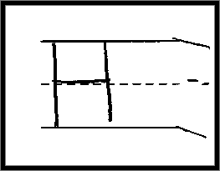
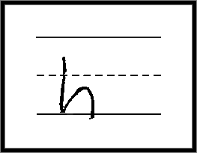
Kindergarten: Letter Writing
Score Point 1
Letter forming: Student produces letters accurately.
Legibility: Student production of single letters is recognizable as the correct letter.
1
2
3
4
5
6

Slide 23
Kindergarten: Word Copying Rubric
This type of constructed-response item requires students to copy and correctly spell the word they see in their test book.
Score Point 0
Letter forming: Student cannot produce letters accurately.
Accuracy: Student cannot produce sight words or commonly spelled words with short vowel sounds.
Score Point 1
Letter forming: Student can produce letters accurately.
Accuracy: Student can produce sight words and commonly spelled words with short vowel sounds.

Slide 24
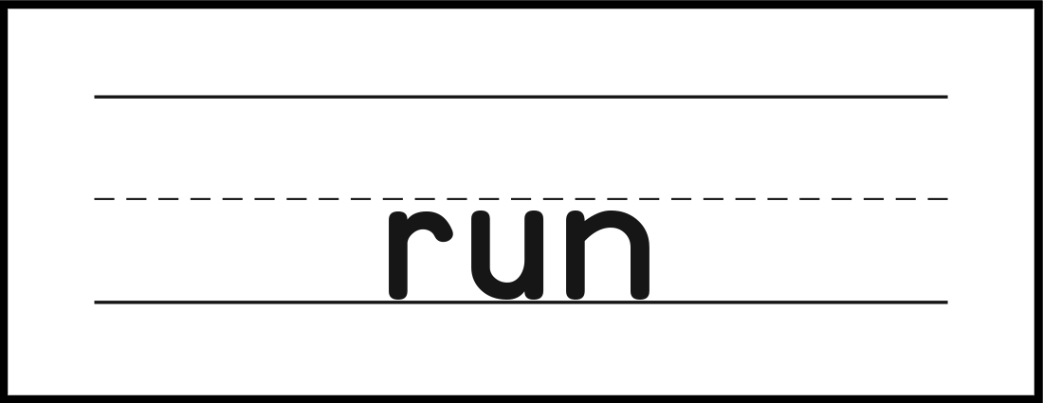
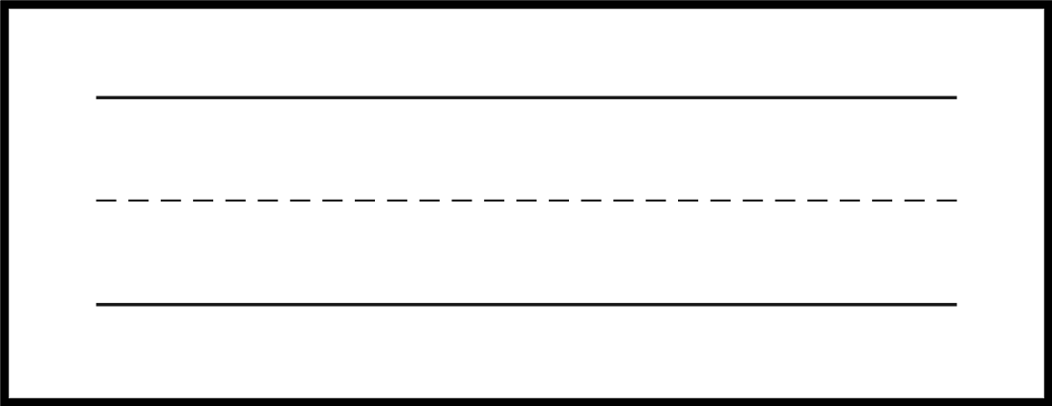
Kindergarten: Word Copying
SAY
Now you will copy a word.
This is the word run.
Copy the word run on the blank line.
Pause. Give the students time to copy the word run.

Slide 25
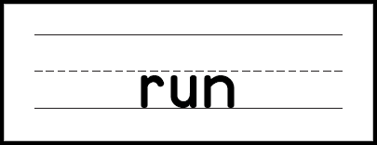
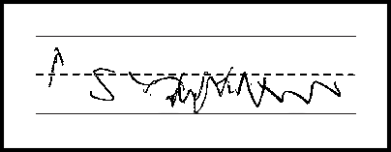
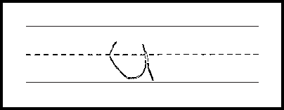
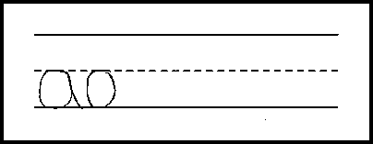
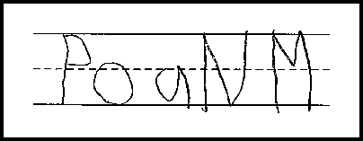
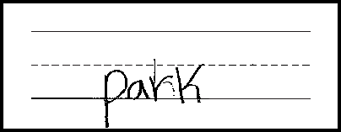
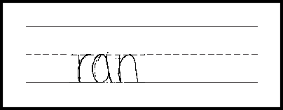
Kindergarten: Word Copying
Score Point 0
Letter forming: Student cannot produce letters accurately.
Accuracy: Student cannot produce sight words or commonly spelled words with short vowel sounds.
1
2
3
4
5
6

Slide 26
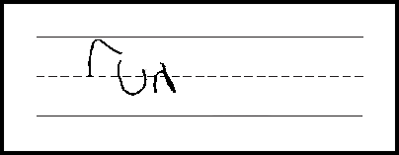
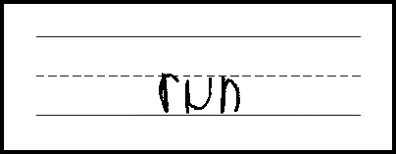
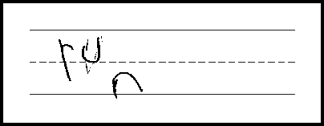
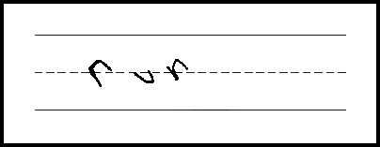
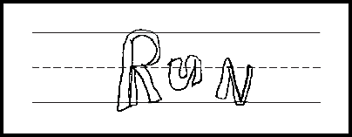
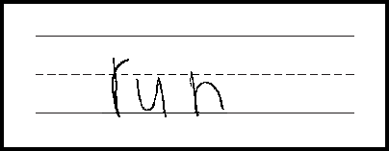
Kindergarten: Word Copying
Score Point 1
Letter forming: Student can produce letters accurately.
Accuracy: Student can produce sight words and commonly spelled words with short vowel sounds.
1
2
3
4
5
6

Slide 27
Kindergarten: Sentence Writing Rubric
Score Point 0
Letter forming: Student cannot produce letters accurately.
Words: Student cannot differentiate letters and words.
Accuracy: Student can produce some or no sight words or commonly spelled words with short vowel sounds.
Score Point 1
Letter forming: Student can produce some letters accurately.
Words: Student can sometimes separate words with spaces and may not produce words in the correct sequence.
Accuracy: Students can often produce sight words and some commonly spelled words with short vowel sounds.
Score Point 2
Letter forming: Student can produce letters accurately.
Words: Student can often separate words with spaces and produce words in the correct sequence.
Accuracy: Student can often produce sight words and commonly spelled words with short vowel sounds.

Slide 28
Kindergarten: Sentence Writing
SAY
Now you will write a sentence.
We will play.
Write the sentence We will play. on the blank lines.
Pause. Give the students time to write the sentence We will play.

Slide 29
Kindergarten: Sentence Writing
Score Point 0
Letter forming: Student cannot produce letters accurately.
Words: Student cannot differentiate letters and words.
Accuracy: Student can produce some or no sight words or commonly spelled words with short vowel sounds.
1
2

Slide 30
Kindergarten: Sentence Writing
Score Point 0
Letter forming: Student cannot produce letters accurately.
Words: Student cannot differentiate letters and words.
Accuracy: Student can produce some or no sight words or commonly spelled words with short vowel sounds.
3
4

Slide 31
Kindergarten: Sentence Writing
Score Point 0
Letter forming: Student cannot produce letters accurately.
Words: Student cannot differentiate letters and words.
Accuracy: Student can produce some or no sight words or commonly spelled words with short vowel sounds.
5
6

Slide 32
Kindergarten: Sentence Writing
Score Point 1
Letter forming: Student can produce some letters accurately.
Words: Student can sometimes separate words with spaces and may not produce words in the correct sequence.
Accuracy: Students can often produce sight words and some commonly spelled words with short vowel sounds.
1
2

Slide 33
Kindergarten: Sentence Writing
Score Point 1
Letter forming: Student can produce some letters accurately.
Words: Student can sometimes separate words with spaces and may not produce words in the correct sequence.
Accuracy: Students can often produce sight words and some commonly spelled words with short vowel sounds.
3
4

Slide 34
Kindergarten: Sentence Writing
Score Point 1
Letter forming: Student can produce some letters accurately.
Words: Student can sometimes separate words with spaces and may not produce words in the correct sequence.
Accuracy: Students can often produce sight words and some commonly spelled words with short vowel sounds.
5
6

Slide 35
Kindergarten: Sentence Writing
Score Point 2
Letter forming: Student can produce letters accurately.
Words: Student can often separate words with spaces and produce words in the correct sequence.
Accuracy: Student can often produce sight words and commonly spelled words with short vowel sounds.
1
2

Slide 36
Kindergarten: Sentence Writing
Score Point 2
Letter forming: Student can produce letters accurately.
Words: Student can often separate words with spaces and produce words in the correct sequence.
Accuracy: Student can often produce sight words and commonly spelled words with short vowel sounds.
3
4

Slide 37
Kindergarten: Sentence Writing
Score Point 2
Letter forming: Student can produce letters accurately.
Words: Student can often separate words with spaces and produce words in the correct sequence.
Accuracy: Student can often produce sight words and commonly spelled words with short vowel sounds.
5
6

Slide 38
Kindergarten: SCR Rubric
Entering 0 | Complexity/Quality of Language: Response contains zero or few words in non-English to respond to the prompt. Coherence of Response: Response includes zero or few words in non-English or no drawings to provide descriptions and events to develop a story or write about a topic. Mechanics: Response may contain errors that totally obscure meaning.
Emerging 1 | Complexity/Quality of Language: Response contains mostly words, short phrases, and occasionally simple sentences. Coherence of Response: Response includes only drawings, OR word(s) and phrases and drawing(s), OR only words and phrases to minimally provide descriptions and events to develop a story or write about a topic. Mechanics: Response may have frequent errors that obscure meaning.
Transitioning 2 | Complexity/Quality of Language: Response contains mostly short phrases and simple sentences. Coherence of Response: Response includes only very detailed drawing(s), OR phrases and sentences and drawings, OR only phrases and sentences to somewhat provide descriptions and events to develop a story or write about a topic. Mechanics: Response may have occasional errors that obscure meaning.
Expanding 3 | Complexity/Quality of Language: Response contains mostly simple sentences. Coherence of Response: Response includes drawing(s) and a string of phrases and sentences, OR only a string of phrases and sentences to partially provide descriptions and events to develop a story or write about a topic. Mechanics: Response rarely contains errors that obscure meaning.
Commanding 4 | Complexity/Quality of Language: Response contains simple and occasionally grade-appropriate compound sentences. Coherence of Response: Response includes drawing(s) and a string of phrases and sentences, OR only a string of phrases and sentences to provide descriptions and events to develop a story or write about a topic. Mechanics: Response has few or no errors that obscure meaning.

Slide 39
Kindergarten: SCR Scoring Notes

Slide 40
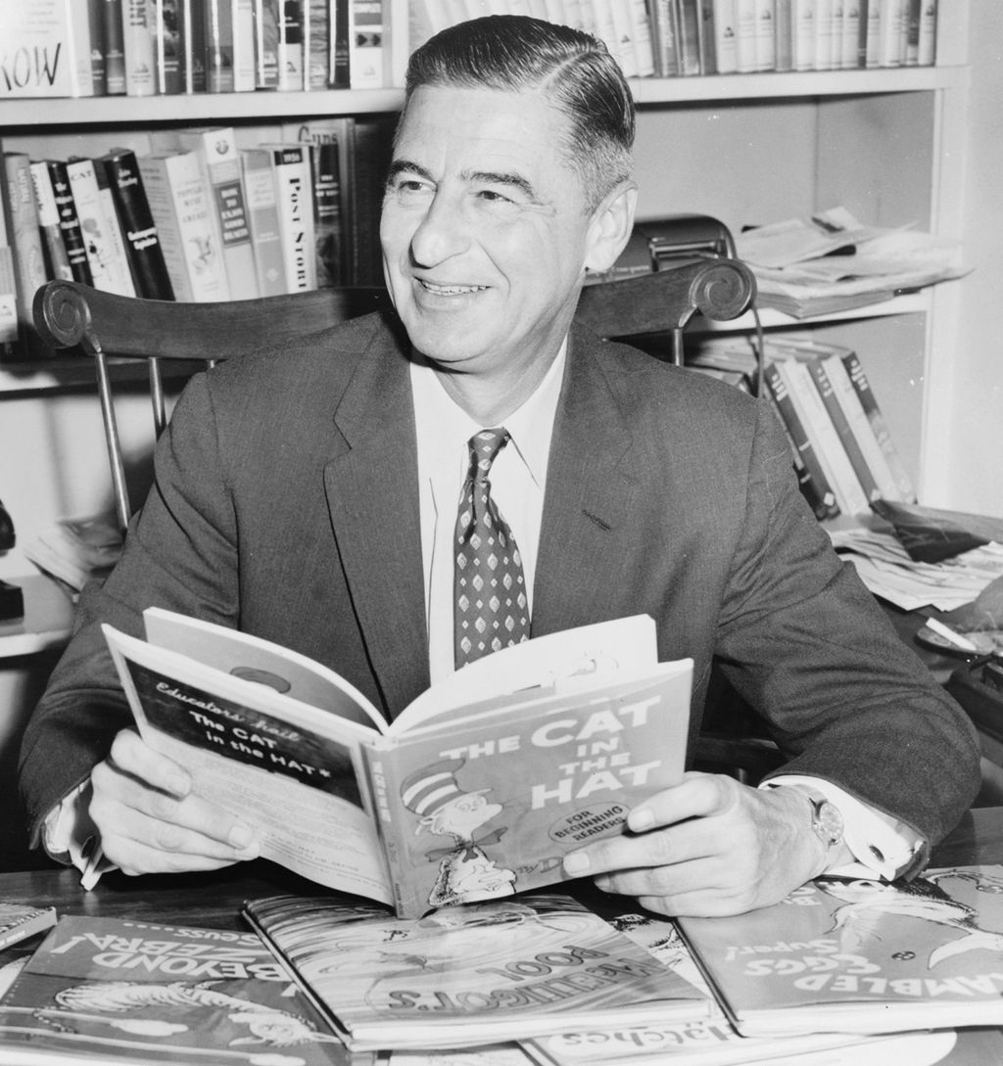
Kindergarten: Short Constructed Response
Now I will read the story called "Dr. Seuss" again. Then you will write some sentences.
Theodor Geisel wrote books. He used the name Dr. Seuss when he wrote his books. His stories usually had an important message.
Dr. Seuss also liked to draw all of the pictures in his books. He drew many different types of animals. He also drew funny creatures. His books are colorful.
Dr. Seuss wrote almost 50 children’s books. Many children know about his “Cat in the Hat” books. People all over the world read his books.
Dr. Seuss was a famous author who wrote children's books. What is your favorite book to read? Write and draw to tell about this book.
Pause. Give the students time to finish writing and drawing.

Slide 41
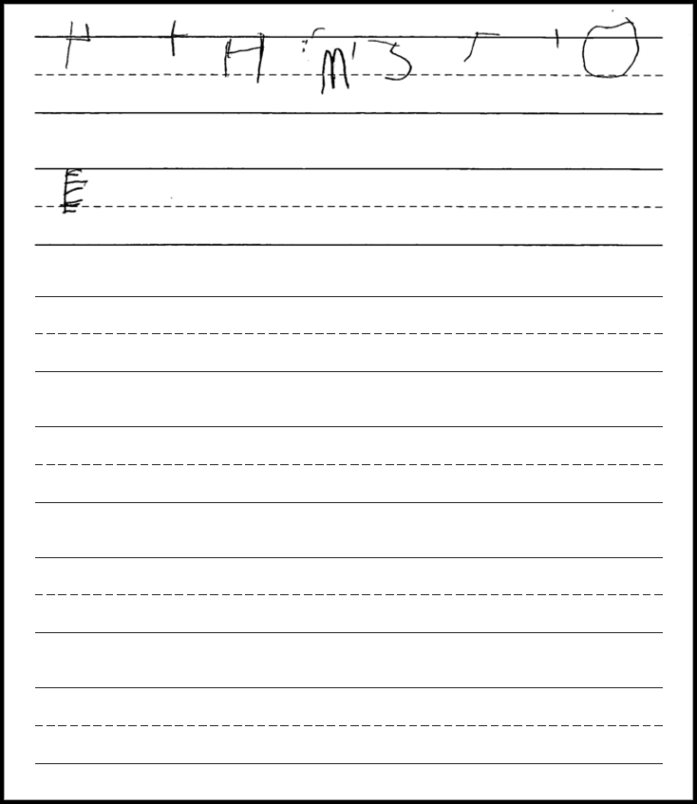
Kindergarten: Short Constructed Response
Score Point 0
Response contains 0 words or drawings to respond to the prompt
*Please see your binder for a full rubric*

Slide 42
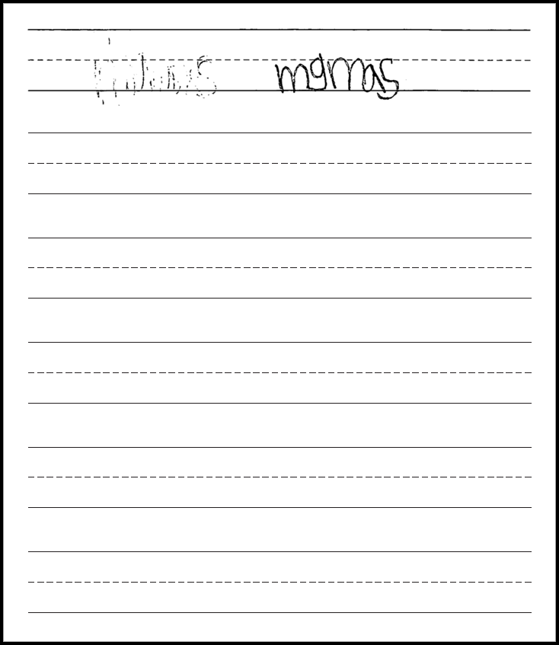
Kindergarten: Short Constructed Response
Score Point 0
Response contains 0 words or drawings to respond to the prompt
*Please see your binder for a full rubric*

Slide 43
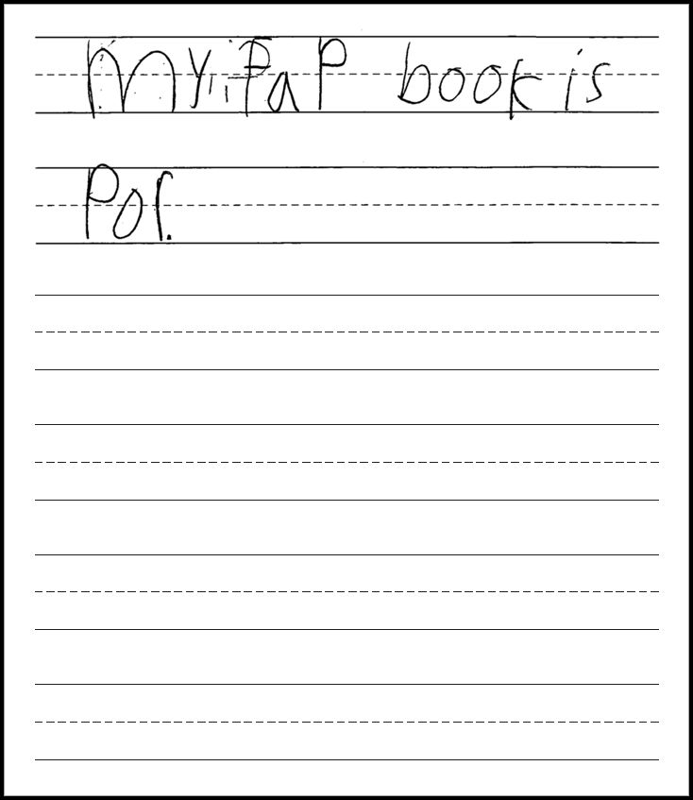
Kindergarten: Short Constructed Response
Score Point 1
Response contains simple sentence
Response contains frequent errors that obscure meaning.
*Please see your binder for a full rubric*

Slide 44
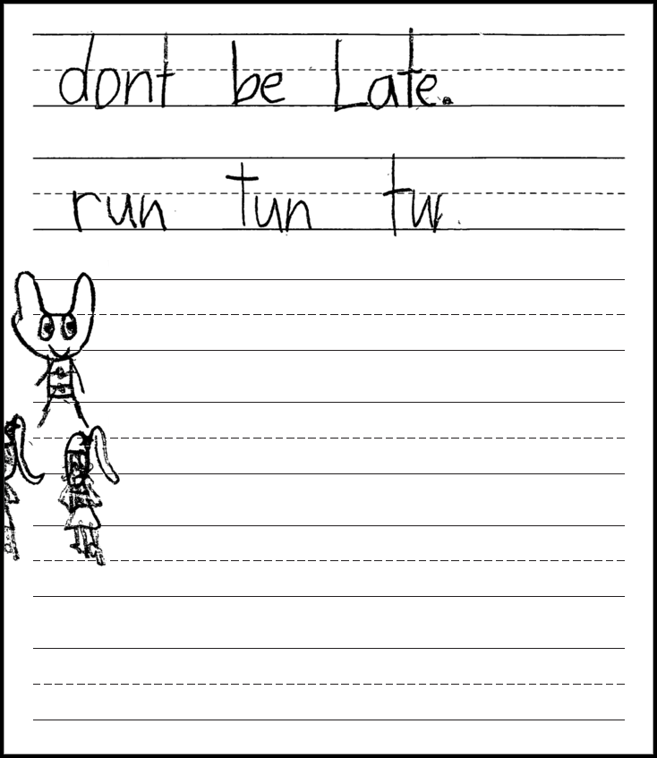
Kindergarten: Short Constructed Response
Score Point 1
Response contains simple sentence to minimally provide descriptions
Response contains relevant or related drawing
Response contains frequent errors that obscure meaning
May or may not use appropriate capitalization and punctuation
*Please see your binder for a full rubric*

Slide 45
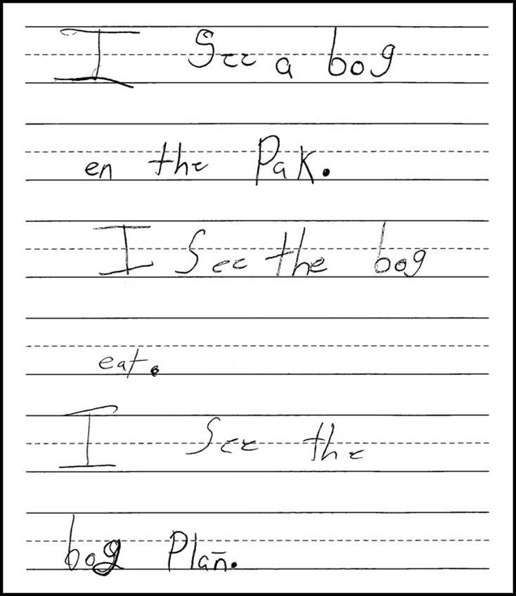
Kindergarten: Short Constructed Response
Score Point 1
Response is completely irrelevant to the prompt
*Please see your binder for a full rubric*

Slide 46
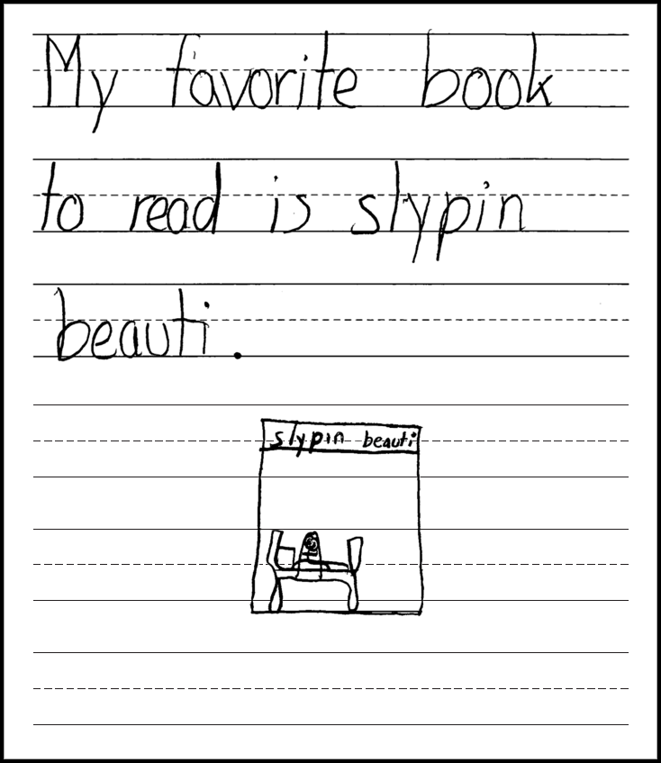
Kindergarten: Short Constructed Response
Score Point 2
Response contains simple sentence as well as a drawing to somewhat provide description to write about the topic
Response contains occasional errors that obscure meaning
*Please see your binder for a full rubric*

Slide 47
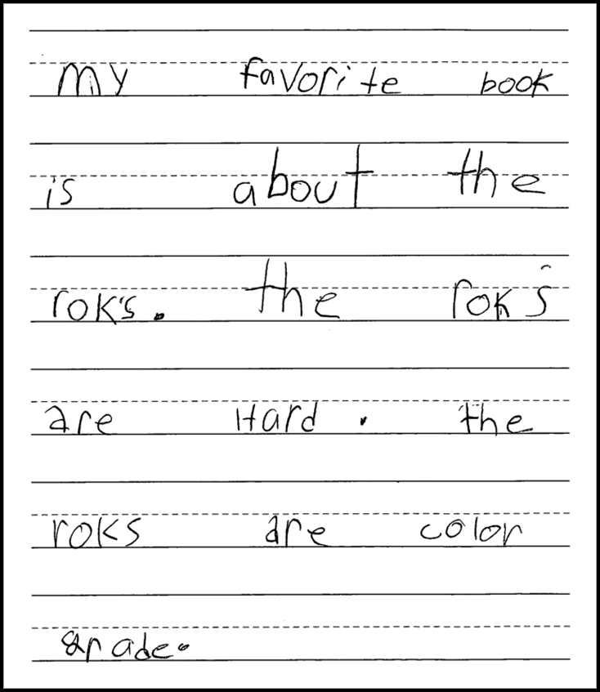
Kindergarten: Short Constructed Response
Score Point 3
Response contains mostly simple sentences to partially provide descriptions to write about a topic
Response rarely contains errors that obscure meaning
*Please see your binder for a full rubric*

Slide 48
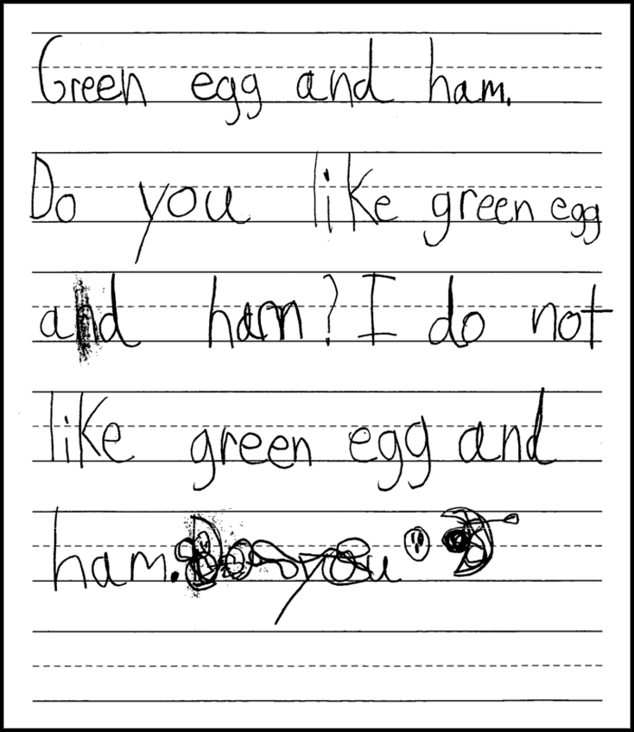
Kindergarten: Short Constructed Response
Score Point 3
Response is at least partially relevant or related to prompt
Response contains mostly simple sentences to partially provide descriptions to write about a topic
Response rarely contains errors that obscure meaning
*Please see your binder for a full rubric*

Slide 49
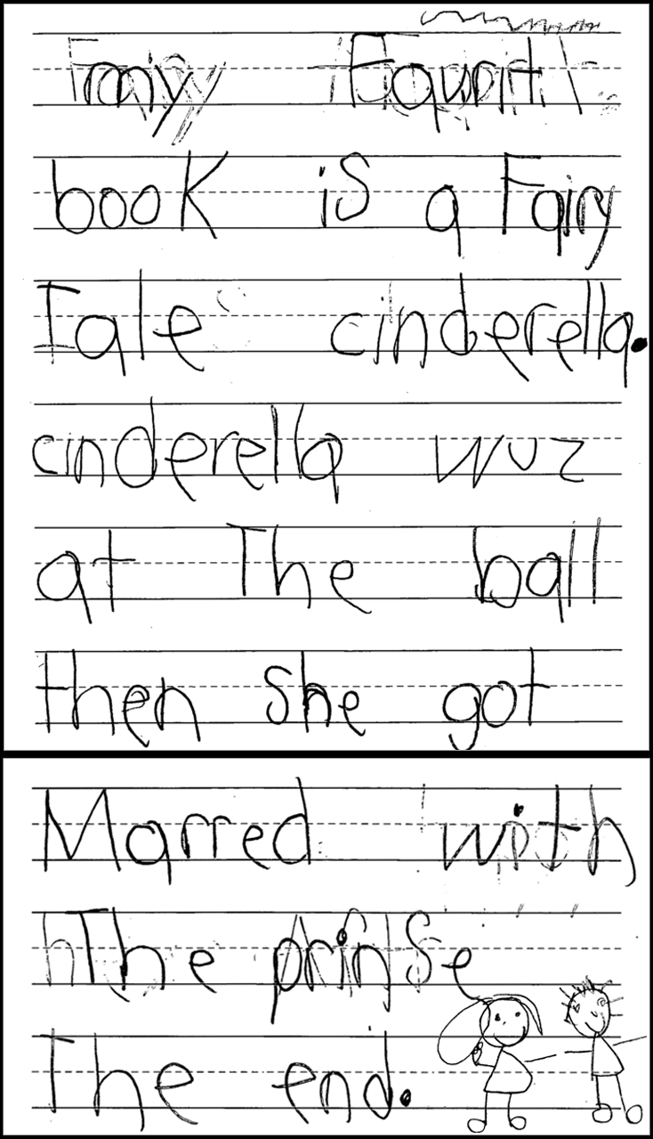
Kindergarten: Short Constructed Response
Score Point 4
Response contains simple sentences as well as drawings to provide descriptions to develop a story
Response has few or no errors that obscure meaning
*Please see your binder for a full rubric*

Slide 50
Grade 1–2: SCR Rubric
Entering 0 | Complexity of Language: Response contains zero or few grade-appropriate words or short phrases to introduce or complete thoughts and ideas in a written text. Quality of Language: Response contains most common literal use of Tier 1 grade-appropriate vocabulary to describe detailed thoughts, feelings, and ideas in a written text. Coherence of Response: Response includes zero or few transitional words that introduce and complete thoughts and ideas in a written text. Degree of Response: Response contains no or at least one detailed thought, feeling, or idea in a written text. Mechanics: Response contains errors that totally obscure meaning.
Emerging 1 | Complexity of Language: Response contains some grade-appropriate words, short phrases, and a few simple sentences to introduce and complete thoughts and ideas in a written text. Quality of Language: Response contains literal use of Tier 1 and a few Tier 2 or Tier 3 grade-appropriate vocabulary to describe detailed thoughts, feelings, and ideas in a written text. Coherence of Response: Response includes a few transitional words and at least one sentence that introduces and completes thoughts and ideas in a written text. Degree of Response: Response contains a few detailed thoughts, feelings, and ideas in a written text. Mechanics: Response may have frequent errors that obscure meaning.
Transitioning 2 | Complexity of Language: Response contains mostly grade-appropriate simple sentences and at least one compound sentence to introduce and complete thoughts and ideas in a written text. Quality of Language: Response contains literal use and a few figurative uses of Tier 1 and Tier 2 or Tier 3 grade-appropriate vocabulary to describe detailed thoughts, feelings, and ideas in a written text. Coherence of Response: Response includes some transitional words and a few sentences to introduce and complete thoughts and ideas in a written text. Degree of Response: Response contains some detailed thoughts, feelings, and ideas in a written text. Mechanics: Response may have occasional errors that obscure meaning.
Expanding 3 | Complexity of Language: Response contains mostly grade-appropriate simple sentences and some compound sentences to introduce and complete thoughts and ideas in a written text. Quality of Language: Response contains literal use and some figurative uses of Tier 1 and Tier 2 or Tier 3 grade-appropriate vocabulary to describe detailed thoughts, feelings, and ideas in a written text. Coherence of Response: Response includes many transitional words and some sentence structures to introduce and complete thoughts and ideas in a written text. Degree of Response: Response contains many detailed thoughts, feelings and ideas in a written text. Mechanics: Response rarely contains errors that obscure meaning.
Commanding 4 | Complexity of Language: Response contains mostly grade-appropriate simple and compound sentences to introduce and complete thoughts and ideas in a written text. Quality of Language: Response contains literal and figurative uses of Tier 1 and Tier 2 or Tier 3 grade-appropriate vocabulary to describe detailed thoughts, feelings, and ideas in a written text. Coherence of Response: Response includes many and varied transitional words and sentence structures to introduce and complete thoughts and ideas in a written text. Degree of Response: Response contains varied and sufficient detailed thoughts, feelings, and ideas in a written text. Mechanics: Response has few or no errors that obscure meaning.

Slide 51
Grade 1–2: SCR Scoring Notes

Slide 52
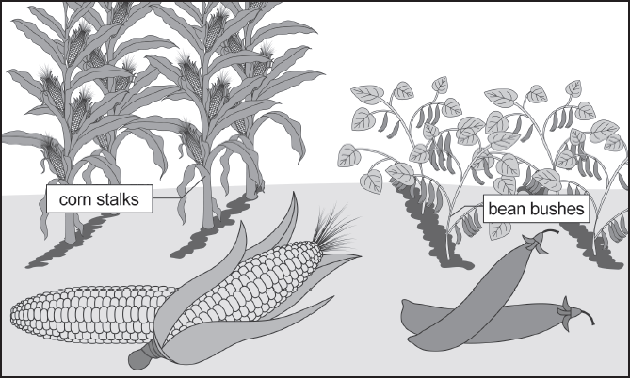
Grades 1–2: Short Constructed Response
Directions Read the passage again. Then you will be asked to write a paragraph based on the passage.
A Special Day in the Garden
My grandmother grows corn and beans. Yesterday, she and I picked five ears of corn. Then, we picked some beans. Today, we will cook the corn and the beans because we want them for dinner.
Now read the directions below.
In the passage "A Special Day in the Garden," how does the narrator feel about the grandmother's garden? Write one paragraph about how the narrator feels about the garden. You can use the words in the Word Box to help you write your paragraph.
Word Box

Slide 53
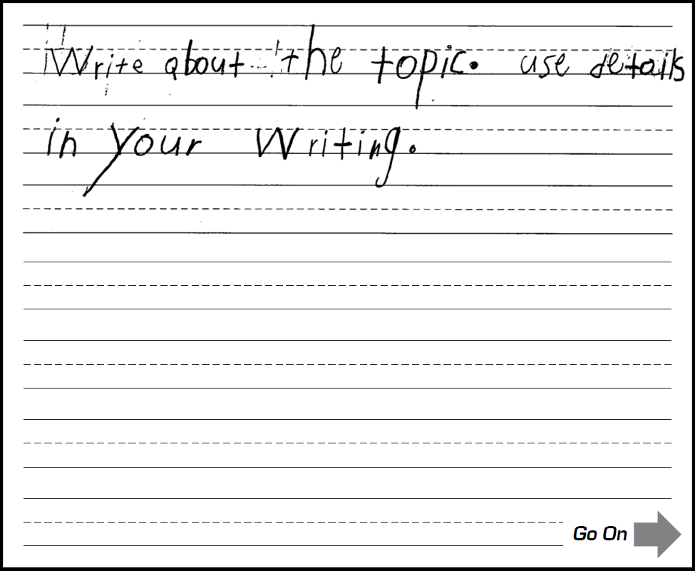
Grades 1–2: Short Constructed Response
Score Point 0
Completely copied text
*Please see your binder for a full rubric*

Slide 54
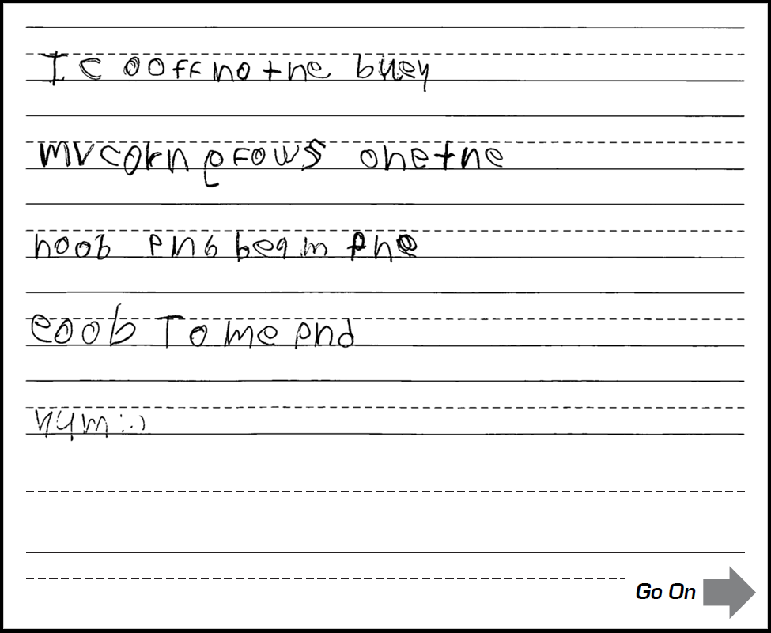
Grades 1–2: Short Constructed Response
Score Point 0
Response contains few grade- appropriate words
Words are unclear and meaning is mostly obscured
*Please see your binder for a full rubric*

Slide 55
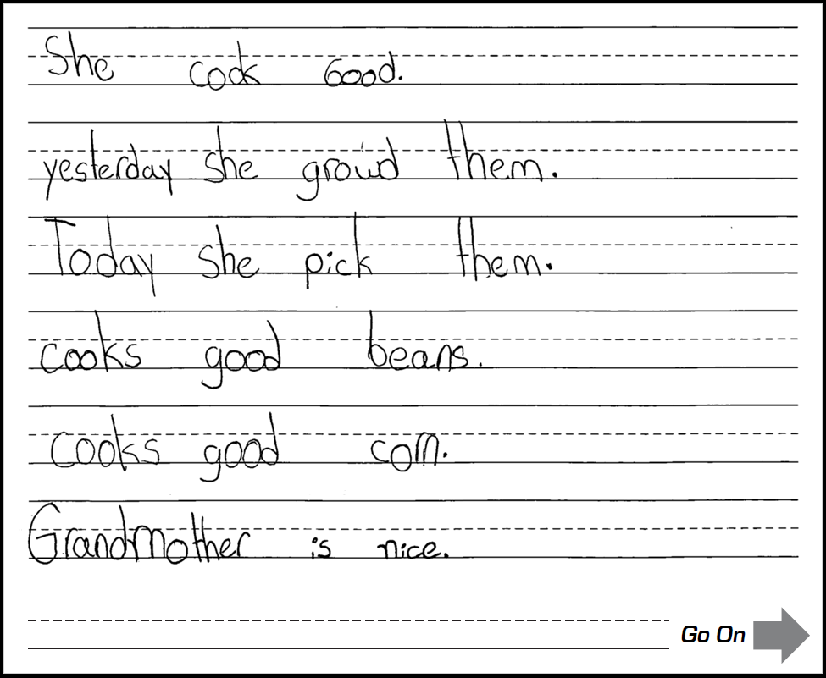
Grades 1–2: Short Constructed Response
Score Point 1
Response contains some grade- appropriate words and some simple sentences to introduce and complete thoughts in a written text
Response contains a few detailed thoughts and ideas in a written text
*Please see your binder for a full rubric*

Slide 56
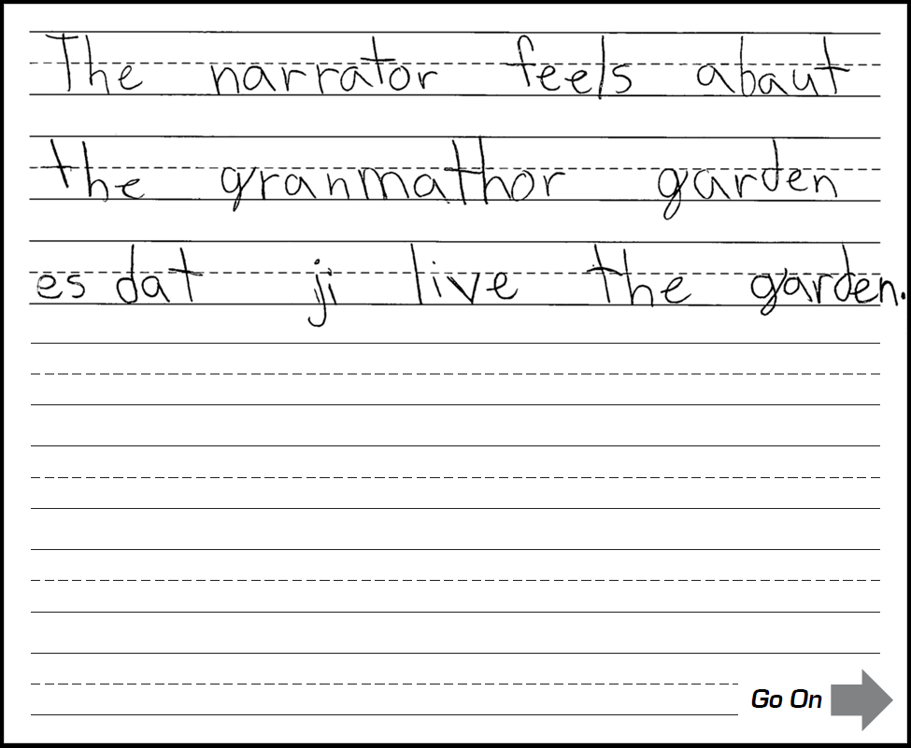
Grades 1–2: Short Constructed Response
Score Point 1
Response includes at least one sentence that completes a thought in a written text
Response may contain adapted text
Response may have frequent errors that obscure meaning
*Please see your binder for a full rubric*

Slide 57
Grades 1–2: Short Constructed Response
Score Point 2
Response contains mostly grade- appropriate simple sentences and at least one compound sentence to introduce and complete thoughts and ideas in a written text
Response contains some detailed thoughts and ideas in a written text
Response may have occasional errors that obscure meaning
*Please see your binder for a full rubric*

Slide 58
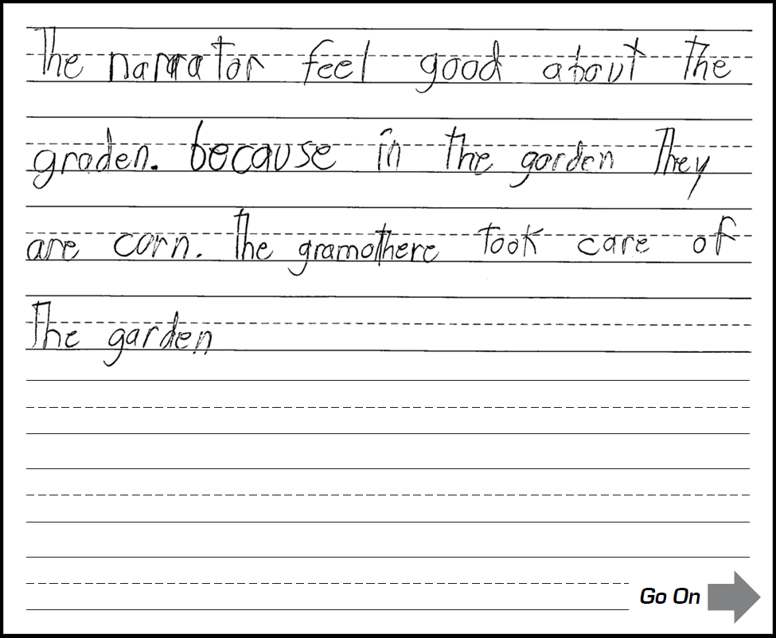
Grades 1–2: Short Constructed Response
Score Point 2
Response includes one sentence beyond a simple sentence
Response includes a few sentences to introduce and complete thoughts and ideas in a written text
Response may have occasional errors that obscure meaning
*Please see your binder for a full rubric*

Slide 59
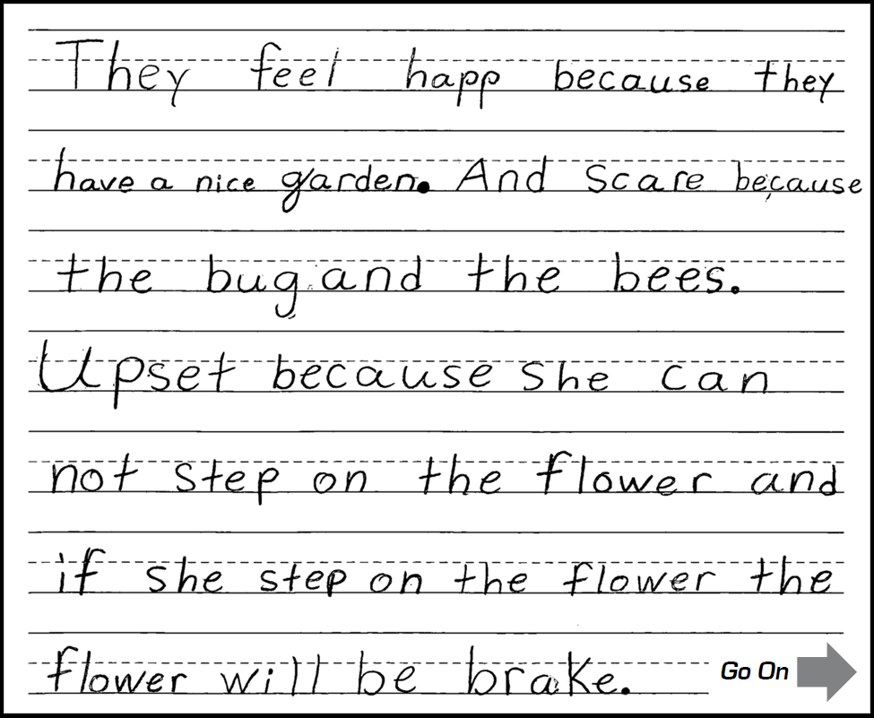
Grades 1–2: Short Constructed Response
Score Point 3
Response contains relevant details to support thoughts, feelings, or ideas
Response includes complex sentences
Response rarely contains errors that obscure meaning
*Please see your binder for a full rubric*

Slide 60
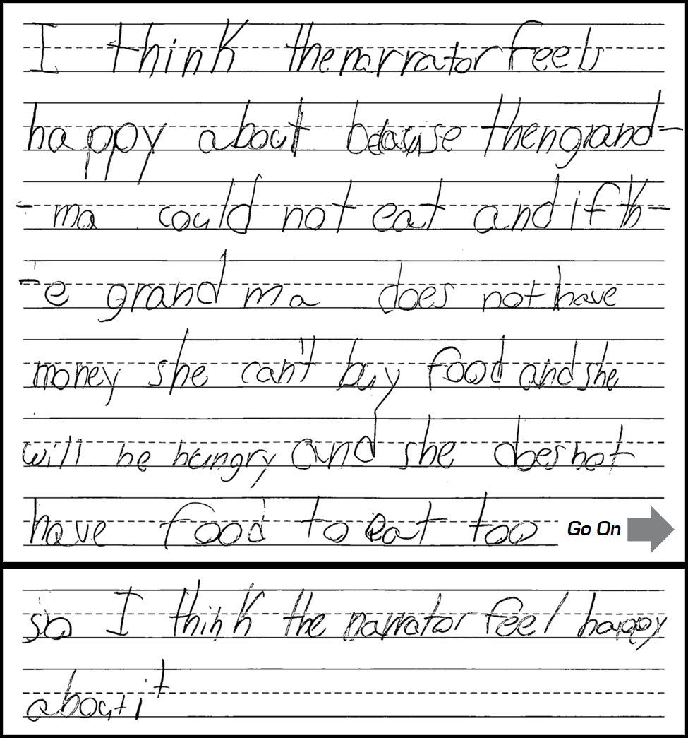
Grades 1–2: Short Constructed Response
Score Point 3
Use of introductory and concluding words makes organization evident
Response includes complex sentences
Response rarely contains errors that obscure meaning
*Please see your binder for a full rubric*

Slide 61
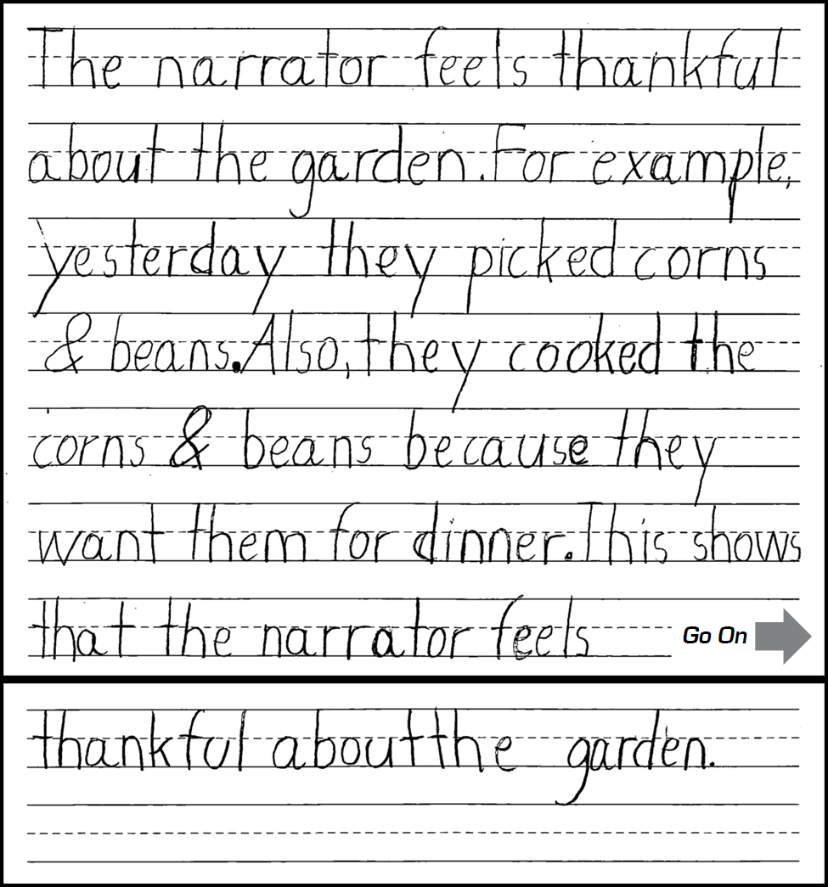
Grades 1–2: Short Constructed Response
Score Point 4
Response includes varied and sufficient detailed thoughts, feelings, and ideas in a written text
Organization is clear with an introduction and a conclusion
Response has few or no errors that obscure meaning
*Please see your binder for a full rubric*

Slide 62
Grades 5–6: SCR Rubric
Entering 0 | Complexity of Language: Response contains zero or few grade-appropriate words and short phrases. Quality of Language: Response contains most common literal use of Tier 1 grade-appropriate vocabulary to precisely describe detailed ideas and facts. Coherence of Response: Response includes zero or few transitional words that orient the reader, logically develop ideas using transitions, or provide closure in a written text. Degree of Response: Response contains no or at least one precisely described detailed idea or fact in written text. Mechanics: Response may contain errors that totally obscure meaning.
Emerging 1 | Complexity of Language: Response contains some grade-appropriate words, short phrases, and a few simple sentences. Quality of Language: Response contains literal use of Tier 1 and a few Tier 2 and Tier 3 grade-appropriate vocabulary to precisely describe detailed ideas and facts. Coherence of Response: Response includes a few transitional words and at least one sentence structure that orient the reader, logically develop ideas using transitions, or provide closure in a written text. Degree of Response: Response contains a few precisely described detailed ideas and facts in a written text. Mechanics: Response may have frequent errors that obscure meaning.
Transitioning 2 | Complexity of Language: Response contains mostly grade-appropriate simple sentences and at least one complex sentence. Quality of Language: Response contains literal use and a few figurative uses of Tier 1 and Tier 2 or Tier 3 grade-appropriate vocabulary to precisely describe detailed ideas and facts in a written text. Coherence of Response: Response includes some transitional words and a few sentence structures that orient the reader, logically develop ideas using transitions, or provide closure in a written text. Degree of Response: Response contains some precisely described detailed ideas and facts in a written text. Mechanics: Response may have occasional errors that obscure meaning.
Expanding 3 | Complexity of Language: Response contains mostly grade-appropriate simple sentences and some complex sentences. Quality of Language: Response contains literal use and some figurative uses of Tier 1 and Tier 2 or Tier 3 grade-appropriate vocabulary to precisely describe detailed ideas and facts in a written text. Coherence of Response: Response includes many transitional words and some sentence structures that orient the reader, logically develop ideas using transitions, or provide closure in a written text. Degree of Response: Response contains many precisely described detailed ideas and facts in a written text. Mechanics: Response rarely contains errors that obscure meaning.
Commanding 4 | Complexity of Language: Response contains mostly grade-appropriate simple and complex sentences. Quality of Language: Response contains literal and figurative uses of Tier 1 and Tier 2 or Tier 3 grade-appropriate vocabulary to precisely describe detailed ideas and facts in a written text. Coherence of Response: Response includes many and varied transitional words and sentence structures that orient the reader, logically develop ideas using transitions, or provide closure in a written text. Degree of Response: Response contains varied and sufficient precisely described detailed ideas and facts in a written text. Mechanics: Response has few or no errors that obscure meaning.

Slide 63
Grades 5–6: SCR Scoring Notes

Slide 64
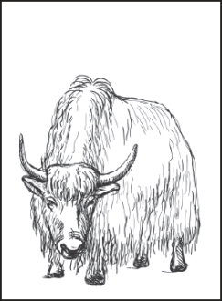
Grades 5–6: Short Constructed Response
Directions
Read the passage again. Then you will be asked to write a paragraph based on the passage.
The Sherpa People of Nepal
Map of Nepal
Yak
1 Nepal is a country that lies between China and India. Most people in Nepal live in the central and southern regions. Nepal’s northern side is formed by the Himalaya mountain range. One ethnic group that lives in Nepal are the Sherpa people. Many Sherpas live around the southern base of Mount Everest, which is the tallest mountain in the world.
Nepal’s climate is arctic in the mountains’ high altitudes. Severely cold winds blow. Glaciers and heavy snow are found in the mountains. The Sherpas are used to living at high altitudes in extreme weather. Their villages are located more than 10,000 feet above sea level.
The mountains are so steep the Sherpas can’t use cars. Because of this, they hike everywhere and carry items that they need on their backs. Sometimes they use animals to carry very heavy loads. One animal they use is called a yak. A yak is like a cow, but it has thick fur. The fur keeps the yak warm. Its large feet with hooves help it successfully navigate snowy paths and icy slopes. The Sherpas use yak wool to make warm clothing. They use yak milk to make butter. A favorite Sherpa meal is a crisp potato pancake served with yak butter.
The Sherpa people are famous for their mountain-climbing ability. Every year, visitors come to Nepal to climb Mount Everest. Because the Sherpas are so good at hiking in the mountains, people often hire them as guides.
Now read the directions below.
Think about where the Sherpa people live and how they live. Why are yaks important to how the Sherpa people live? Write one paragraph explaining why yaks are important to the Sherpa people. Use information from the passage to support your reasons.

Slide 65
Grades 5–6: Short Constructed Response
Score Point 0
Response contains no idea or fact (adapted or original)
Copied phrase verbatim
*Please see your binder for a full rubric*

Slide 66
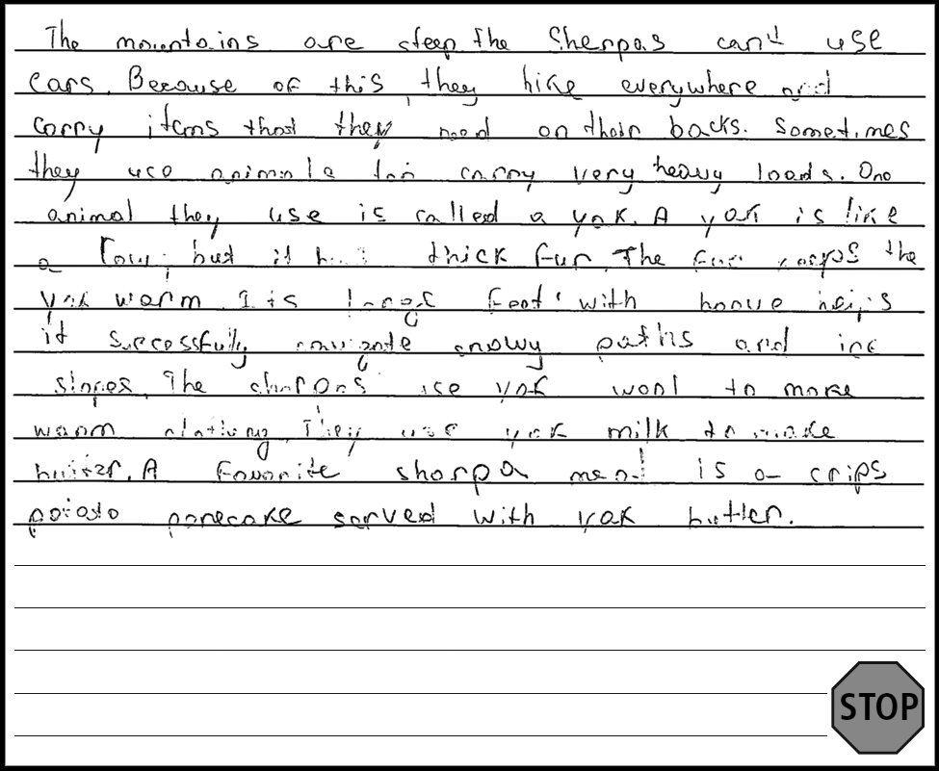
Grades 5–6: Short Constructed Response
Score Point 0
Response contains no idea or fact (adapted or original)
Copied paragraph verbatim
*Please see your binder for a full rubric*

Slide 67
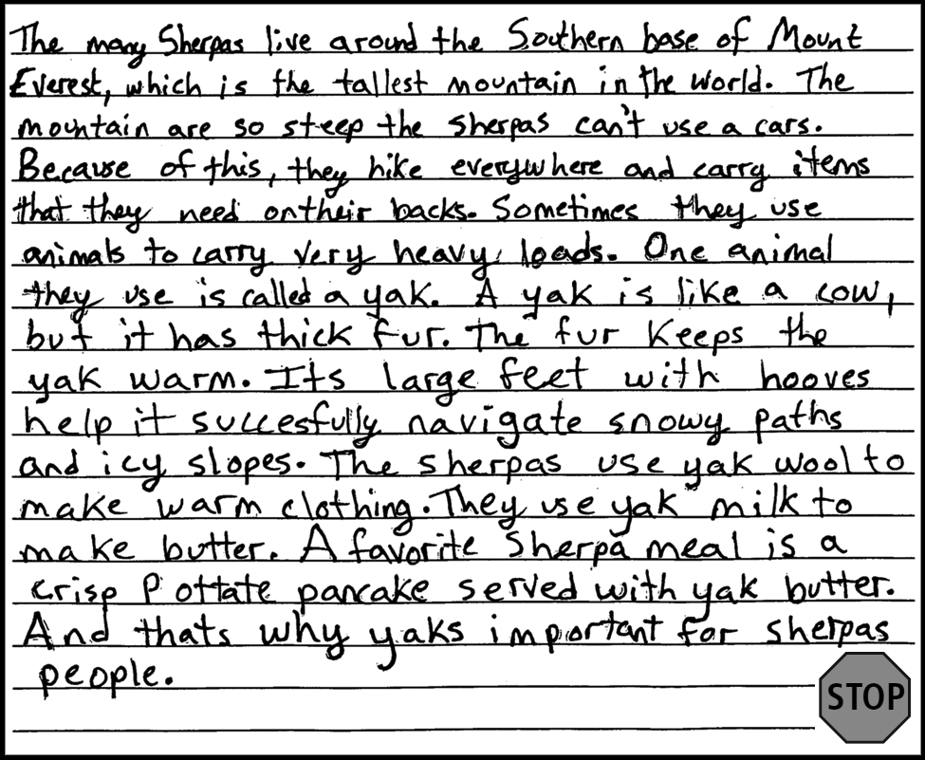
Grades 5–6: Short Constructed Response
Score Point 1
Response contains some grade- appropriate words
One adapted sentence
Response includes at least one sentence structure that provides closure in a written text
*Please see your binder for a full rubric*

Slide 68
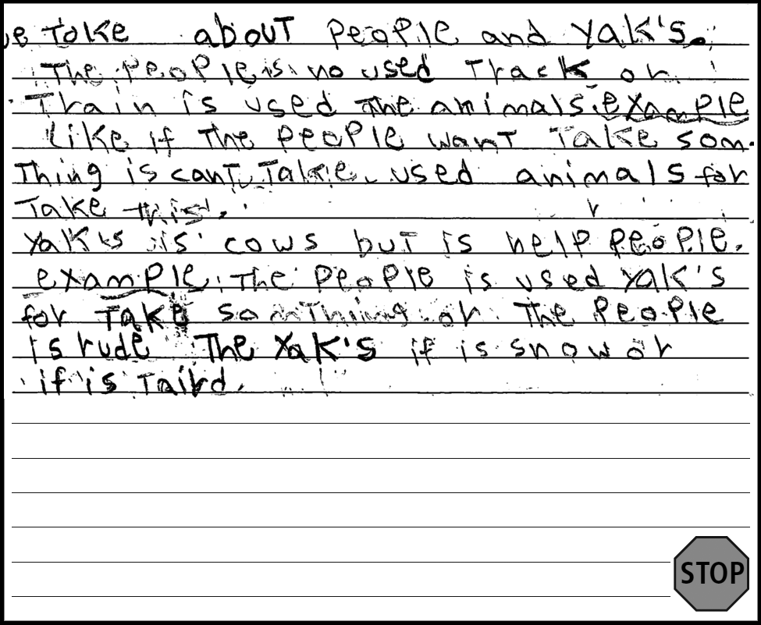
Grades 5–6: Short Constructed Response
Score Point 1
Response contains some grade- appropriate words
Response contains literal use of Tier 1 and a few Tier 2 grade-appropriate vocabulary words
More than 1 detail is included in the response
Response contains frequent errors that obscure meaning
*Please see your binder for a full rubric*

Slide 69
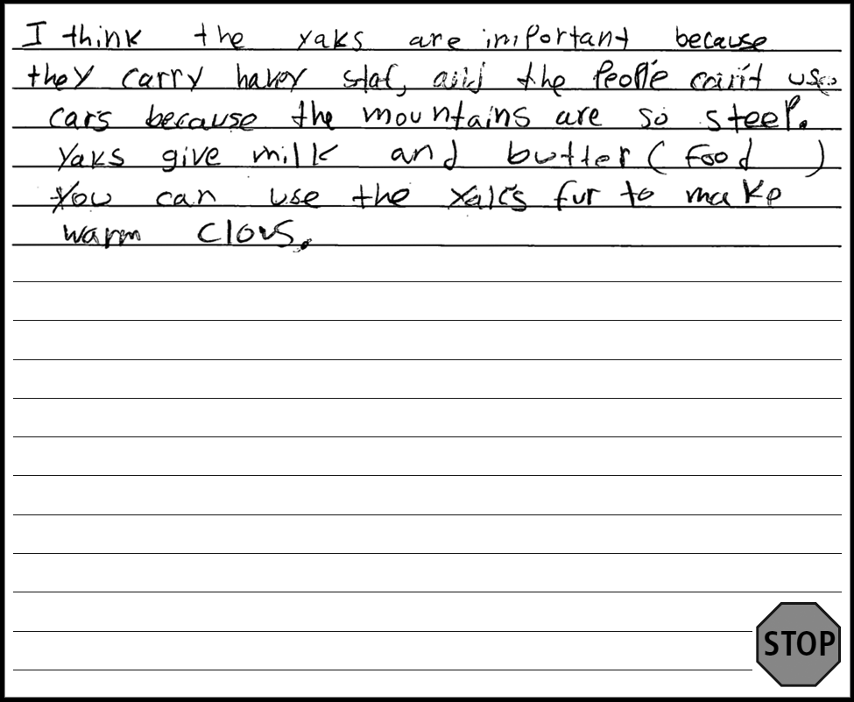
Grades 5–6: Short Constructed Response
Score Point 2
Response contains mostly grade- appropriate simple sentences and at least one complex sentence
Relevant to prompt
Response includes some precise details
Response is mostly clear; errors may occasionally obscure meaning
Includes inventive spelling
*Please see your binder for a full rubric*

Slide 70
Grades 5–6: Short Constructed Response
Score Point 3
Response contains mostly grade- appropriate simple sentences and complex sentences
Relevant to the prompt
Response includes transitional words and some sentence structures that orient the reader, logically develop ideas, and provide closure in a written text
Response contains some precisely detailed ideas and facts in a written text
Response is clear; errors exist, but rarely obscure meaning
*Please see your binder for a full rubric*

Slide 71
Grades 5–6: Short Constructed Response
Score Point 3
Response contains mostly grade- appropriate simple sentences and some complex sentences
Relevant to the prompt
Response includes transitional words and some sentence structures that orient the reader, logically develop ideas, and provide closure in a written text
Response contains many precisely detailed ideas and facts in a written text
Response is clear; errors exist, but rarely obscure meaning
*Please see your binder for a full rubric*

Slide 72
Grades 5–6: Short Constructed Response
Score Point 4
Response contains mostly grade- appropriate simple sentences and complex sentences
Relevant to the prompt
Response includes many and varied transitional words and some sentence structures that orient the reader, logically develop ideas, and provide closure in a written text
Response contains varied and sufficient precisely detailed ideas and facts in a written text
Response has few or no errors that obscure meaning
*Please see your binder for a full rubric*

Slide 73
Grades 5–6: Short Constructed Response
Score Point 4
Response contains mostly grade- appropriate simple sentences and complex sentences
Relevant to the prompt
Response includes many and varied transitional words and some sentence structures that orient the reader, logically develop ideas, and provide closure in a written text
Response contains varied and sufficient precisely detailed ideas and facts in a written text
Response has few or no errors that obscure meaning
*Please see your binder for a full rubric*

Slide 74
Break
Time
15 Minutes

Slide 75
Grades 3–4: ECR Rubric (Narrative)
Entering 0 | Complexity of Language: Response contains zero or few grade-appropriate words or short phrases. Quality of Language: Response contains most common literal use of Tier 1 grade-appropriate vocabulary in narrative. Coherence of Response: Response includes zero or few transitional words that may or may not introduce, develop, link, or complete a narrative. Degree of Response: Response contains no or at least one detailed description, event, or a closure in response to prompt. Mechanics: Response contains errors that totally obscure meaning.
Emerging 1 | Complexity of Language: Response contains some grade-appropriate words, short phrases, and a few simple sentences. Quality of Language: Response contains literal use of Tier 1 and a few Tier 2 or Tier 3 grade-appropriate vocabulary in narrative. Coherence of Response: Response includes a few transitional words and at least one sentence structure that minimally introduce, develop, link, or complete a narrative. Degree of Response: Response contains a few detailed descriptions, events in sequence, or a closure in response to prompt. Mechanics: Response may have frequent errors that obscure meaning.
Transitioning 2 | Complexity of Language: Response contains mostly grade-appropriate simple sentences and at least one complex sentence. Quality of Language: Response contains literal use and a few figurative uses of Tier 1 and Tier 2 or Tier 3 grade-appropriate vocabulary in narrative. Coherence of Response: Response includes some transitional words and a few sentence structures that partially introduce, develop, link, and complete a narrative. Degree of Response: Response contains some detailed descriptions, events in sequence, and a closure in response to prompt. Mechanics: Response may have occasional errors that obscure meaning.
Expanding 3 | Complexity of Language: Response contains mostly grade-appropriate simple sentences and some complex sentences. Quality of Language: Response contains literal use and some figurative uses of Tier 1 and Tier 2 or Tier 3 grade-appropriate vocabulary in narrative. Coherence of Response: Response includes many transitional words and some sentence structures that introduce, develop, link, and complete a narrative. Degree of Response: Response contains many detailed descriptions, events in sequence, and a closure in response to prompt. Mechanics: Response rarely contains errors that obscure meaning.
Commanding 4 | Complexity of Language: Response contains mostly grade-appropriate simple and complex sentences. Quality of Language: Response contains literal and figurative uses of Tier 1 and Tier 2 or Tier 3 grade-appropriate vocabulary in narrative. Coherence of Response: Response includes many and varied transitional words and sentence structures that introduce, develop, link, and complete a narrative. Degree of Response: Response contains varied and sufficient detailed descriptions, events in sequence, and a closure in response to the prompt. Mechanics: Response has few or no errors that obscure meaning.

Slide 76
Grades 3–4: ECR Scoring Notes

Slide 77
Grades 3–4: Extended Constructed Response
Directions
Read the passage again. Then you will be asked to write about the passage. A Trip to the City
1 The train came to a shaky stop. Isabella looked up at her grandfather.
2 “Are you ready to go into the city?” he asked.
3 Isabella nodded and her brown eyes widened. The last time she had been in the city was nine years ago. She was a newborn baby then. She had spent most of her life living in the mountains, far from the city.
4 “You’ll notice it is a lot different here,” Grandfather said, as a smile appeared on his face. He had spent most of his childhood in the city.
5 They quickly walked off the train and up some stairs. A blast of warm August air hit Isabella as they reached the city street.
6 “It’s a lot warmer here,” Isabella said.
7 But that wasn’t the only thing she noticed. The noise was new to her, too. There were people talking, cars driving, and horns honking. Instead of forests, buildings of all shapes and sizes lined the city streets. Lights and signs blinked on and off.
8 It was nothing like home.
9 Isabella loved it. “Thank you for bringing me here, Grandfather,” she said. “I can’t wait to see more.”
Now read the directions below.
At the end of the passage “A Trip to the City,” Isabella says, “I can’t wait to see more.” What other things do you think Isabella saw on her trip? Write another part of the story that tells what she and her grandfather did and saw. Write at least two paragraphs. Use details from the passage and your own ideas to create your story.

Slide 78
Grades 3–4: Extended Constructed Response
Score Point 0
Copied words
Response contains few grade-appropriate words or short phrases
Response contains most common literal use of Tier 1 grade-appropriate vocabulary
*Please see your binder for a full rubric*

Slide 79
Grades 3–4: Extended Constructed Response
Score Point 0
All text is copied verbatim from the prompt
*Please see your binder for a full rubric*

Slide 80
Grades 3–4: Extended Constructed Response
Score Point 1
Single original sentence; remaining text is copied verbatim
Response contains at least one sentence structure that minimally introduces a narrative
Response contains literal use of Tier 1 grade-appropriate vocabulary
*Please see your binder for a full rubric*

Slide 81
Grades 3–4: Extended Constructed Response
Score Point 1
Response contains some grade- appropriate words, short phrases, and simple sentences
Response contains at least one sentence structure that minimally introduces a narrative
Response contains literal use of Tier 1 grade-appropriate vocabulary
Response contains frequent errors that obscure meaning
*Please see your binder for a full rubric*

Slide 82
Grades 3–4: Extended Constructed Response
Score Point 1
Response is completely irrelevant to the prompt
*Please see your binder for a full rubric*

Slide 83
Grades 3–4: Extended Constructed Response
Score Point 2
Response contains grade-appropriate simple sentence and one complex sentence
Response contains a few sentence structures that partially introduces a narrative
Response contains some detail, and events in sequence
Response contains occasional errors that obscure meaning
*Please see your binder for a full rubric*

Slide 84
Grades 3–4: Extended Constructed Response
Score Point 3
Response contains mostly grade-appropriate simple sentences and some complex sentences
Response is related to the prompt
Response includes some sentence structures that introduce, develop, and complete a narrative
Response contains many details, events in sequence, and a closure in response to the prompt
Response is always clear; though errors may be present, they rarely obscure meaning
*Please see your binder for a full rubric*

Slide 85
Grades 3–4: Extended Constructed Response
Score Point 4
Response contains mostly grade-appropriate simple and complex sentences
Response includes many and varied transitional words and sentence structures that introduce, develop, and complete a narrative
Response contains varied and sufficient detailed descriptions, events in sequence, and a closure in response to the prompt
Response is always clear, with very few errors or no errors that obscure meaning
*Please see your binder for a full rubric*

Slide 86
Grades 3–4: Extended Constructed Response
Score Point 4
Response contains mostly grade-appropriate simple and complex sentences
Response includes many and varied transitional words and sentence structures that introduce, develop, and complete a narrative
Response contains varied and sufficient detailed descriptions, events in sequence, and a closure in response to the prompt
Response is always clear, with very few errors or no errors that obscure meaning
*Please see your binder for a full rubric*

Slide 87
Grades 7–8: ECR Rubric (Informational)
Entering 0 | Complexity of Language: Response contains zero or few grade-appropriate words or short phrases. Quality of Language: Response contains most common literal use of Tier 1 grade-appropriate vocabulary to develop a topic. Coherence of Response: Response includes zero or few transitional words that may or may not orient the reader, logically organize or connect ideas, or provide closure to a topic. Degree of Response: Response contains no or at least one precisely stated and linked claim and evidence, a variety of support, or closure in response to prompt. Mechanics: Response contains errors that totally obscure meaning.
Emerging 1 | Complexity of Language: Response contains some grade-appropriate words, short phrases, and a few simple sentences. Quality of Language: Response contains literal use of Tier 1 and a few Tier 2 or Tier 3 grade-appropriate vocabulary to develop a topic. Coherence of Response: Response includes a few transitional words and at least one sentence structure that minimally orient the reader, logically organize and connect ideas, or provide closure to a topic. Degree of Response: Response contains a few precisely stated and linked claims and evidence, a variety of support, or closure in response to prompt. Mechanics: Response may have frequent errors that obscure meaning.
Transitioning 2 | Complexity of Language: Response contains mostly grade-appropriate simple sentences and at least one complex sentence. Quality of Language: Response contains literal use and a few figurative uses of Tier 1 and Tier 2 or Tier 3 grade-appropriate vocabulary to develop a topic. Coherence of Response: Response includes some transitional words and a few sentence structures that partially orient the reader, logically organize and connect ideas, and provide closure to a topic. Degree of Response: Response contains some precisely stated and linked claims and evidence, a variety of support, and closure in response to prompt. Mechanics: Response may have occasional errors that obscure meaning.
Expanding 3 | Complexity of Language: Response contains mostly grade-appropriate simple sentences and some complex sentences. Quality of Language: Response contains literal use and some figurative uses of Tier 1 and Tier 2 or Tier 3 grade-appropriate vocabulary to develop a topic. Coherence of Response: Response includes many transitional words and some sentence structures that orient the reader, logically organize and connect ideas, and provide closure to a topic. Degree of Response: Response contains many precisely stated and linked claims and evidence, a variety of support, and closure in response to prompt. Mechanics: Response rarely contains errors that obscure meaning.
Commanding 4 | Complexity of Language: Response contains mostly grade-appropriate simple and complex sentences. Quality of Language: Response contains literal and figurative uses of Tier 1 and Tier 2 or Tier 3 grade-appropriate vocabulary to develop a topic. Coherence of Response: Response includes many and varied transitional words and sentence structures that orient the reader, logically organize and connect ideas, and provide closure to a topic. Degree of Response: Response contains varied and sufficient precisely stated and linked claims and evidence, a variety of support, and closure in response to prompt. Mechanics: Response has few or no errors that obscure meaning.

Slide 88
Grades 7–8: ECR Scoring Notes

Slide 89
Grades 7–8: Extended Constructed Response
Directions
Read the passage again. Then you will be asked to write about the passage. Going Green
1 The phrase "Going Green" is popular these days. “Going Green” means people are trying to protect Earth from pollution and other damage humans cause. On April 22 each year, people around the world celebrate "Earth Day." However, we should try to reduce pollution and recycle every day. “Going Green” really refers to a way of life that focuses on saving our environment.
2 We need to protect this planet so we have a clean, healthy place to live. One way to protect Earth is to keep garbage out of landfills, which are huge areas filled with trash. Picking up trash along roadsides and beaches can also help. Litter and landfill waste cause polluted soil, water, and air, and destroy the natural beauty of the land.
3 We can also protect the planet in other ways. First, we can take shorter showers to save water. Second, we can walk or ride a bicycle instead of using gasoline-powered vehicles to reduce air pollution. Another option is to purchase used or recycled products instead of using valuable resources to create new products.
4 How can we save our planet? The Worldwatch Institute offers helpful ideas about ways people can join “Going Green” efforts to be part of the solution, not part of the problem:
Use water bottles that can be refilled. Don't buy plastic water bottles that will likely be thrown away.
Save energy by turning down the heat in homes and unplugging appliances when they are not being used.
Borrow and share items such as books, movies, or tools. This also saves resources.
Keep electronic devices, such as cell phones and laptops, as long as possible. When it's time for a new device, don’t throw old ones away. Instead, donate or recycle them.
9 Making better choices is good for all of us who want to live on a healthy planet. “Going Green” is one small step in the right direction.
Now read the directions below.
Think about the steps to protect the environment given in the passage. Which steps do you already do? What are some other ways you can help protect the environment? Write at least two paragraphs to explain how you and your friends can help protect the environment. Use information from the passage and your own ideas to support your response.
5
6
7
8

Slide 90
Grades 7–8: Extended Constructed Response
Score Point 0
Response contains no claims, evidence, support, or closure (adapted or original)
All text copied verbatim from the prompt
*Please see your binder for a full rubric*

Slide 91
Grades 7–8: Extended Constructed Response
Score Point 0
Response contains a short phrase
Response contains errors that totally obscure meaning
*Please see your binder for a full rubric*

Slide 92
Grades 7–8: Extended Constructed Response
Score Point 1
Response contains some grade- appropriate simple sentences that minimally orient the reader
Response contains a few precisely stated claims
*Please see your binder for a full rubric*

Slide 93
Grades 7–8: Extended Constructed Response
Score Point 1
Response is completely irrelevant to the prompt
*Please see your binder for a full rubric*

Slide 94
Grades 7–8: Extended Constructed Response
Score Point 2
Response contains mostly grade- appropriate simple sentences and at least one complex sentence (adapted complex sentence)
Response includes a sentence structure that partially orients the reader
Response contains some precisely stated claims and evidence
Response is mostly clear, though there may be occasional errors that obscure meaning
*Please see your binder for a full rubric*

Slide 95
Grades 7–8: Extended Constructed Response
Score Point 2
Response contains mostly grade- appropriate simple sentences and at least one complex sentence (remaining text is copied verbatim from prompt)
Response includes sentence structures that partially orient the reader
Response contains some precisely stated claims and evidence, a variety of support in response to prompt
Response is mostly clear; may have occasional errors that obscure meaning
May include inventive spelling
*Please see your binder for a full rubric*

Slide 96
Grades 7–8: Extended Constructed Response
Score Point 4
Response contains mostly grade-appropriate simple and complex sentences
Response is related to the prompt
Response includes many and varied transitional words and sentence structures that orient the reader, logically organize and connect ideas, and provide closure to a topic
Response contains varied and sufficiently precisely stated and linked claims and evidence; a variety of support and closure
Response has few or no errors that obscure meaning
*Please see your binder for a full rubric*

Slide 97
Grades 7–8: Extended Constructed Response
Score Point 4
Response contains mostly grade-appropriate simple and complex sentences
Response is relevant to the prompt
Response includes many and varied transitional words and sentence structures that orient the reader, logically organize and connect ideas, and provide closure to a topic
Response contains varied and sufficiently precisely stated and linked claims and evidence; a variety of support and closure
Response has few or no errors that obscure meaning
May include inventive spelling
*Please see your binder for a full rubric*

Slide 98
Lunch Break
30 Minutes

